Slide 1





Scott County Public Health
Substance Use Prevention
9 October, 2025

Slide 2
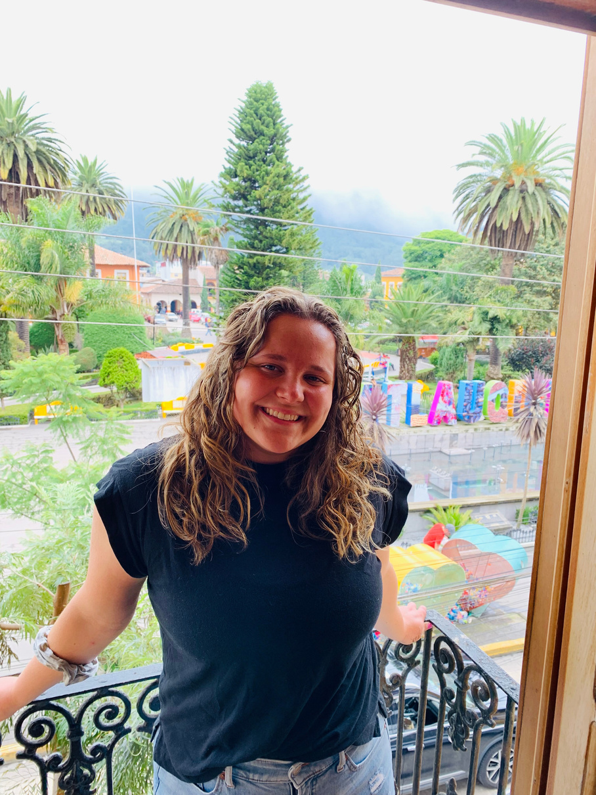

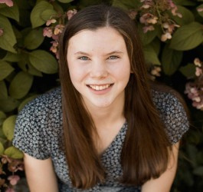

Team Members
Emily Hill
Emma Anderson
Sarah Mansky
Sahra Odowa
Substance Use Prevention Coordinator
Prevention Specialist
Recovery Corps Member
Community Health Speacialist

Slide 3
The Data

Slide 4
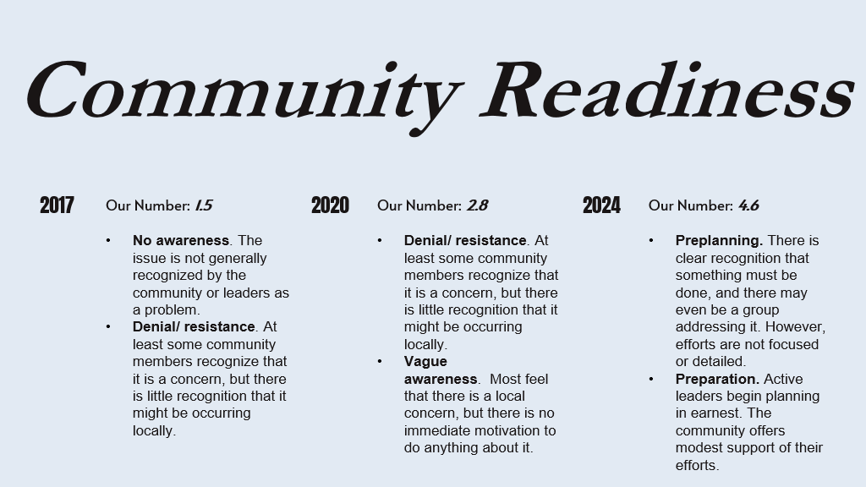

Slide 5
The Minnesota Student Survey

Slide 6
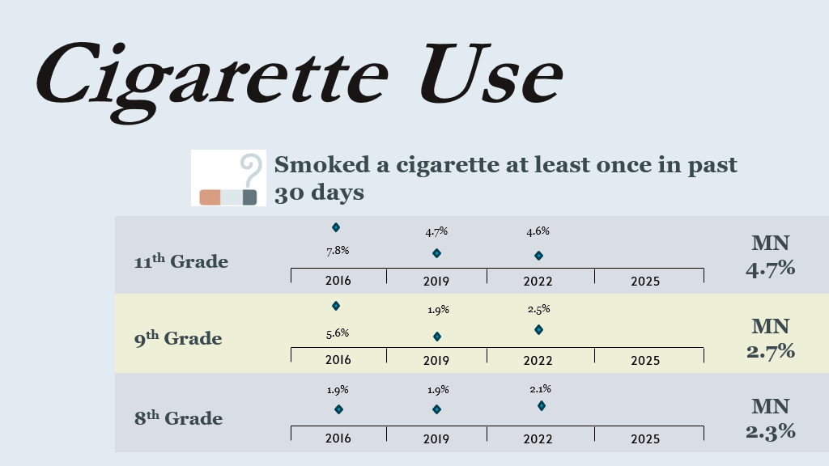

Slide 7
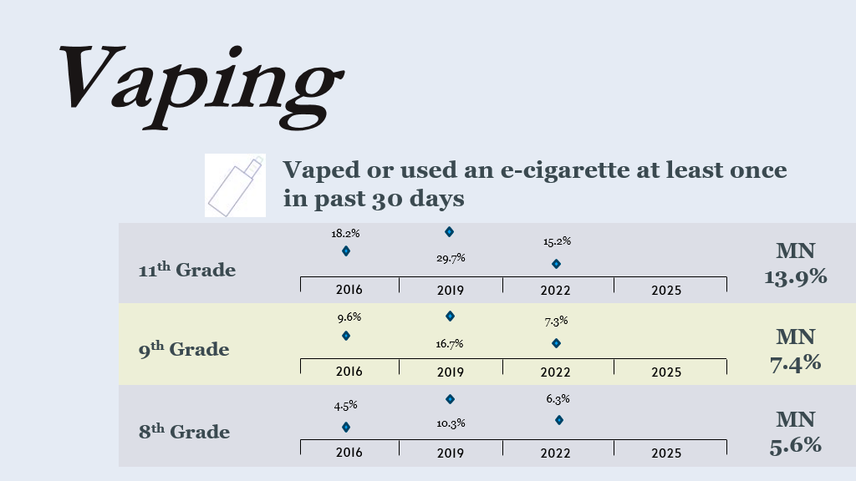

Slide 8
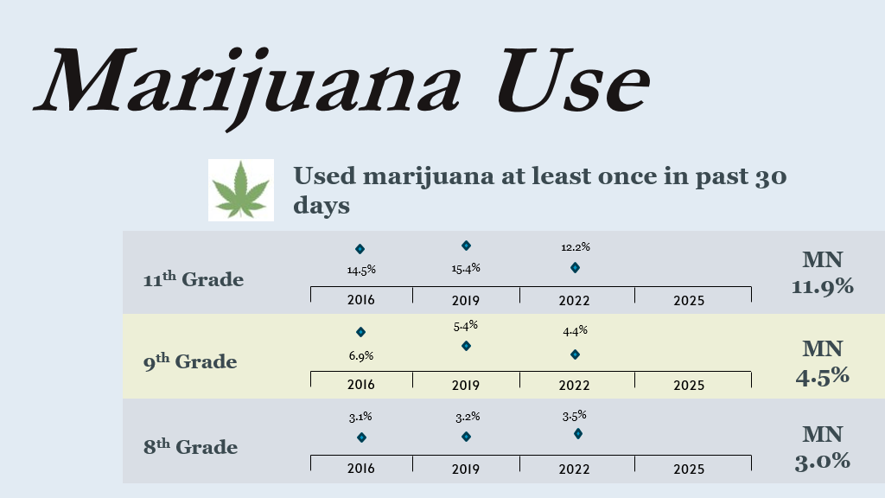

Slide 9
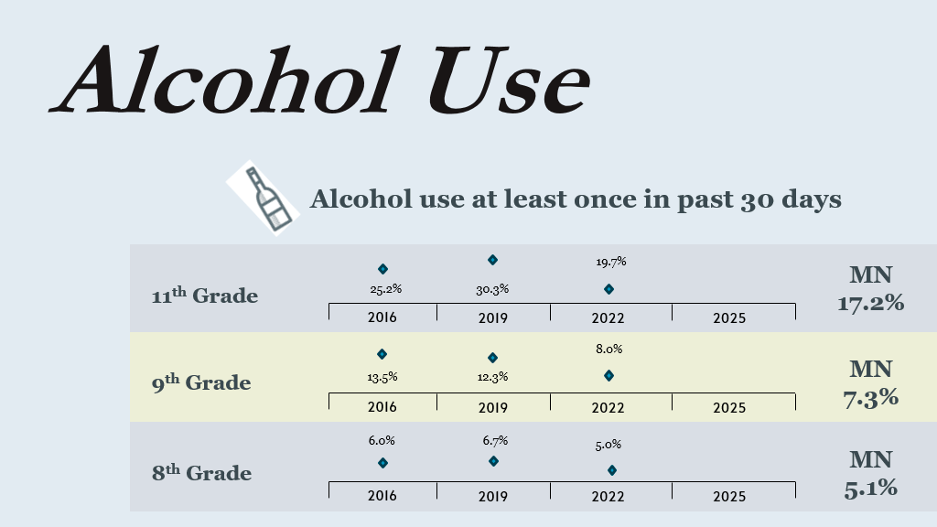

Slide 10
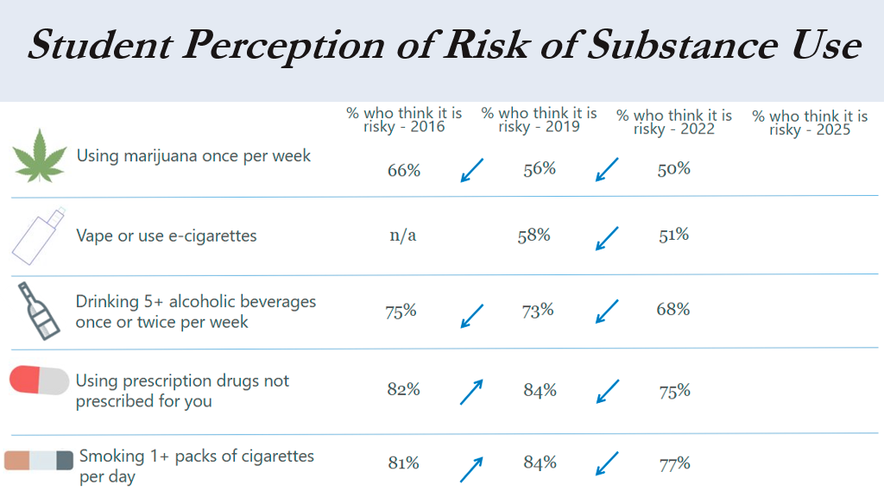

Slide 11
Parent Perception Survey

Slide 12
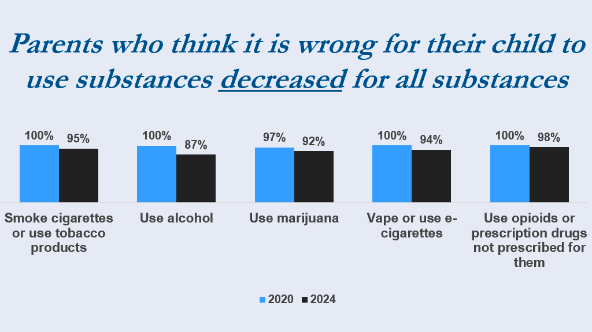

Slide 13
What are we doing about it?

Slide 14
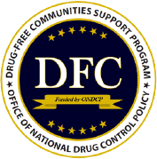
Drug Free Communities (DFC)
DFC Objectives:​
​
  Establish and strengthen collaboration among communities, public and private non-profit agencies, and Federal, state, local and tribal governments to support the efforts of community coalitions working to prevent and reduce substance use among youth.​​
​
  Reduce substance use among youth and, over time, reduce substance use among adults by addressing the factors in a community that increase risk and promoting factors that minimize risk for substance use.​

Slide 15
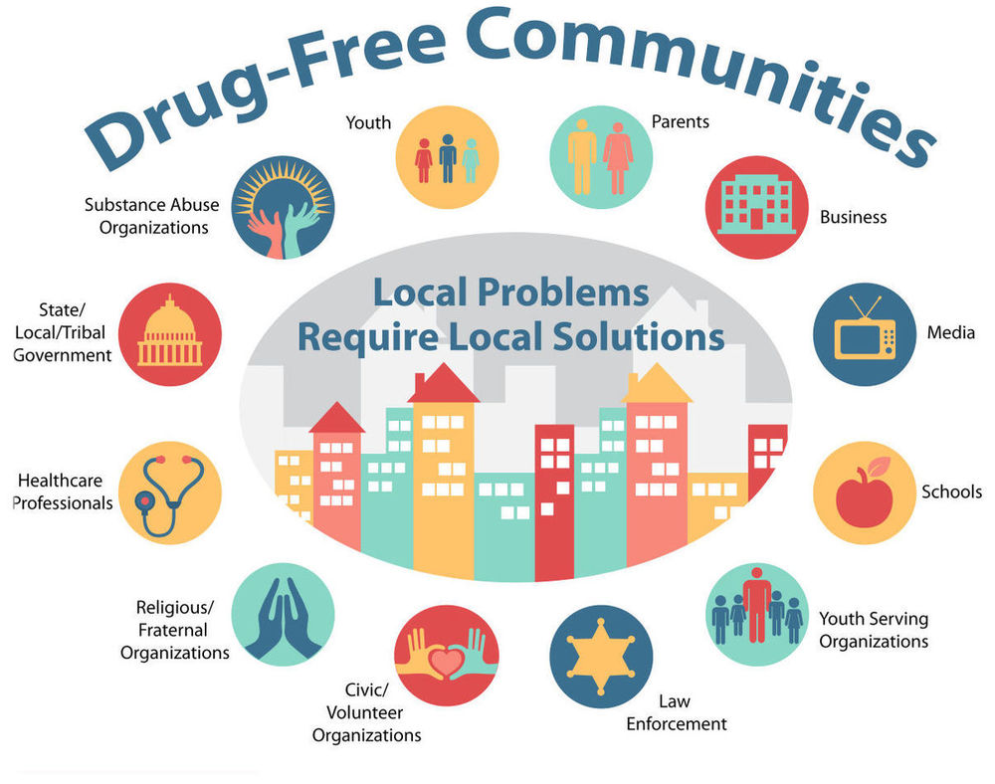
Scott County Prevention Coalition
The Scott County Prevention Coalition (SCPC) is a diverse partnership dedicated to engaging and mobilizing the community to reduce and prevent youth and adult substance misuse for a sustainable and healthy community. Representatives on our coalition come from 12 different sector areas in our community!

Slide 16
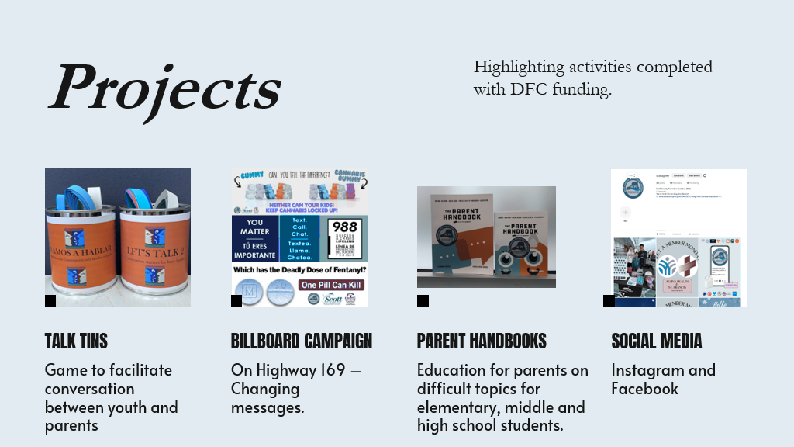
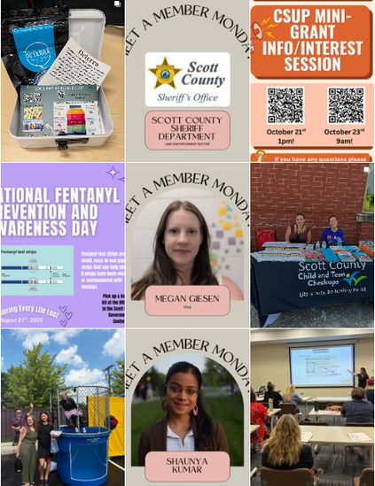
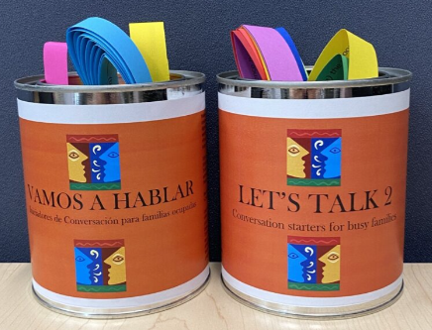
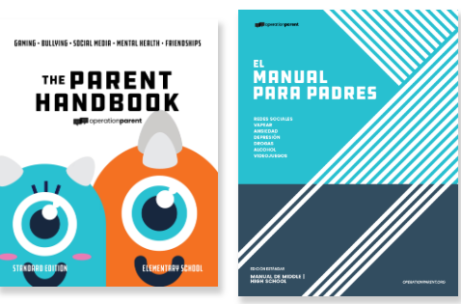

Slide 17
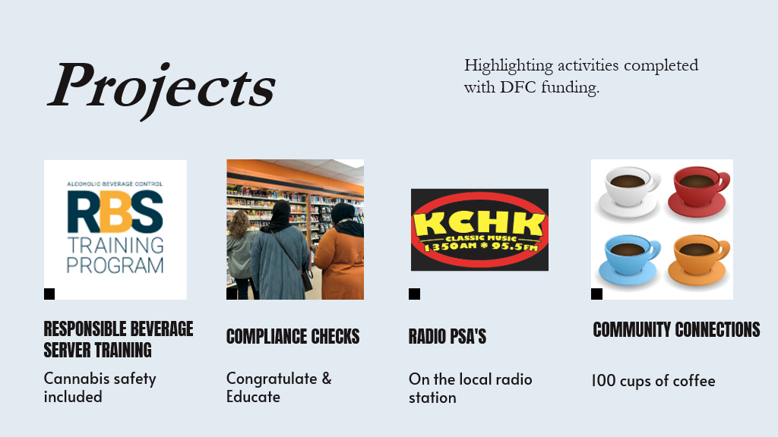

Slide 18
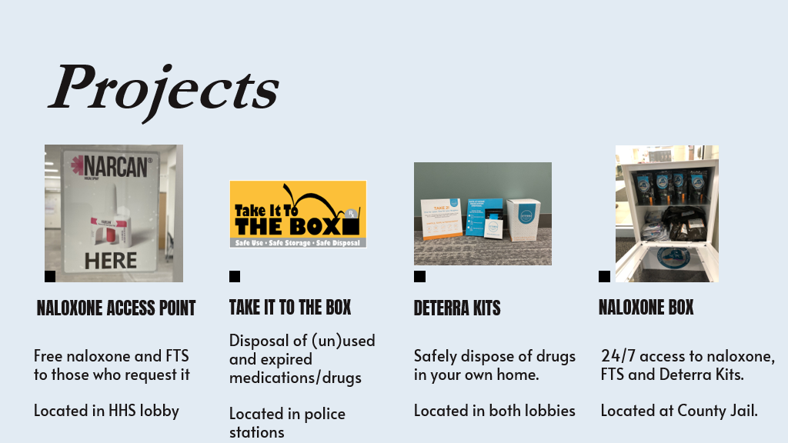

Slide 19
Scott County Youth Advisory Committee
Purpose:​
Focusing on substance use prevention and education through youth-led initiatives.​
Objectives:​
  Raise awareness among Scott County​ Community Members
  Education related to substance use and mental health including fentanyl​
  Encourage healthy decision making among youth​
​
Main Concerns:​
  Nicotine​
  Marijuana/Cannabis

Slide 20
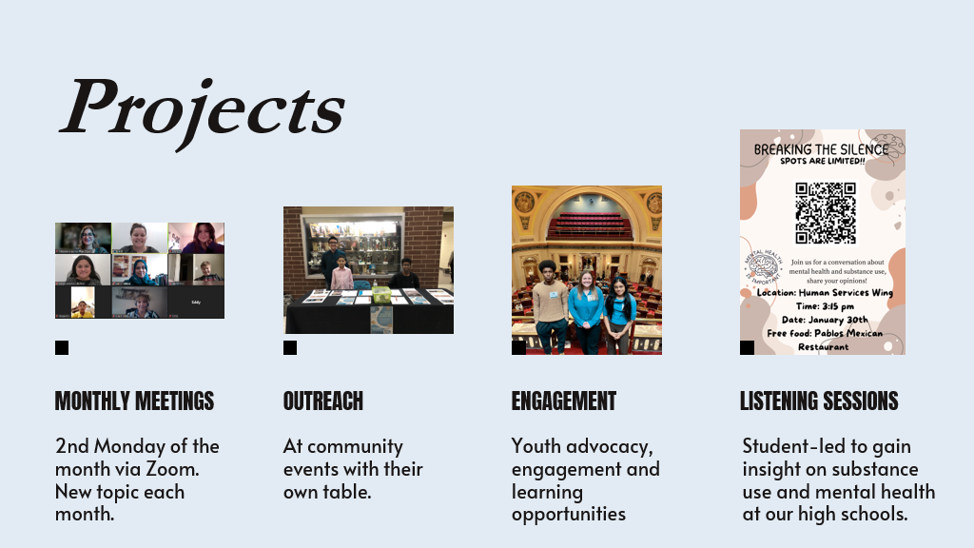

Slide 21
Cannabis and Substance Use Prevention (CSUP)
CSUP Objectives:​
To provide community organizations and schools the opportunity to implement evidence-based and evidence-informed primary prevention strategies to reduce cannabis and substance use among residents in Scott County. ​
*Cannabis must be included in all projects. *​
  This may include providing accessible education, resources, and skills training that empower individuals to make healthy, substance-free choices and reduce risk factors associated with substance use.

Slide 22
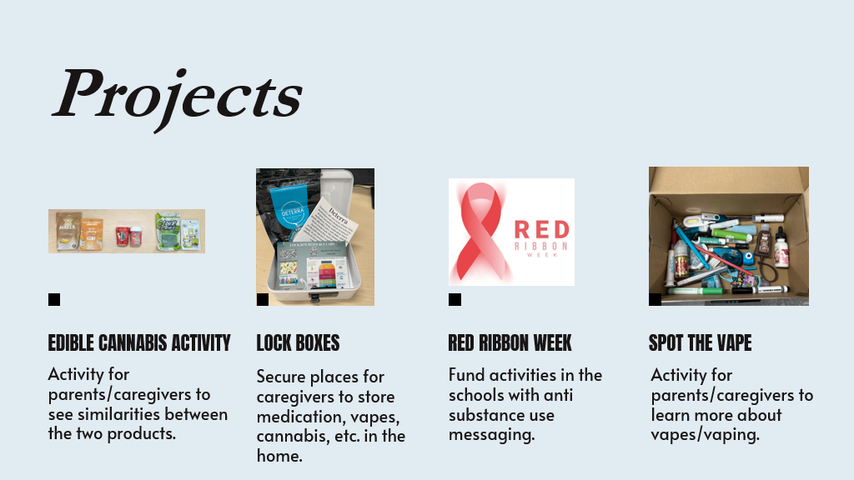

Slide 23
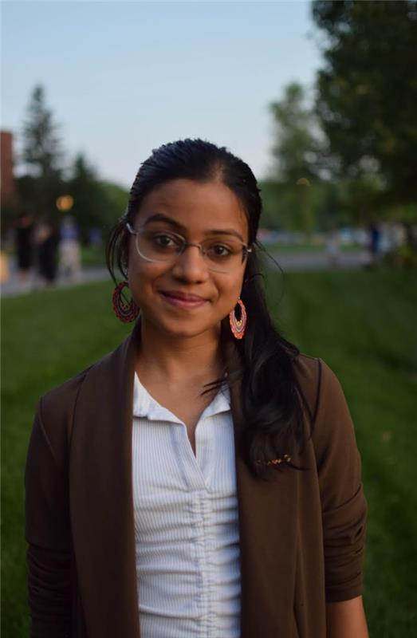
Shaunya Kumar
Community Health Specialist

Slide 24
Cannabis Needs Based Assessment
Assessment Objectives:
  Document community-level concerns related to cannabis use and its perceived risks.
  Explore differences in experiences across populations, including age, race/ethnicity, housing status, LGBTQ+ identity, and mental health status.
  Identify service gaps and barriers in systems that are intended to support prevention, treatment, or recovery.
  Highlight opportunities for action at Scott County, via the C-SUP mini-grant program, and with the Scott County Prevention Coalition.

Slide 25
Cannabis Needs Based Assessment
Key Concerns & System Gaps:
  Normalization & Misperceptions: Cannabis seen as “safe,” increasing use among youth, parents, and seniors.
  Youth Access & Risks: Easy access via peers and retailers; early initiation and vaping of potent synthetic THC common.
  Mental Health Impacts: Used for self-medication but linked to anxiety, psychosis, and relapse.
  Generational & Equity Issues: Accidental child poisonings, uninformed senior use; higher impact on LGBTQ+, Native, and unhoused populations.
  System Gaps:
  No detox or mother-child treatment centers.
  Few school chemical counselors; prevention funds misused.
  Confusing treatment access and mistrust of county services.
  Lack of sober housing and ineffective public messaging.

Slide 26
Cannabis Needs Based Assessment
Opportunities & Recommended Priorities
  Policy & Systems:
    Adopt Social Host Ordinance for cannabis.
    Regulate synthetic THC sales locally.
    Offer free recovery spaces in public buildings.
  Recovery & Youth Supports:
    Expand sober living and mother-child treatment options.
    Add prevention specialists, peer mentors, and drop-in centers in schools.
  Education & Outreach:
    Launch multilingual campaigns on safe storage and signs of use.
    Fund parent education and culturally tailored prevention programs.
  Prevention Focus:
    Correct “safe” cannabis perceptions.
    Reduce youth access and accidental poisonings.
    Strengthen early intervention and community collaboration.

Slide 27
Cannabis and Substance Use Prevention Mini-Grants
The goal of CSUP mini grants:​
To provide community organizations and schools the opportunity to implement evidence-based and evidence-informed primary prevention strategies to reduce cannabis and substance use among residents in Scott County.
  This may include providing accessible education, resources, and skills training that empower individuals to make healthy, substance-free choices and reduce risk factors associated with substance use.
*Cannabis must be included in all projects.*​

Slide 28
Cannabis and Substance Use Prevention Mini-Grants
  All project applications should include at least one policy, system or environmental change:​
    Policy: the passing of policies, ordinances, or rules within an organization​
    Systems: changes to transform “the way things are typically done.”​
    Environmental: occurs within social, economic, or physical environments.

Slide 29
Application Timeline
  Applications open: November 1st, 2025​
  Application deadline: December 20th, 2025​
  Award notification: January 12th, 2026
  Deadline for funds spending: September 1st , 2026
  Final Reporting and Evaluation: October 1st, 2026

Slide 30
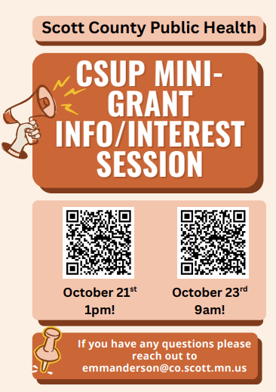

Slide 31
Funded Mini-Grants (2025)
Mi Casa
Advocates for Thriving Communities
Belle Plaine High School
Shakopee High School

Slide 32
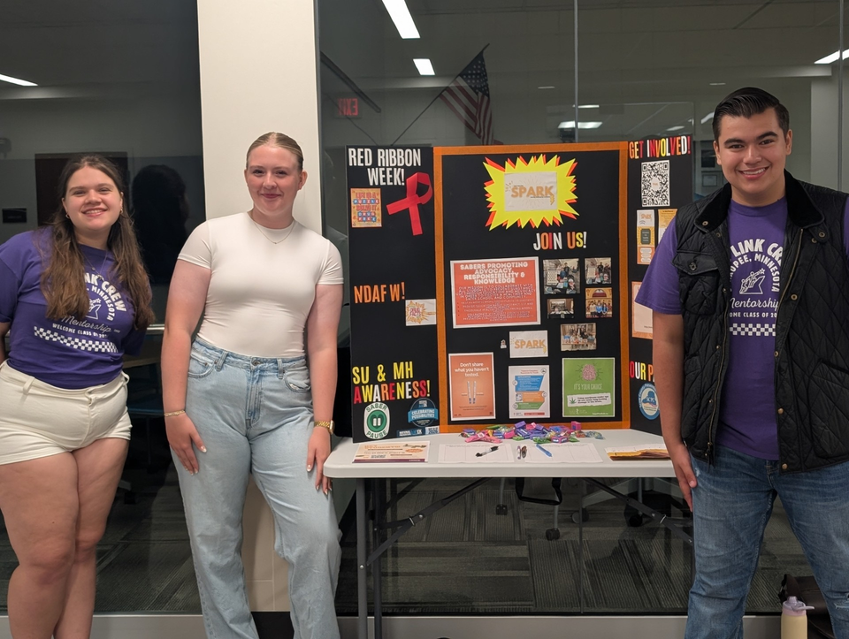

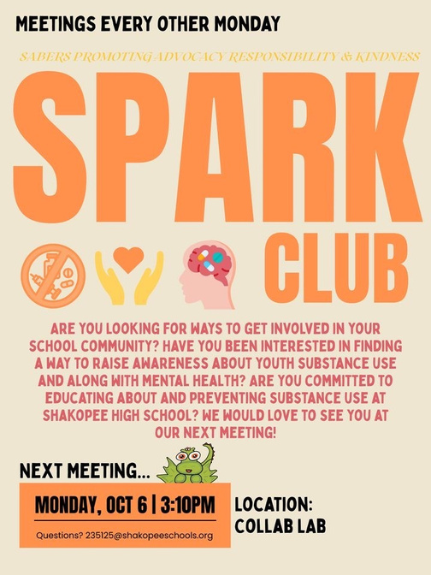
Shakopee High School - SPARK Group
Mission Statement:
SPARK is a group focused on collaborating with all students to prevent substance use through education and advocacy in order to foster a healthy and safer school. This will be done through raising awareness and education about substance use and mental health, encouraging healthy decision making, and partnering with other groups in our school and community.

Slide 33
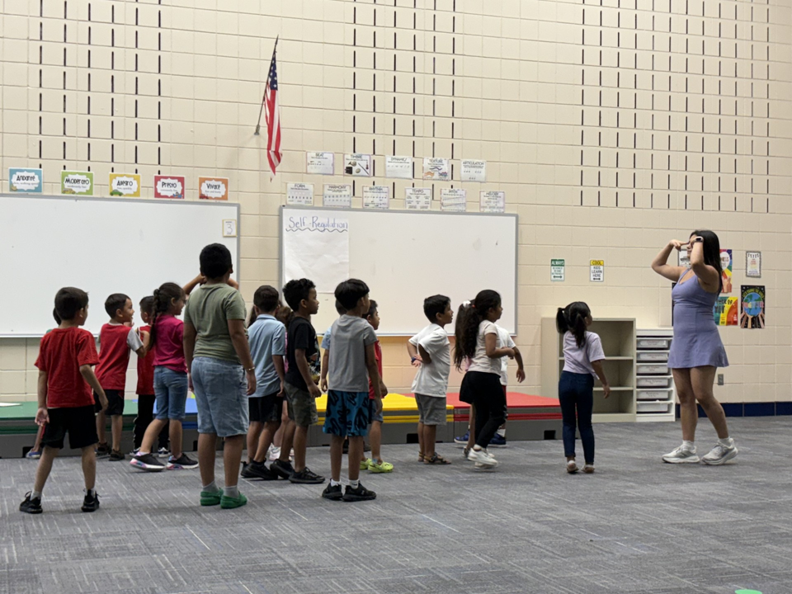
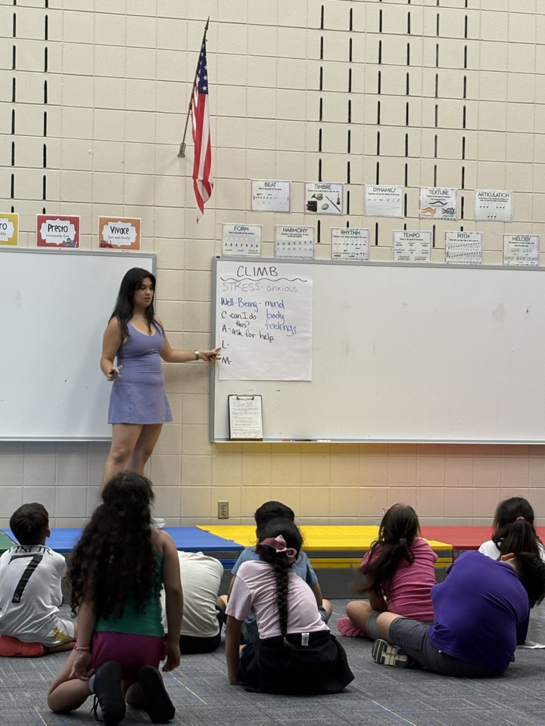
Mi Casa
CLIMB Theatre came to Mi CASA Summer Camp on July 23, 2025, and led customized, age-appropriate workshops for Pre-K, K–5, and 6th–9th grade students. Through interactive theater, students learned and practiced empathy, manners, perseverance, ownership, well-being, equity, and regulation in ways that were both engaging and developmentally appropriate. Older students also explored how these skills could be applied to substance use refusal. The workshops provided a fun and meaningful way for youth to build self-expression, resilience, and decision-making skills, empowering them to prioritize their health and well-being, especially in the face of cultural and societal pressures that often limit their choices.

Slide 34
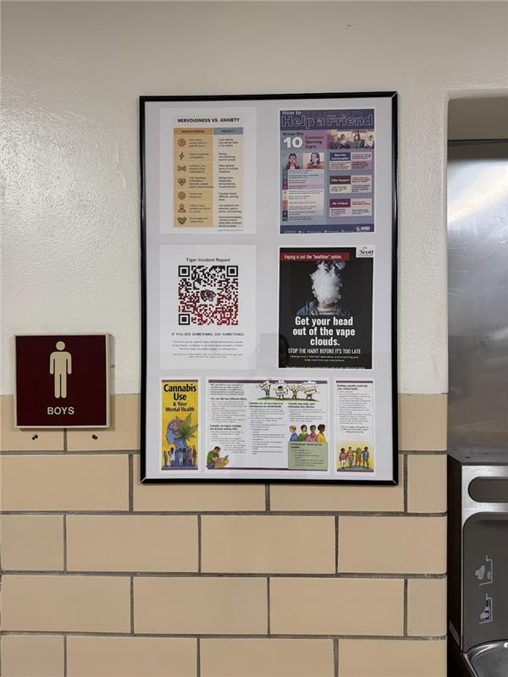
Belle Plaine High School
Project Goal:
At the start of the 2025–2026 school year, Belle Plaine enhanced drug and alcohol prevention efforts by installing impactful, rotating signage throughout the school to engage students, staff, and community members in promoting a healthy, drug-free environment. These signs reinforced positive behaviors, challenged the false perception that “everyone is doing it,” and maintained visibility and relevance through quarterly updates. To further support prevention, Belle Plaine provided t-shirts for the student ambassador leadership team, recognizing their role in promoting health and safety across campus.

Slide 35
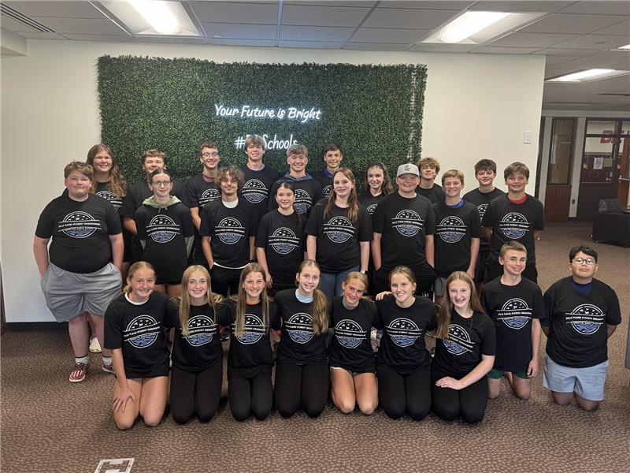

Slide 36

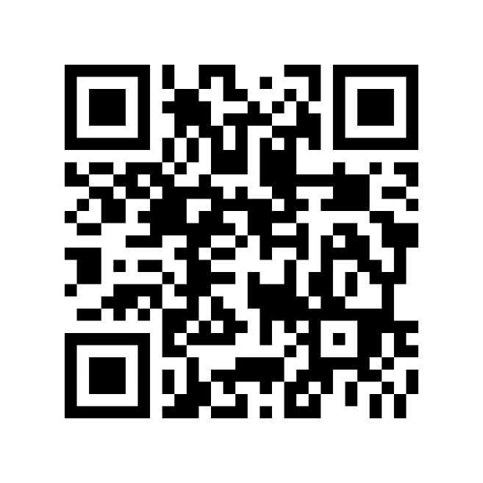
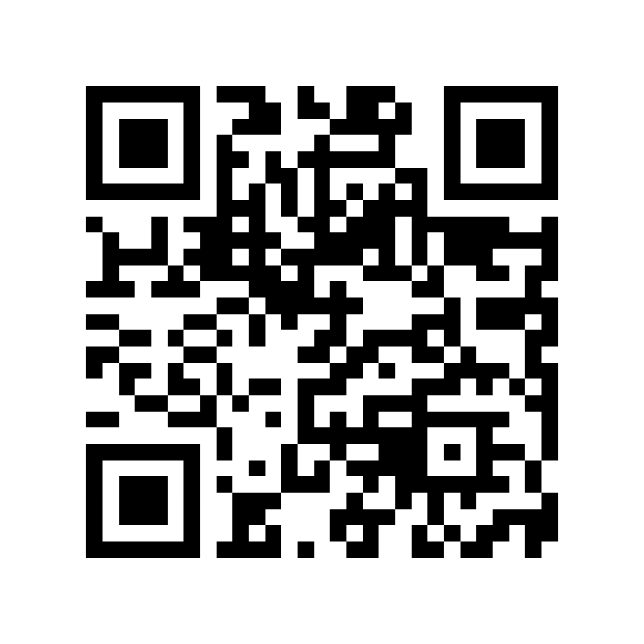



Social Media
Instagram
Facebook

Slide 37
If you have questions please reach out to emhill@co.scott.mn.us or emmanderson@co.scott.mn.us

Slide 38
Thank you

