Slide 1
MISSION:
To promote positive outcomes for all Scott County children, families, and communities by advancing quality family supports through family-centered practices and policies and leveraging partnerships with public, private, non-profit, business and faith communities to promote healthy child development and family resiliency.
VISION:
A community in which community partners, collaborators and individuals come together to help families and children thrive.

Slide 2
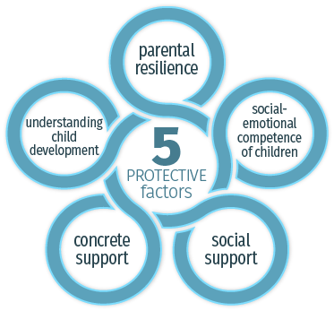
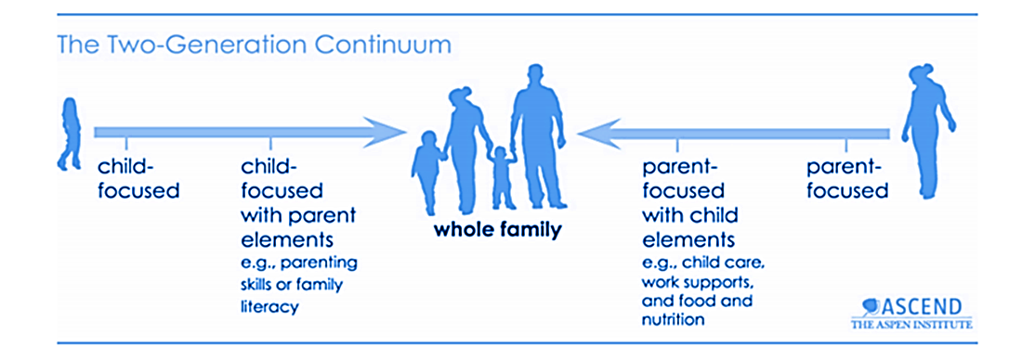
Foundations
Strengthening Families 5 Protective Factors
Two-Generation Continuum
Diversity, Equity, Inclusion and Belonging

Slide 3
Five Protective Factors

Slide 4
How do we build these protective factors in Scott County?
How to support families in times of stability and times of crisis
How to build partnerships in all sectors of the community
How to demonstrate a shared goal of healthy children, healthy families, healthy homes, and healthy communities
How do we respond to gaps & barriers identified by the community?

Slide 5
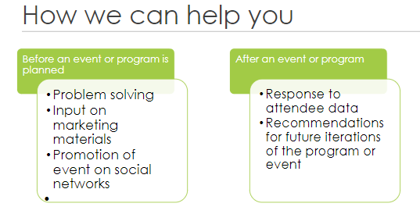
The Parent Advisory Committee +
Community Feedback Loops
Notes:
(PAC) is a group of parents and caregivers from the community. Its purpose is to provide input to the Family Resource Centers on designing programs and services that meet the needs of families in Scott County.

Slide 6
Family Resource Center Partners
County Partners (10)
Community Partners (23)
Scott County Child Support
Scott County Children Services
Scott County Courts
Scott County Economic Assistance
Scott County Housing
Scott County Law Library
Scott County Library
Scott County Mental Health Center
Scott County Public Health
Scott County/Three Rivers Parks
Advocates for Thriving Communities
CAP Agency
Community Resource Center
Damascus Way
Forgotten Initiative
FISH
Isuroon
Jordan Area Food Shelf
Jordan Community Education and Recreation Center
Local City Governments
Local School Districts
Mi C.A.S.A.
Minnesota Prevention and Recovery Alliance
NAMI MN
Parent Advisory Committee
Savage Library
Scott County, Together WE CAN
Shakopee Community Assistance
Southern Valley Alliance
St. David's
St. Francis/Allina
The Katallaso Group
University of Minnesota Extension

Slide 7
Sites and Schedules
Family Resource Center (1615 Weston Court, Shakopee)
Mondays 1-6pm
Tuesdays 9am-4:30pm
Wednesdays 1-6pm
Thursdays 9am-4:30pm
Fridays 9am-1pm
Savage Library (13090 Alabama Ave S, Savage)
Thursdays 1:30-4:30pm
Jordan Area Food Shelf (312 Water Street, Jordan)
1st Saturdays of the month from 9am-12pm
*Additional outreach through the Jordan CERC, City of Belle Plaine, Scott County Library Readmobile

Slide 8
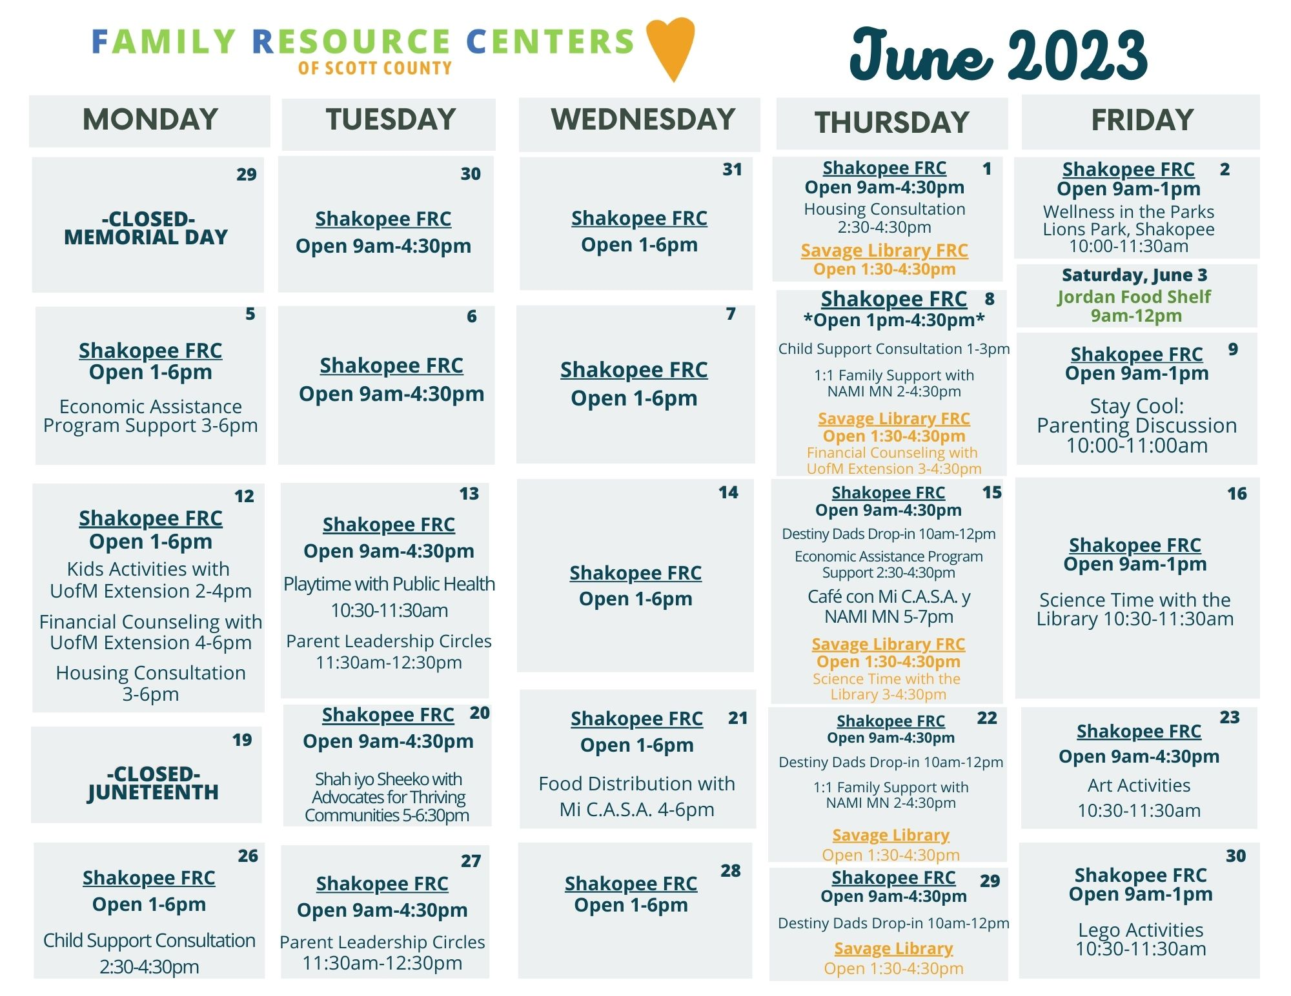

Slide 9
Individualized Support | Parenting Programs | Family Programs
Cultural Navigation Economic Assistance Program Navigation Housing Consultations Child Support Consultations Financial Counseling (University of Minnesota Extension) Family Peer Mental Health Support (NAMI MN) Peer Recovery Support (MN Prevention and Recovery Alliance) | Parent Leadership Circles (Katallasso Group) Destiny Dads (Damascus Way) Parenting Skills Classes (Scott County Mental Health Center) Culturally Specific Parenting Circles (Together WE CAN and partners) | Wellness in the Parks (Scott County and Three Rivers Parks) Playtime with Scott County Public Health Science Time with the Scott County Library Financial Capability Activities for Kids (University of Minnesota Extension) And more!
Visit the FRC website for programming information: www.scottcountymn.gov/frc

Slide 10
Cultural Navigation Partnerships

Slide 11
Individualized Supports
1st Monday of the month from 3-6pm 3rd Thursday of the month from 2:30-4:30pm
2nd Thursday of the month from 10am-12pm 4th Monday of the month from 2:30-4:30pm
1st Thursday of the month
from 2:30-4:30pm 3rd Monday of the month
from 3-6pm

Slide 12
Virtual Support
2nd Mondays of the month from 3-6pm
2nd Thursdays of the month from
3-4:30pm at the Savage Library FRC
Family Peer Support
2nd and 4th Thursday of the month
from 2-4:30pm.

Slide 13
Parenting Programs

Slide 14
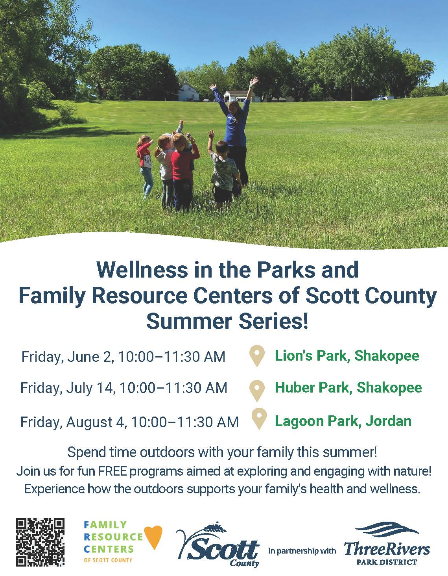
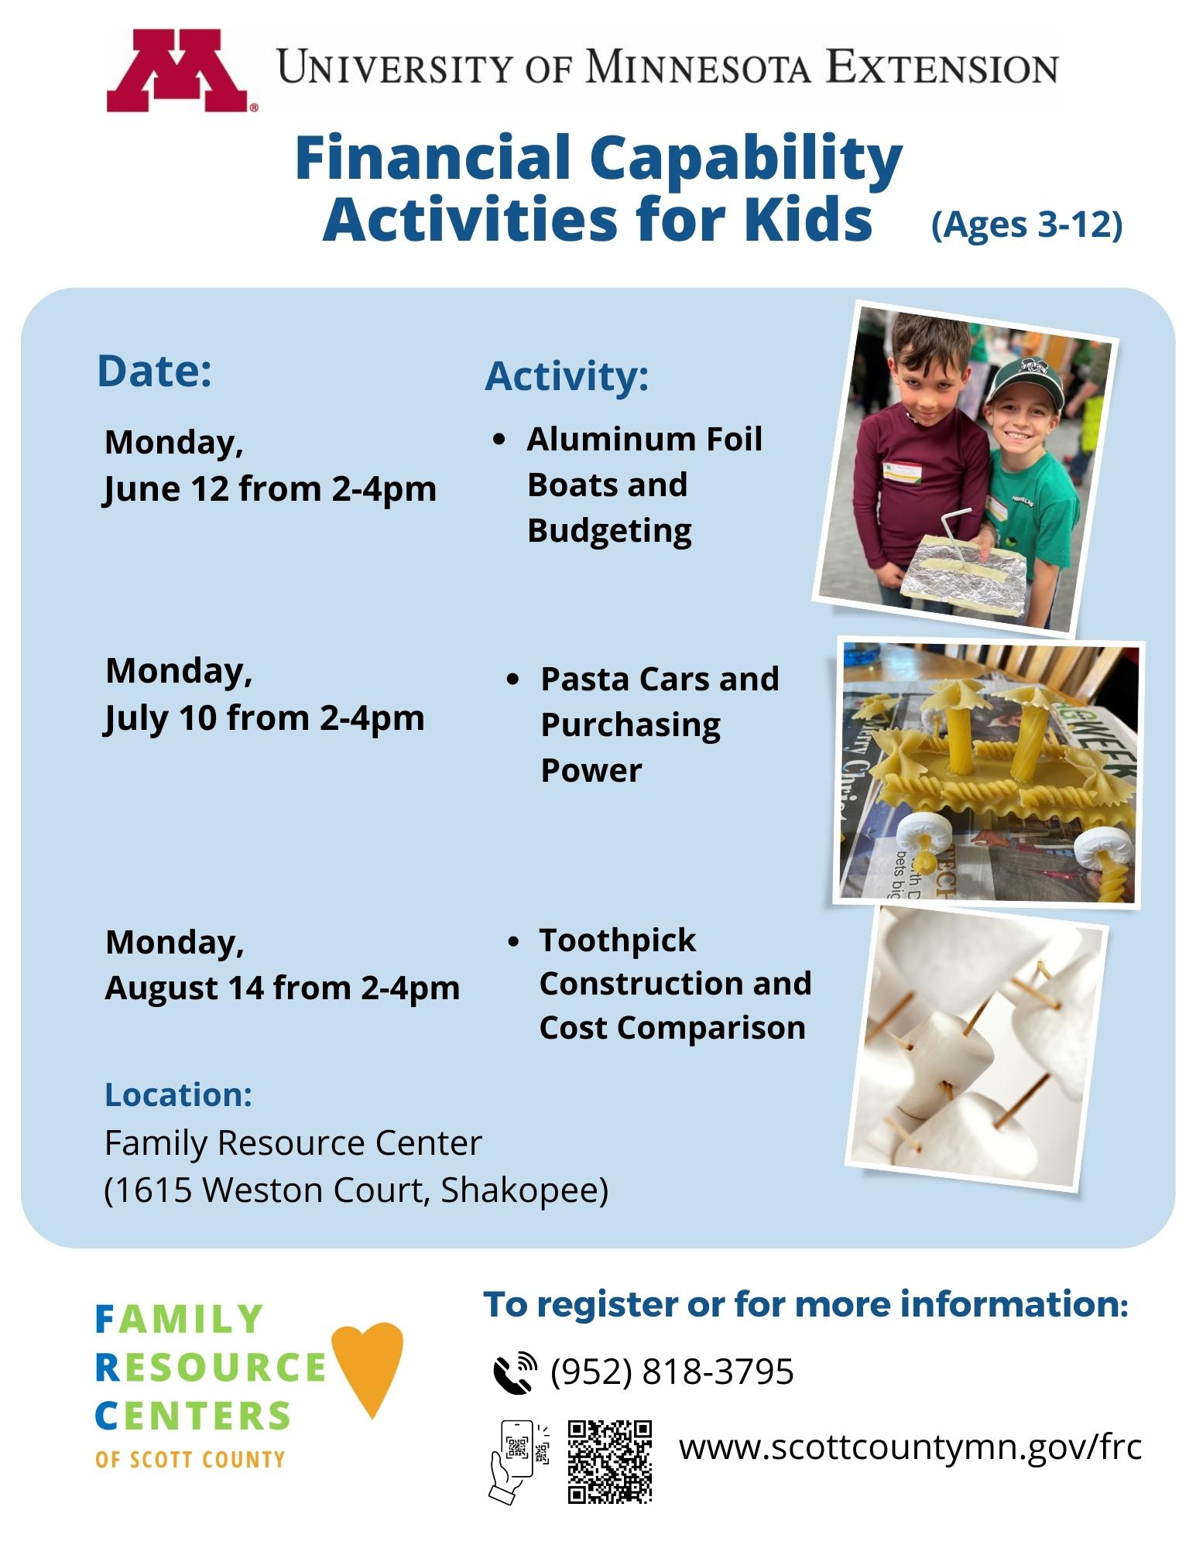
Family Programs

Slide 15
Culturally Inclusive Programs
Community Conversations with

Slide 16
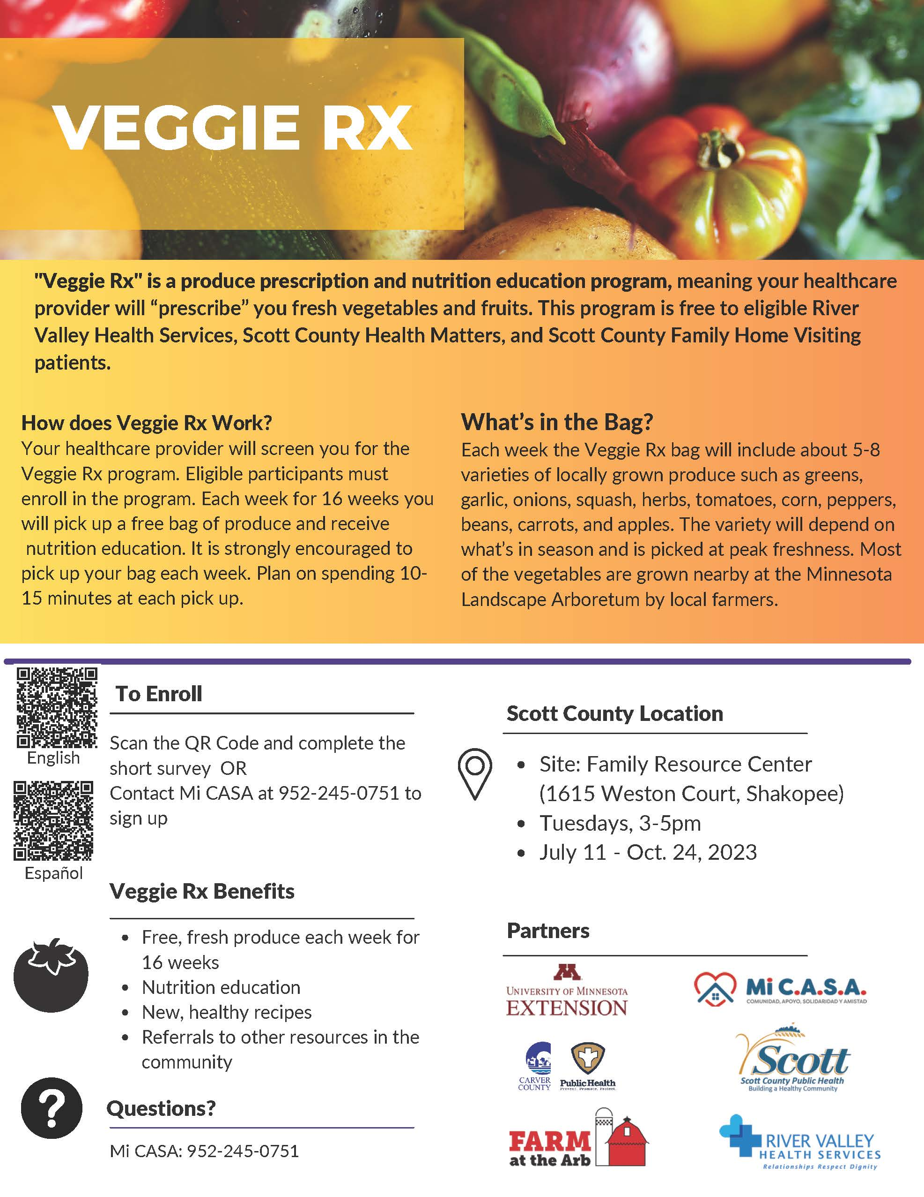
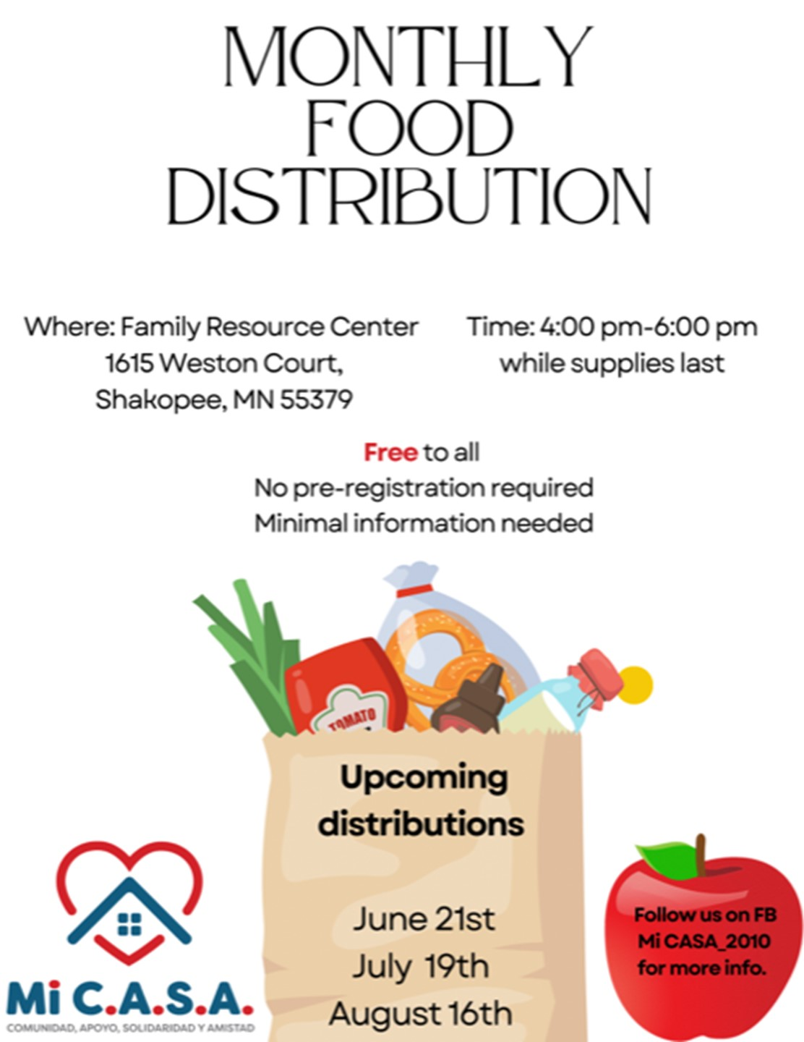
Health and Wellness Connections

Slide 17
Data
Engagement Count of adults and children engaging with FRCs
August 2021-May 2023 | 3,882
January-May 2023 | 1,336
Demographic Information for individuals receiving services
August 2021-May 2023
African American/Black | 20%
American Indian | 1%
Asian/Pacific Islander | 6%
White | 36%
Self/Other/No Response | 36%
Hispanic, any race | 32%
Service Navigation Count of individuals receiving service navigation support *Duplicative
August 2021-May 2023 | 1017
January-May 2023 | 352

Slide 18
Key Highlights
Incredibly appreciative of our partners. Government can not do this work alone.
Proud of our service array and our work to meet the needs of the community.
Statistics reflecting the diversity of our participants shows trust being built through Family Resource Centers partnerships and programs.

Slide 19
Thank you FISH and community partners!
FISH has been instrumental in helping to meet the needs of Family Resource Center families including:
-Rental assistance
-Car repairs
-New clothes for a fresh start
-Appliance repairs
-Comfy living room furniture

Slide 20
Thank you!
For more information
Visit: www.scottcountymn.gov/frc
Email: frcinfo@co.scott.mn.us
Call: 952-818-3795

