Slide 1
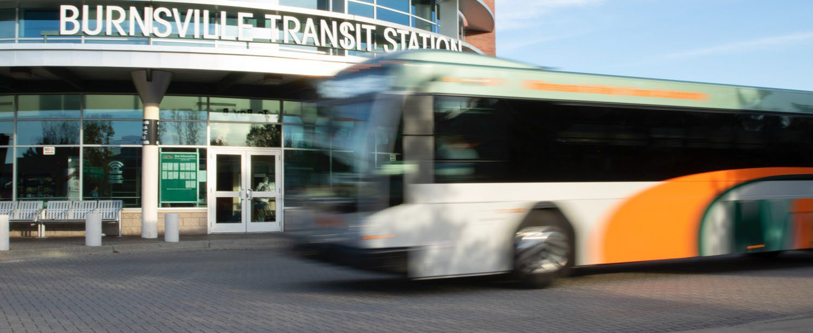
Dakota County Technical College MVTA Services | October 2022
FAMILY RESOURCE CENTER
Minnesota Valley Transit Authority

Slide 2
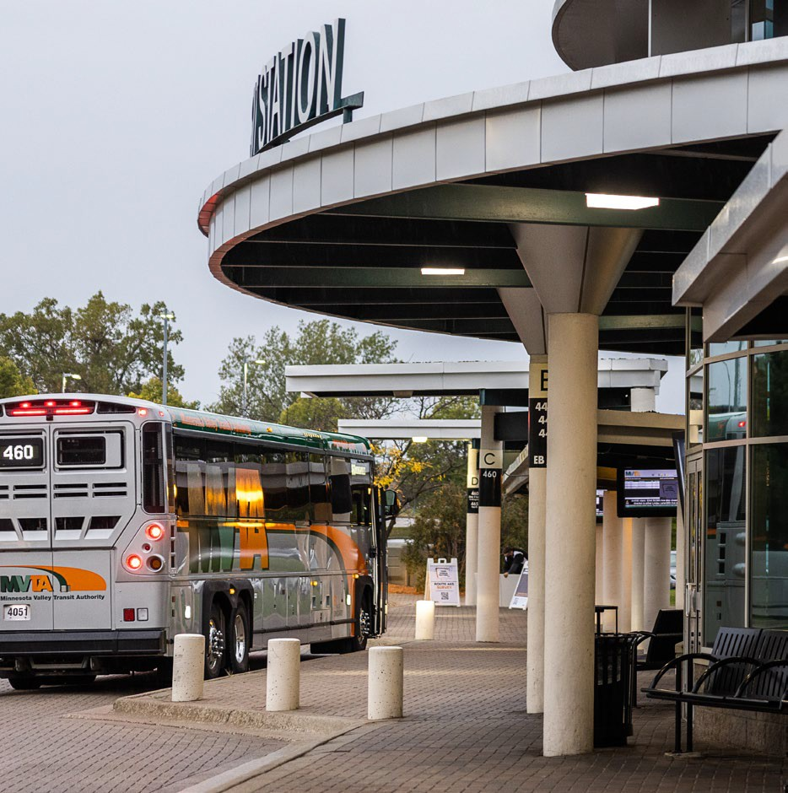
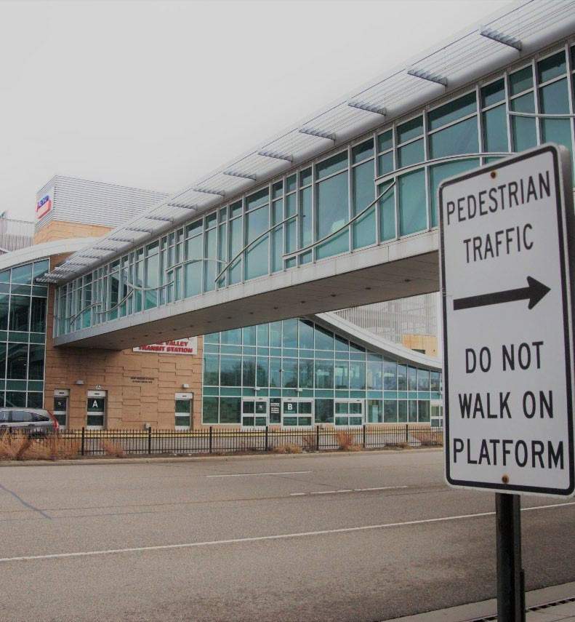
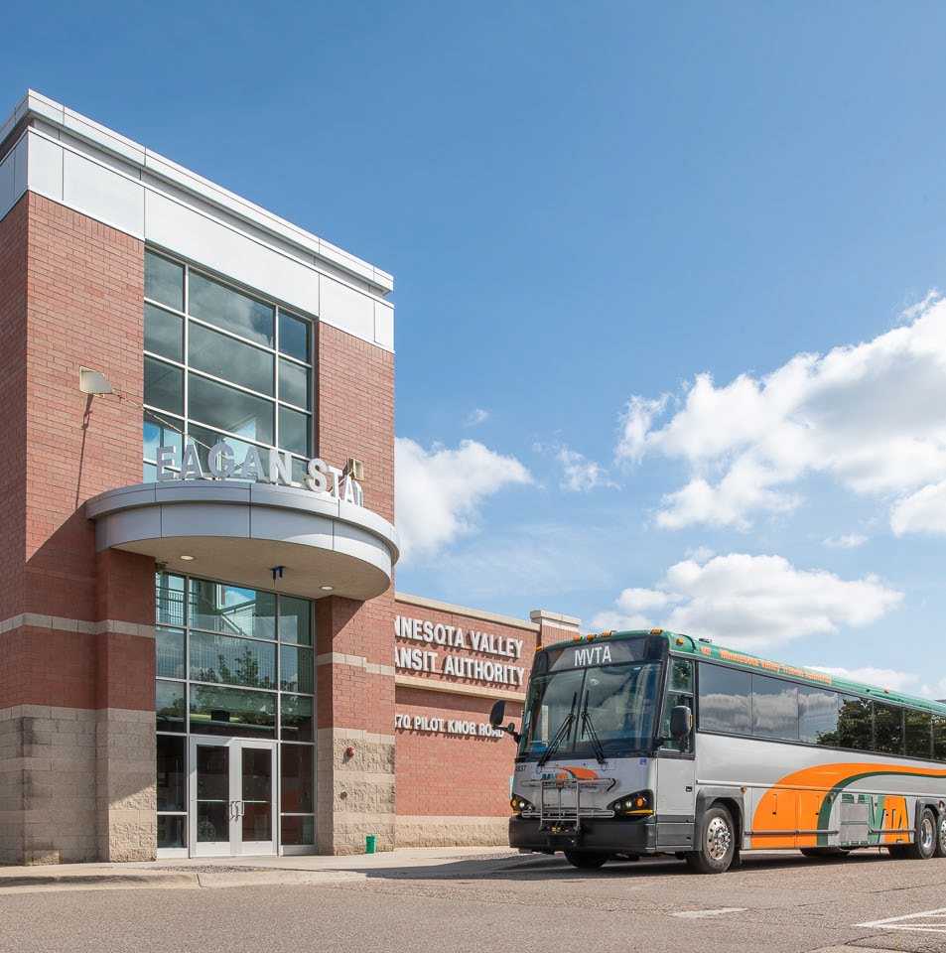
Family Resource Center
MVTA Services | June 2023
Burnsville Transit Station
Apple Valley Transit Station
Eagan Transit Station
MVTA Transit Stations

Slide 3
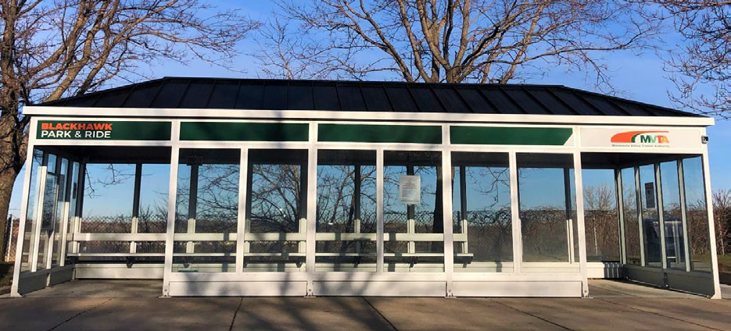
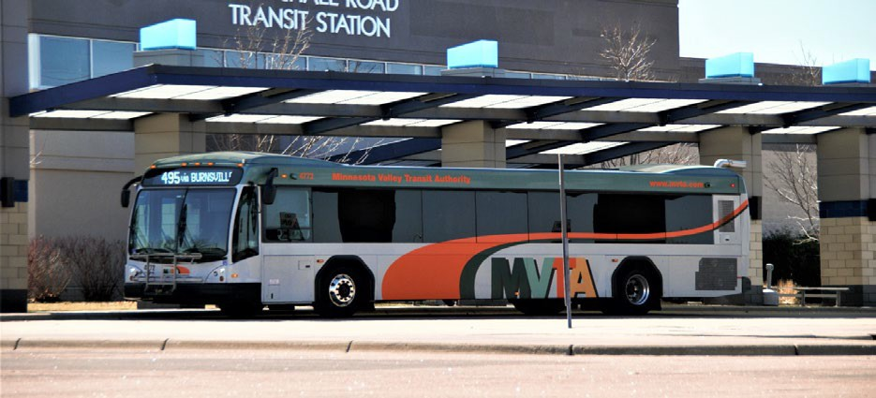
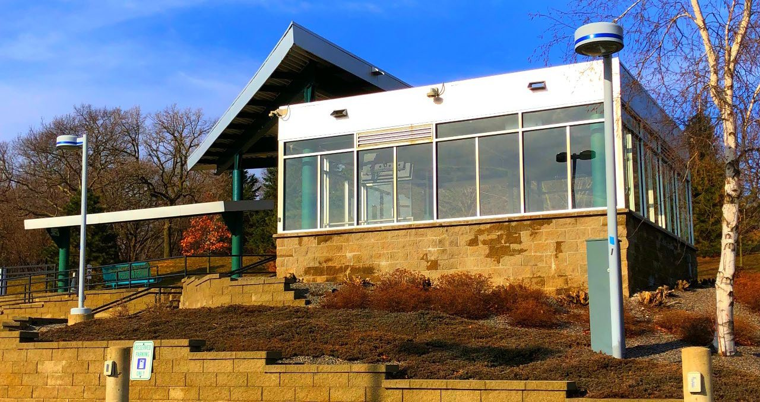
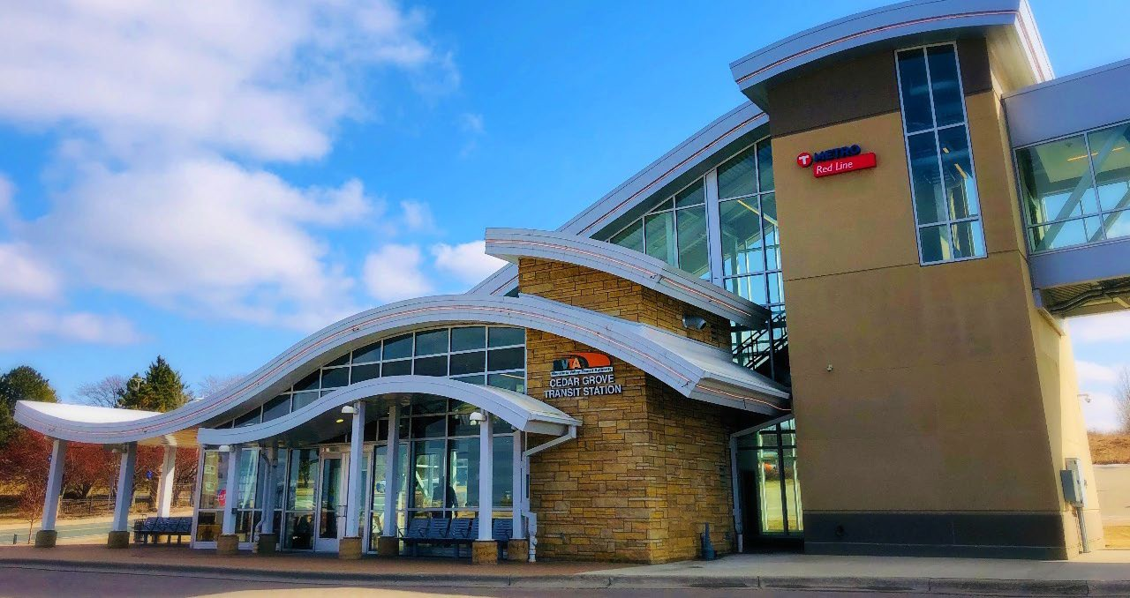
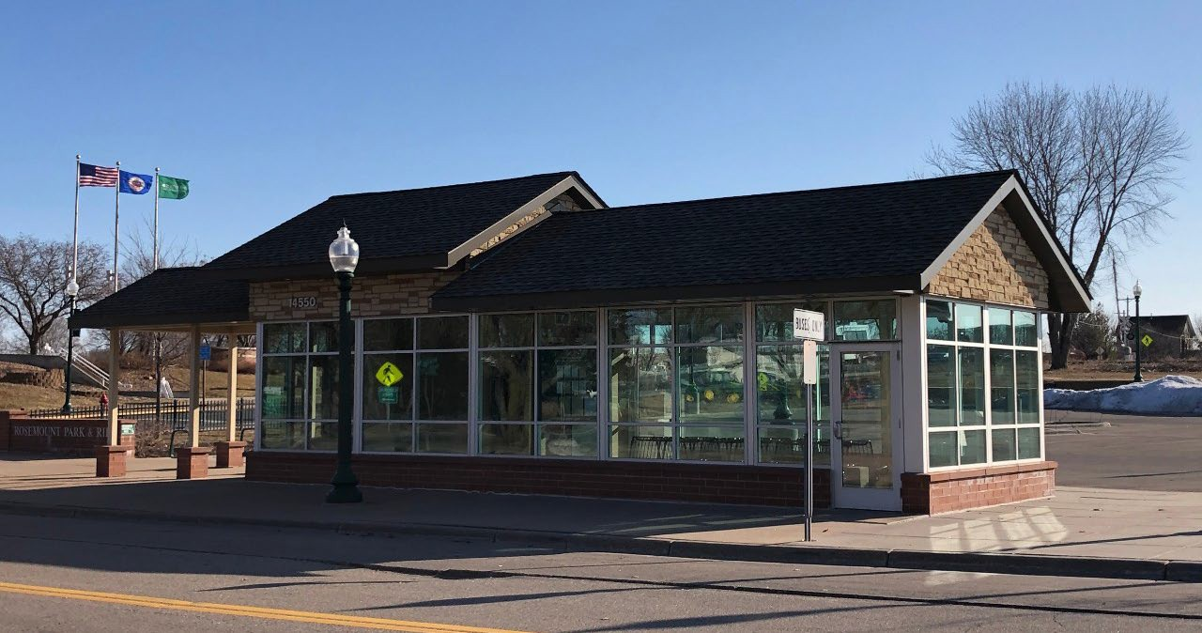
Family Resource Center
MVTA Services | June 2023
Blackhawk Park & Ride
Marschall Road Transit Station
Cedar Grove Transit Station
Palomino Hills Park and Ride
Rosemount Transit Station

Slide 4
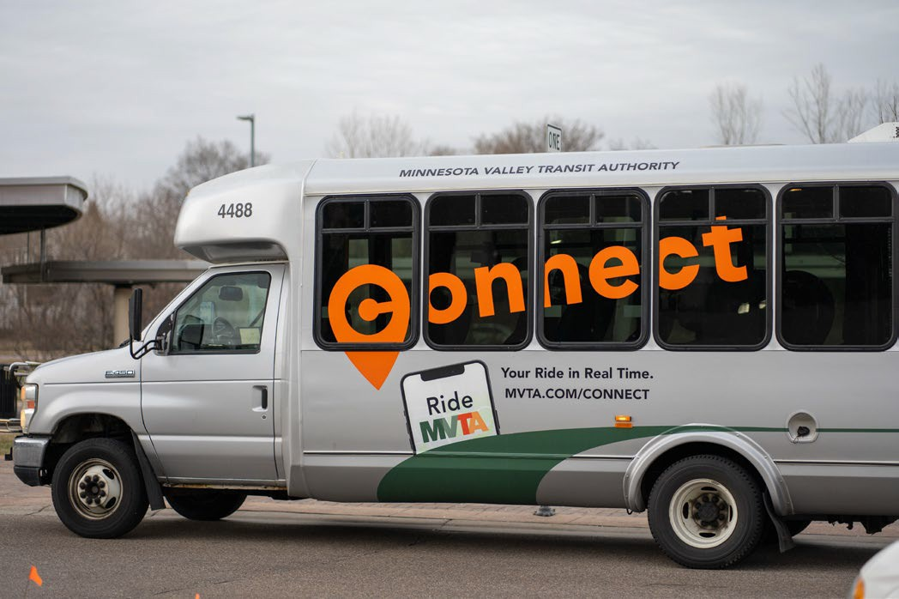
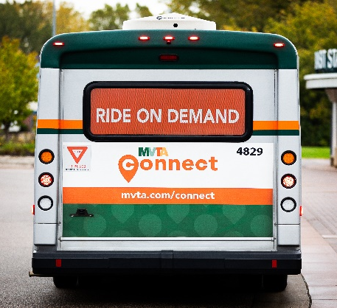
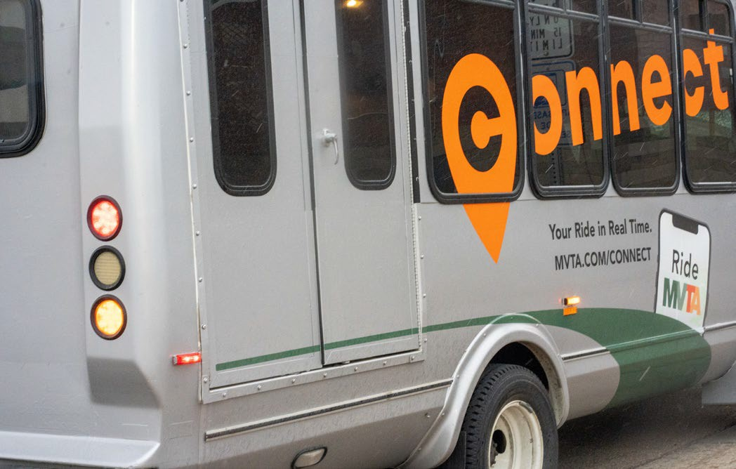
Family Resource Center
MVTA Services | June 2023
Taking MVTA Connect

Slide 5
What is MVTA Connect?
Family Resource Center
MVTA Services | June 2023
On-demand service, booked via an app
First-last mile service or a “link”
Service is based on availability
$3 fare (one-way)
Runs 6am to 9pm, 7 days a week
Serves Apple Valley, Burnsville, Rosemount, and Savage
Also serves the City of Eagan (separate zone)

Slide 6
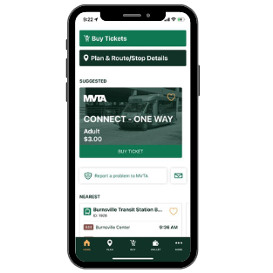
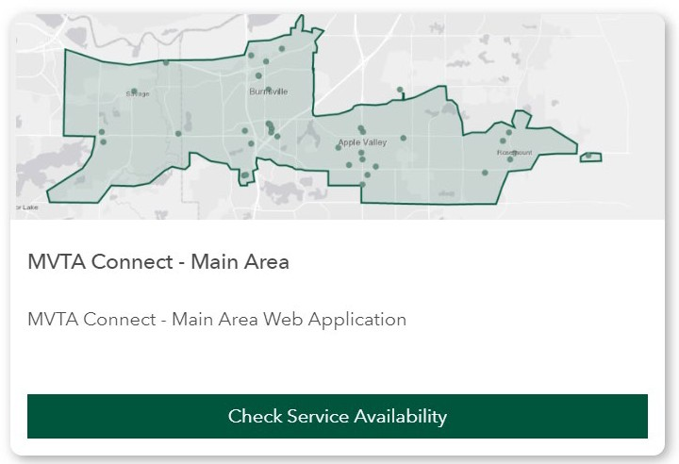
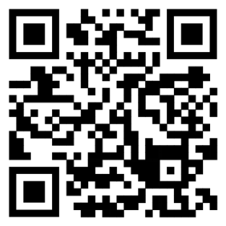
Preparing for Your Trip
Family Resource Center
MVTA Services | June 2023

Slide 7
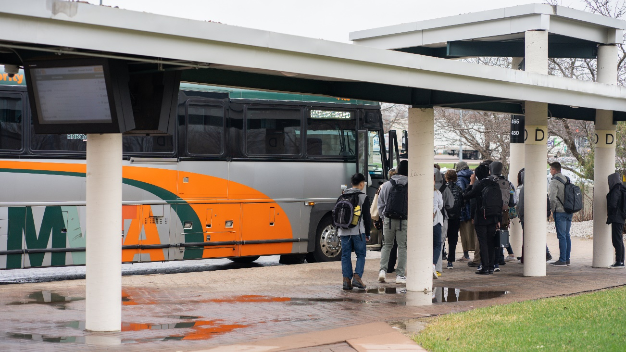
How to Ride the Bus
Family Resource Center
MVTA Services | June 2023

Slide 8
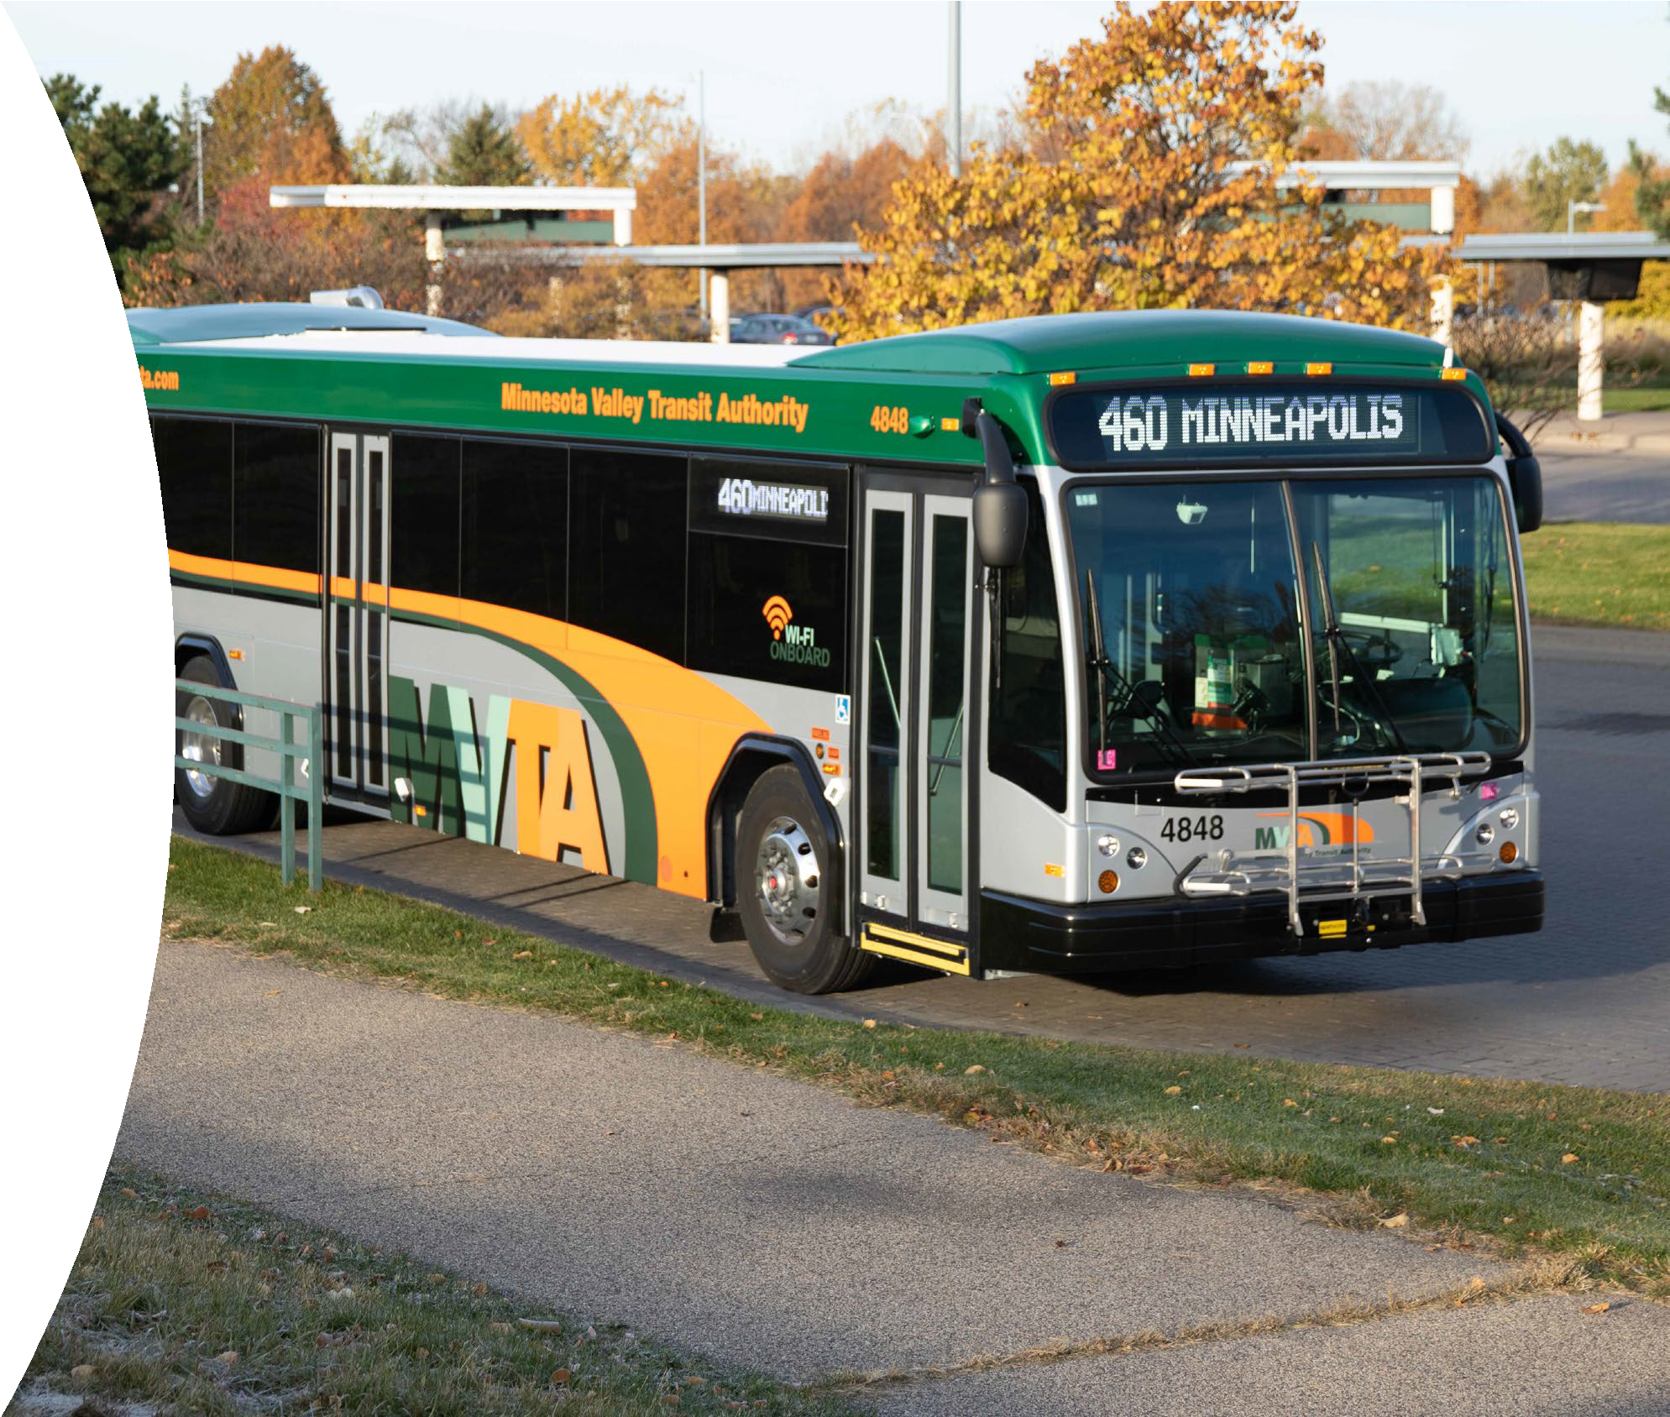
Family Resource Center
MVTA Services | October 2022
Taking Fixed Route

Slide 9
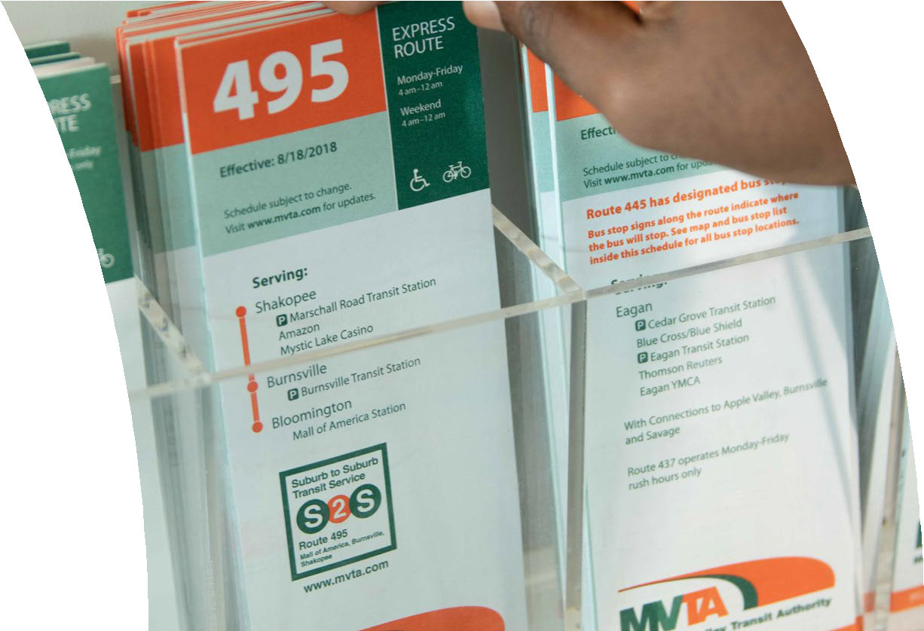
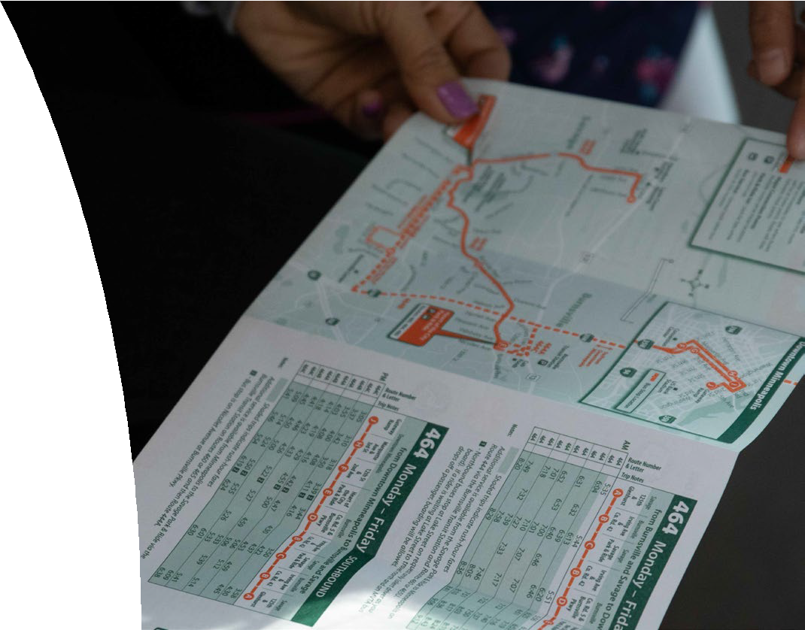
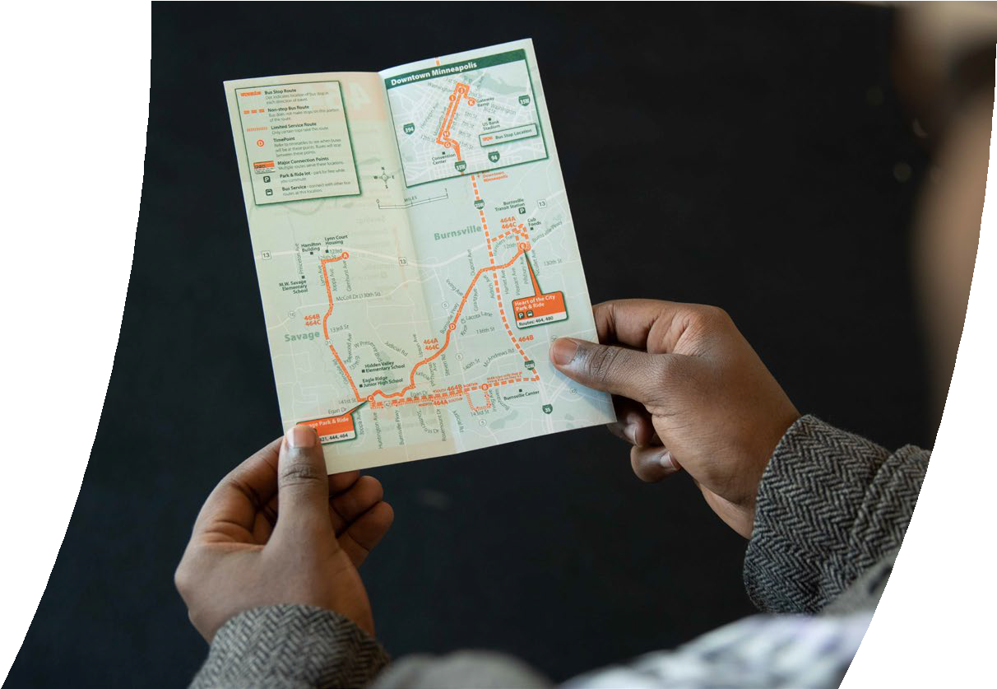
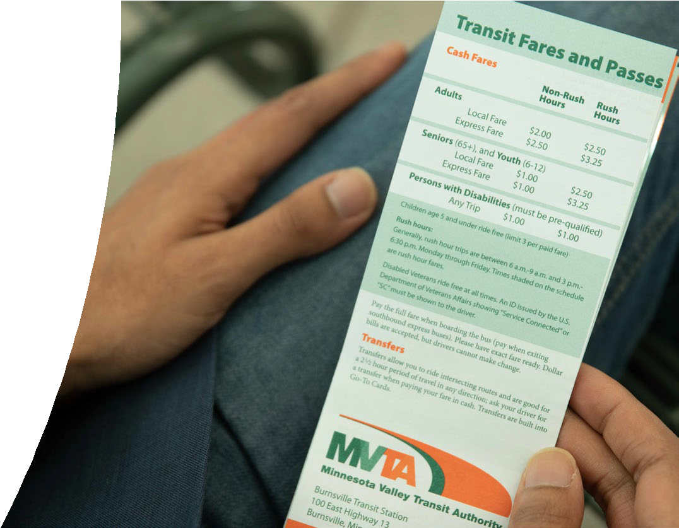
1. Plan Your Trip
Family Resource Center
MVTA Services | October 2022
MVTA Pocket Schedules are available at transit stations throughout the MVTA Service Area
Online Trip Planning Tools
MVTA Site
RideMVTA App
Google Maps

Slide 10
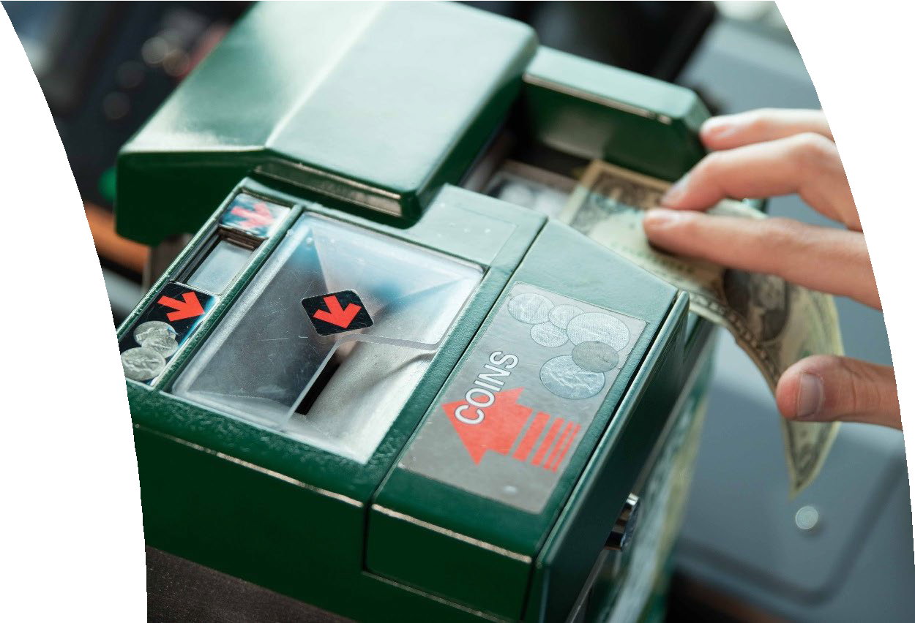
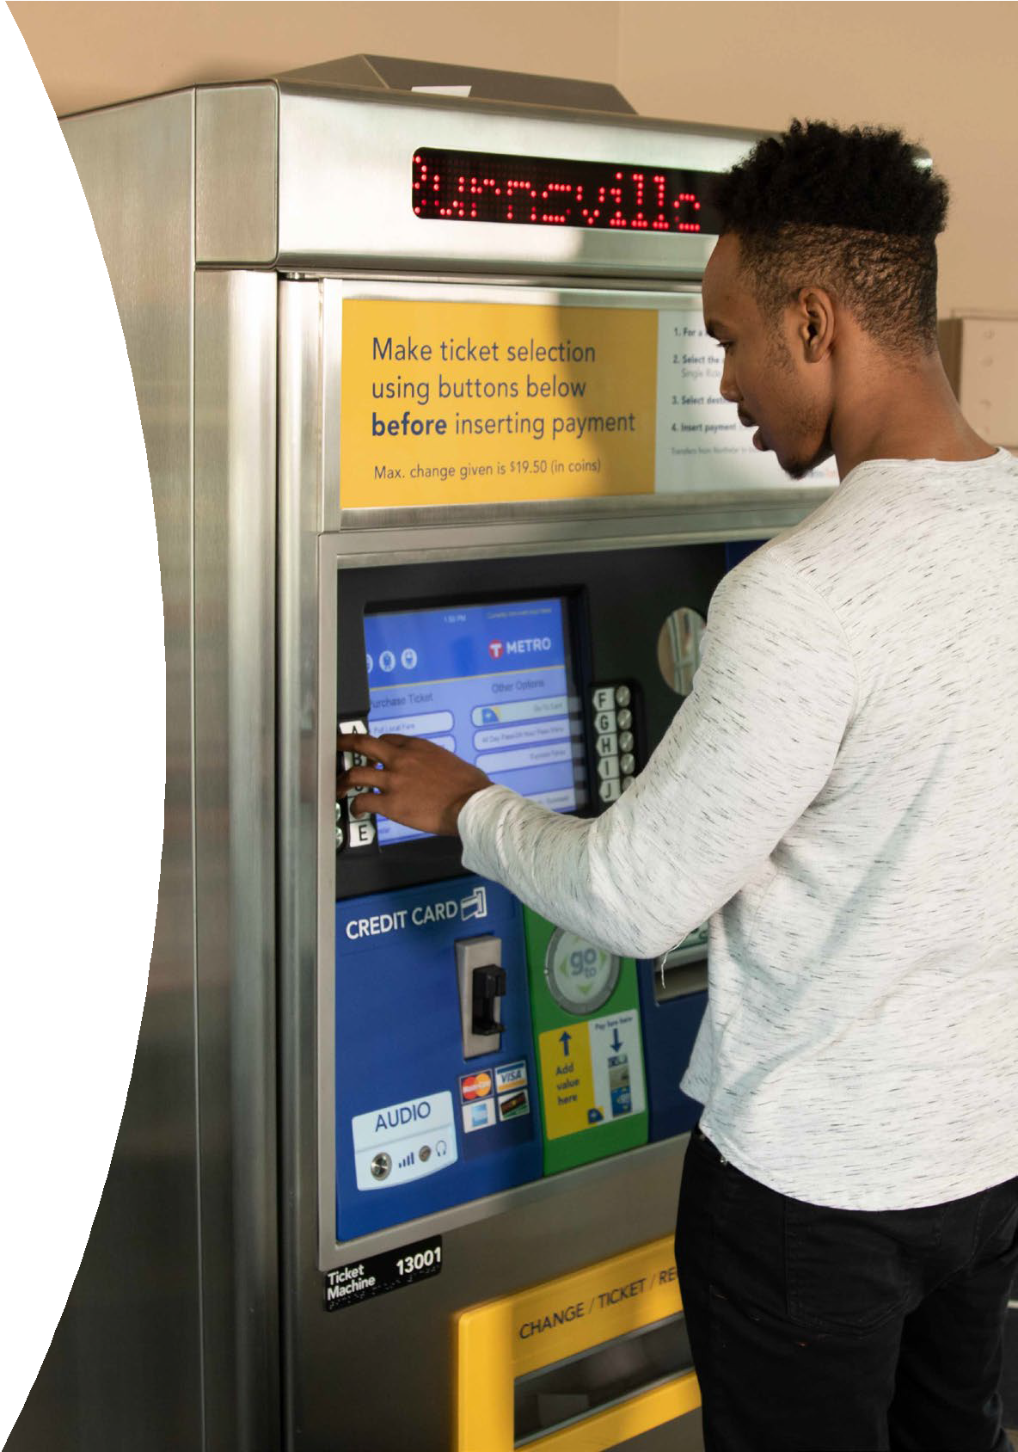
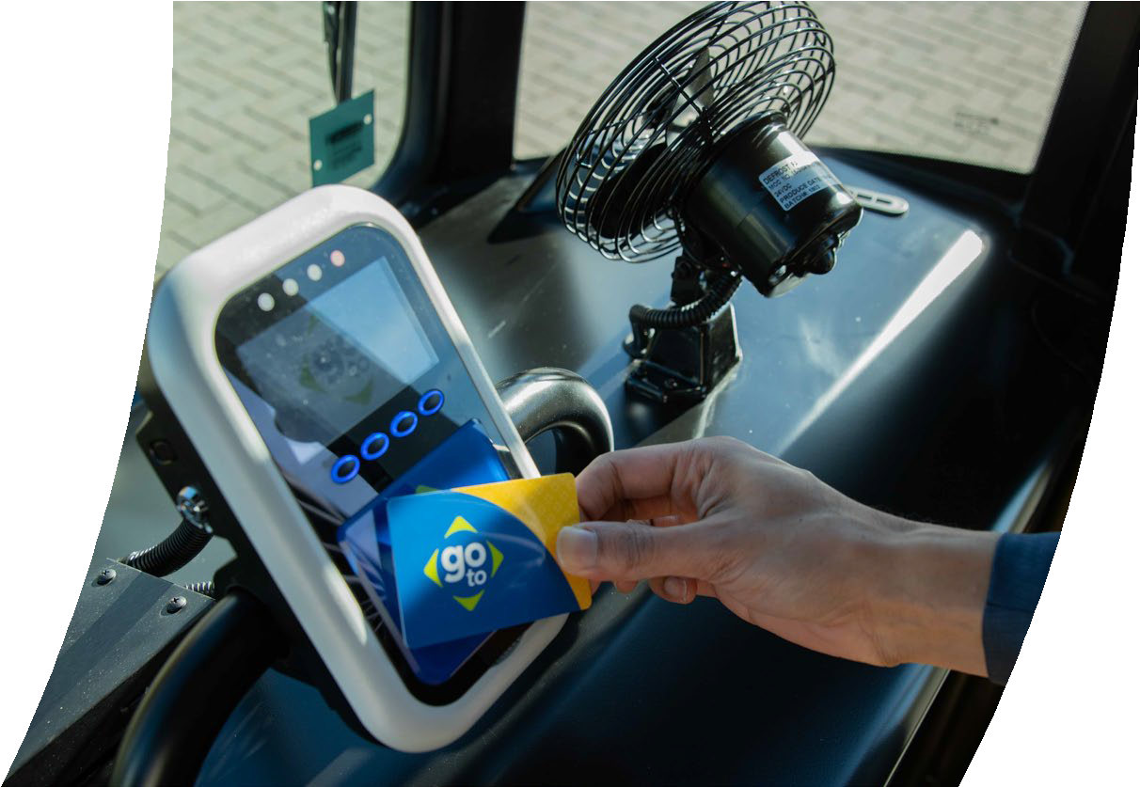
2. Paying for Your Trip
Family Resource Center
MVTA Services | October 2022
When riding Connect, fare can be paid via credit card on the app or with cash
When transferring to fixed route, riders may use a free transfer ticket
If you are not utilizing a transfer, fixed route fare can be paid with:
Paying with Cash
Go-To Tap Card
Cash*
*Note that drivers do not make change
Tapping Your Card
Getting Your Ticket or Card

Slide 11
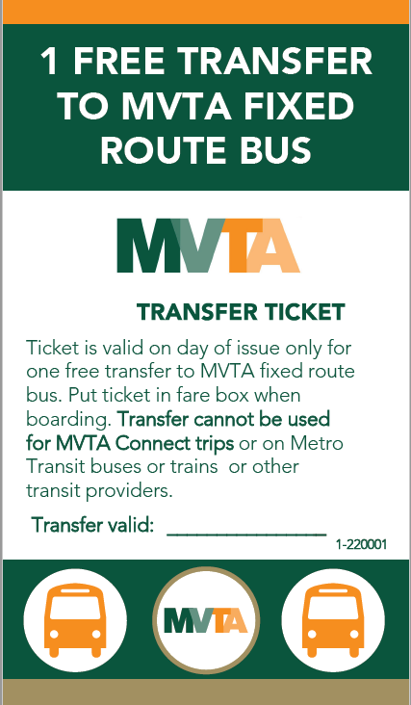
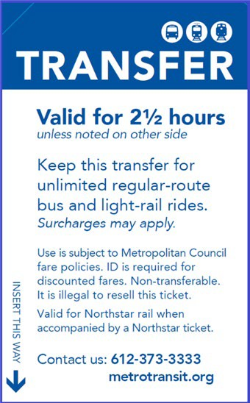
Types of Transfers
Family Resource Center
MVTA Services | June 2023

Slide 12
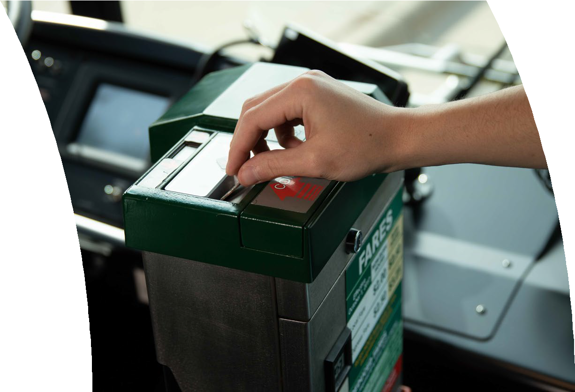
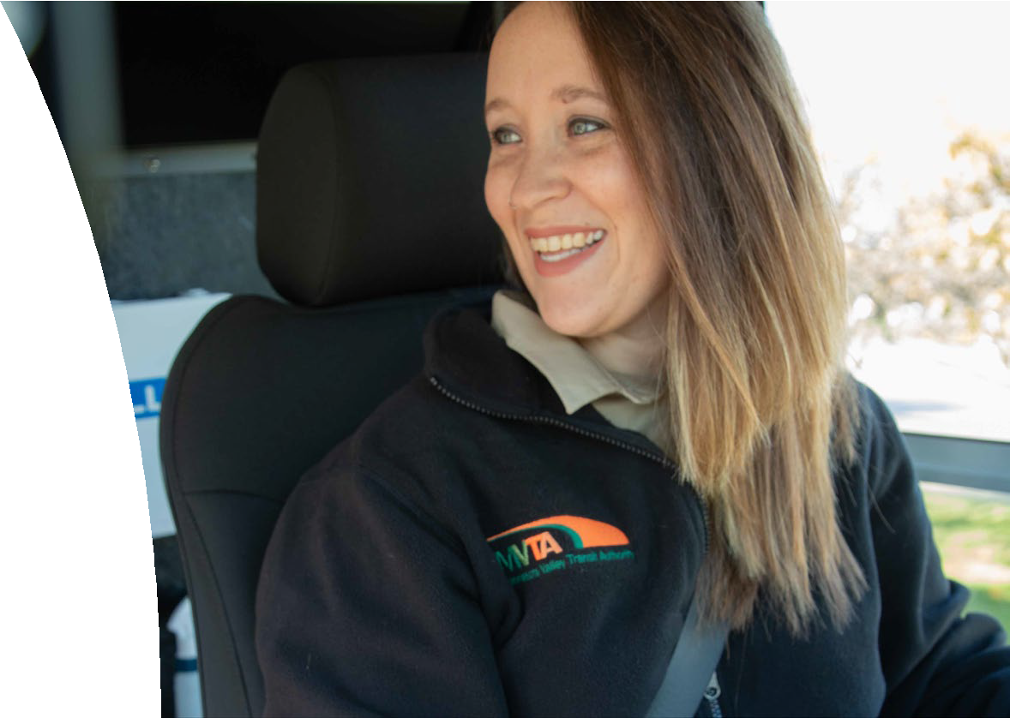
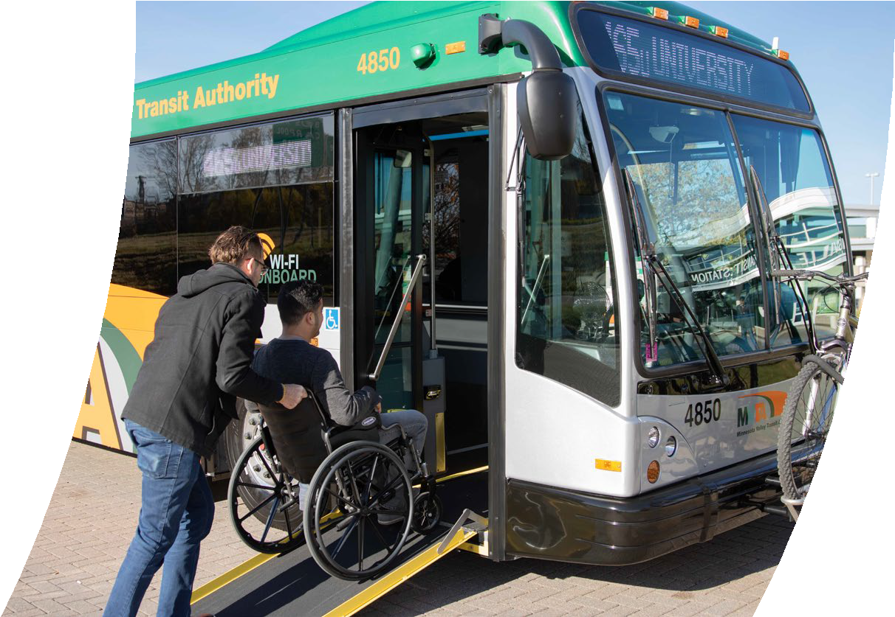
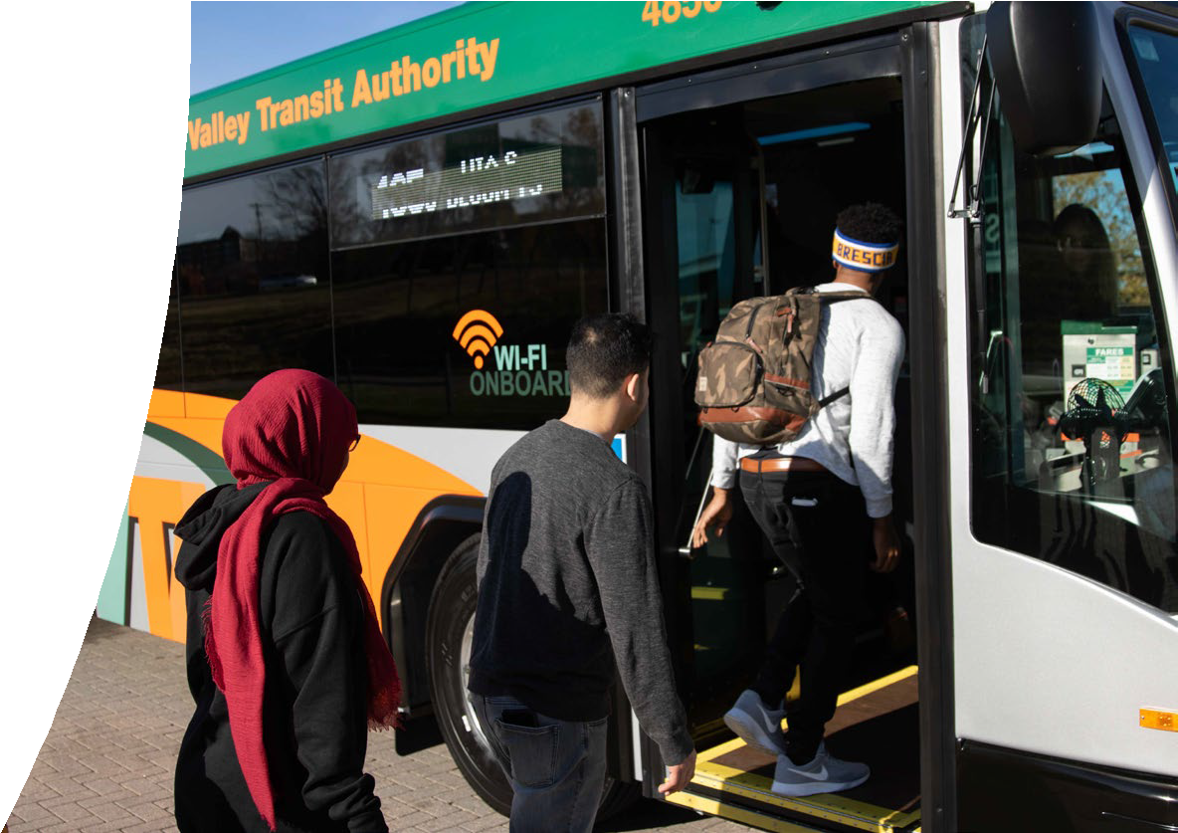
3. Boarding the Bus
MVTA Services | October 2022
Insert cash or MVTA Connect transfer ticket into farebox
Go-To cards can be tapped on the reader
Pull yellow cord or press red stop button to alert driver just before desired bus stop
If using a mobility device, the driver will assist you in boarding the bus via ramp and provide proper device securement
Please remember to collect all belongings upon exiting the bus

Slide 13
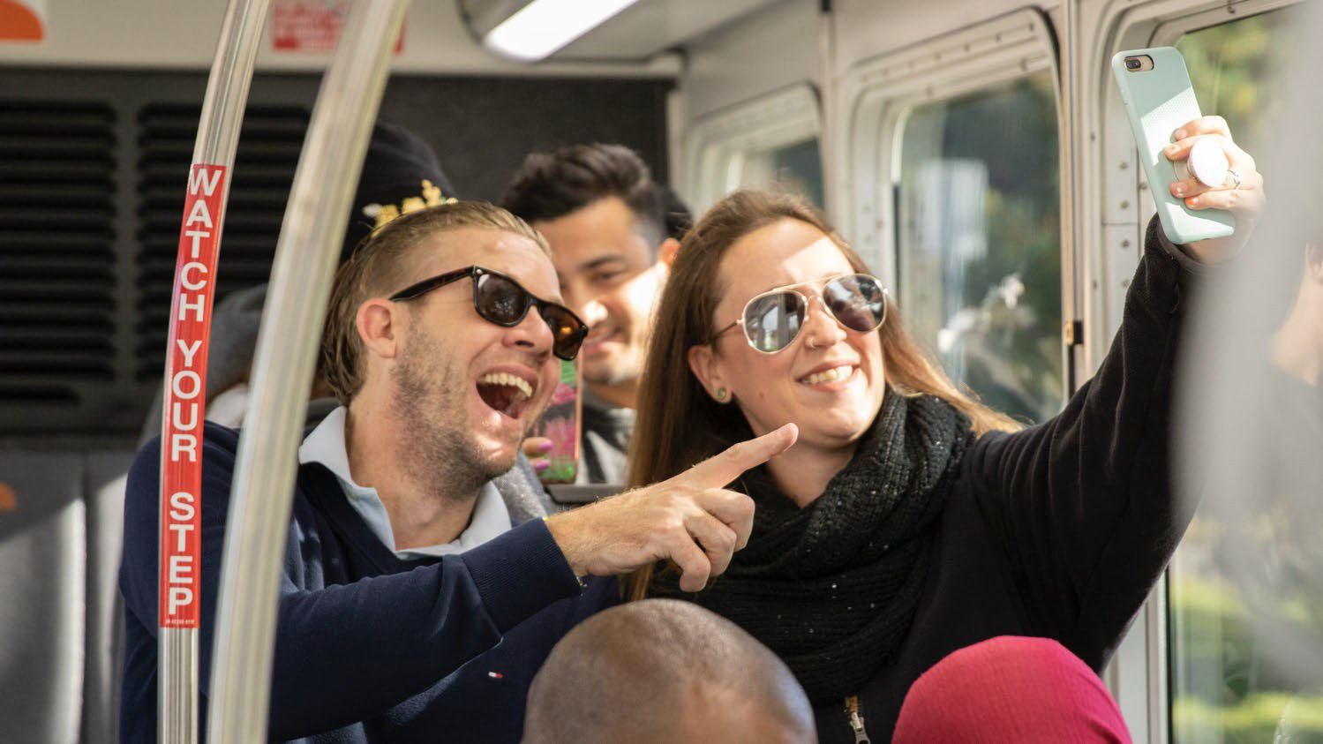
Questions?
Dakota County Technical College MVTA Services | October 2022

