Slide 1
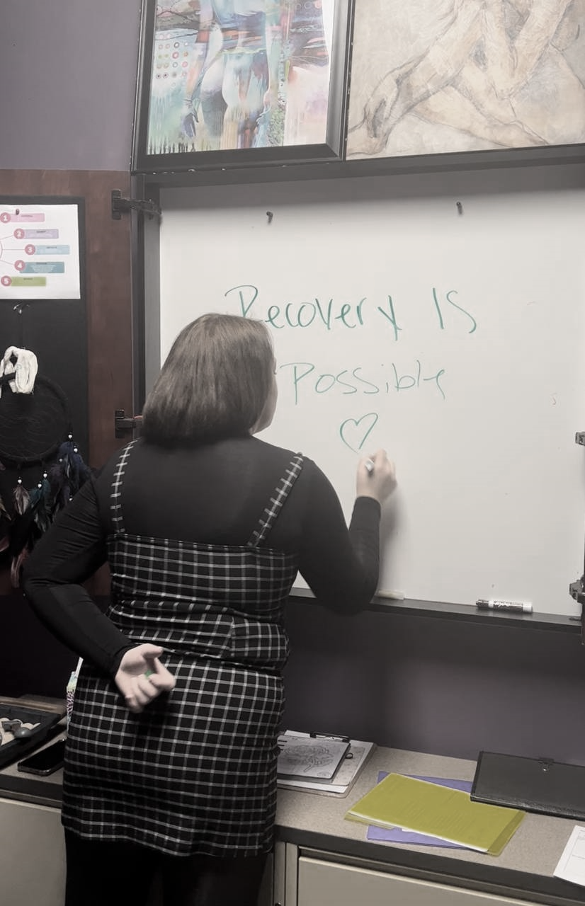
South Metro Community Services
Serving those in need, regardless
of a participants
desired recovery pathway.

Slide 2
Who we are
Program platform
The services we offer
Goals for the future

Slide 3

Who we are….
We are a growing nonprofit serving the south metro. We strive to connect individuals with substance use disorders to vital resources tailored to each persons unique needs. We fight together to empower autonomy and decrease stigma. Currently all of our services are FREE.

Slide 4
Basic Program Platform Peer Recovery services
1. Referral: Participant is referred
Participant is referred by an organization. Referral forms are user friendly and can be sent via email or fax. Information obtained from the referral is used to ensure that the participant is assigned a PRS that can most meet the participants immediate needs.
2. Initiate: PRS will initiate services
PRS’s can call, text or email the participant to schedule the first session. We have seen significantly higher successful first contact rates via text message.
3. Identify: In collaboration participant and PRS identify the participants needs.
In the first few sessions our PRS will help participants identify immediate needs in addition to goal setting. Participants needs are documented within initial well plan and recovery capital scale.
4. Provide: Provide participant identified resources and supports.
Recovery capital scale and well plan will be completed for each interaction.
5. Revisit: Participant goals and needs are revisited often within a continued care plan
6. Supervision: PRS’s take part in twice weekly staffing to ensure that their participants are receiving the best possible care. Scope of practice, participant concerns, and participant’s successes are evaluated with supervisor.
7. Communication with referrers: If safety is ever a concern PRS’s can communicate vital information to the referrer as deemed appropriate by supervisor.

Slide 5
A Definition
Our services…….
Peer Support

Slide 6
A Definition
Our services…….
Naloxone Training
SMCS offers life saving Naloxone training.
Are you in need of Naloxone?
SMCS partners with the Steve Rummler Hope Network
to prevent overdose and educate the community.

Slide 7
A Definition
Our services…….
INK-NITIAVE
We partnered with a Removery!
This exciting collaboration allows SMCS to connect individuals
to NO COST tattoo removal, no strings attached. Candidates for ink-nitiative do not have to be receiving other services from SMCS to qualify, nor do they have to have a SUD diagnosis. Healing can be even more
challenging when we wear our painful past on our skin daily. Simply send over a referral and we will take it from there.
Here are the qualifications for INK-NITIATIVE:
• Previously or are currently incarcerated
• Survivor of human trafficking/ Survivor of domestic violence
• Have a hate symbol or racist tattoo
• Former gang member

Slide 8
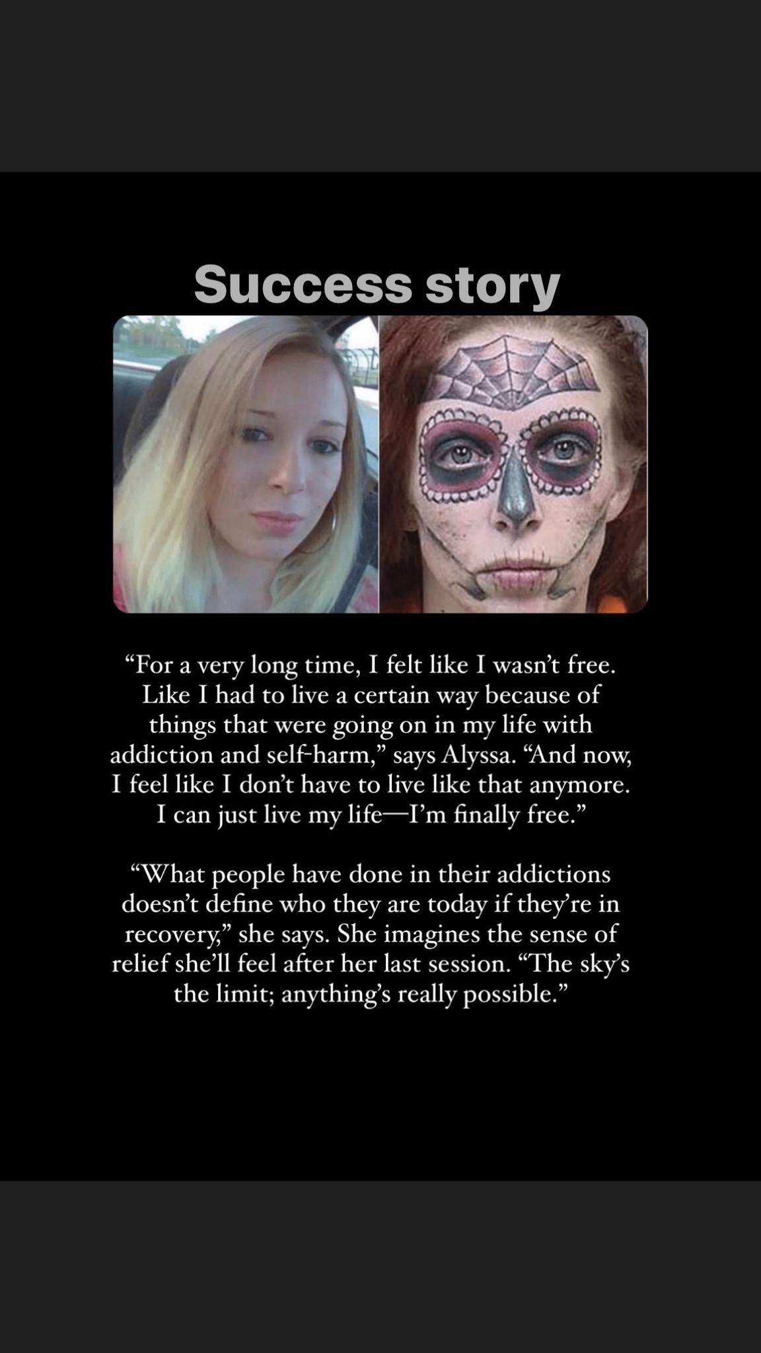
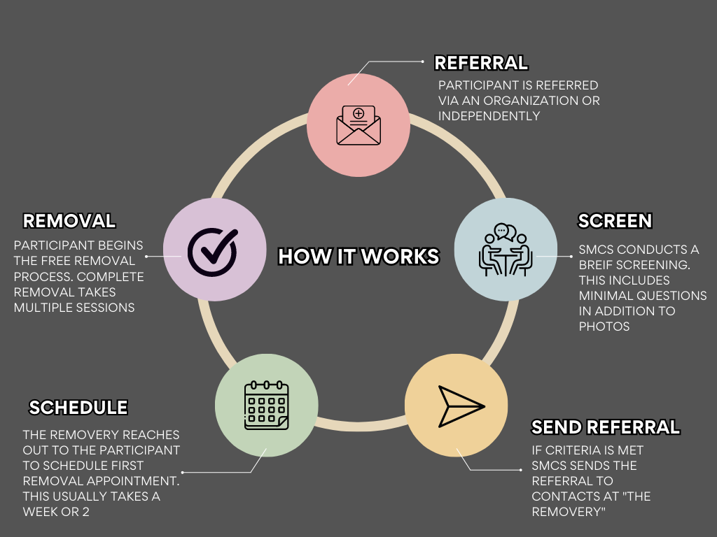
Screening process

Slide 9
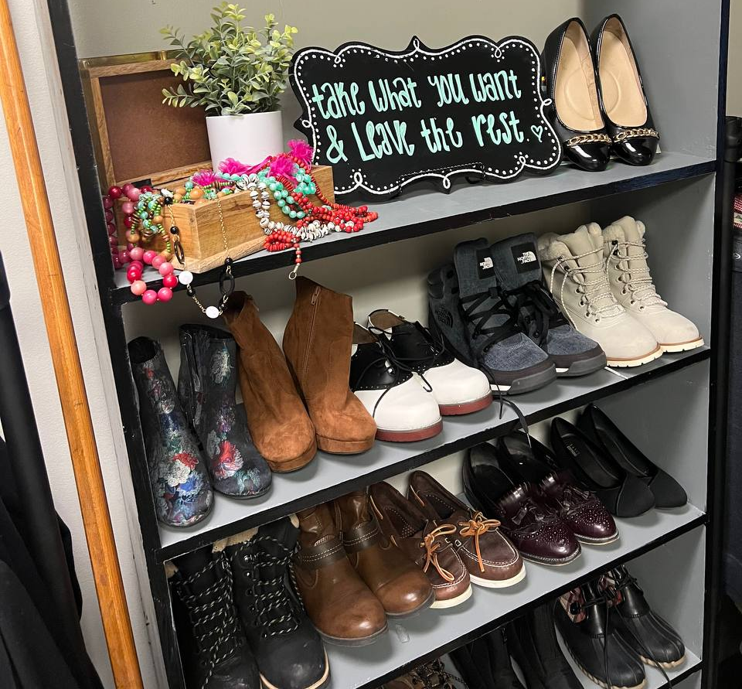
A Definition
Our services…….
Home Free Boutique
Home Free is a boutique style
donation site, Serving those in
need, those struggling and
succeeding in Recovery. With
a highlight in dignity our
boutique is filled with new and
gently used clothing, shoes,
linens and home goods of all
kinds.

Slide 10

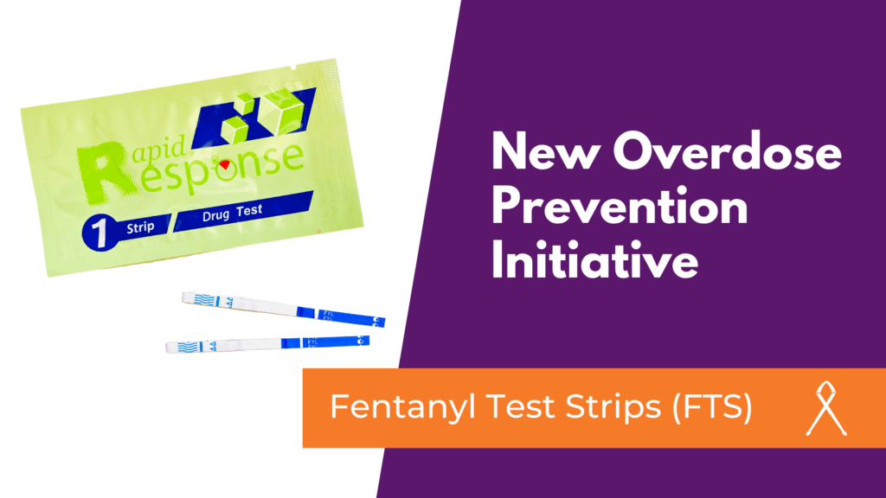
Goals for the future
PROVIDING CULTURALLY SPECIFIC RECOVERY SERVICES TO THE SHAKOPEE COMMUNUNITY
DECREASING FATAL OPIOD OVERDOSES
DISTRIBUTION OF FENTANYL TESTING STRIPS AND NALXONE TO SCOTT AND DAKOTA COUNTY
COMMUNITY NALXONE TRAINING

Slide 11
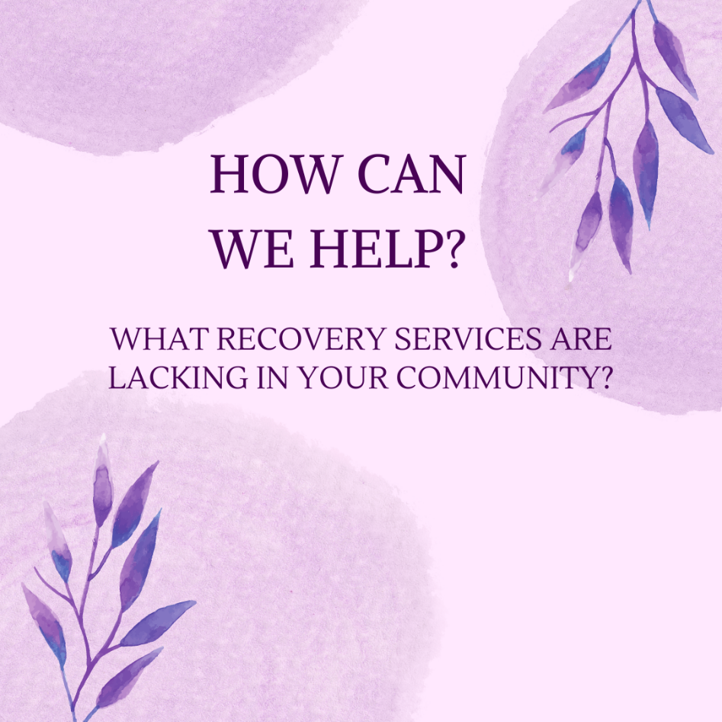

Slide 12
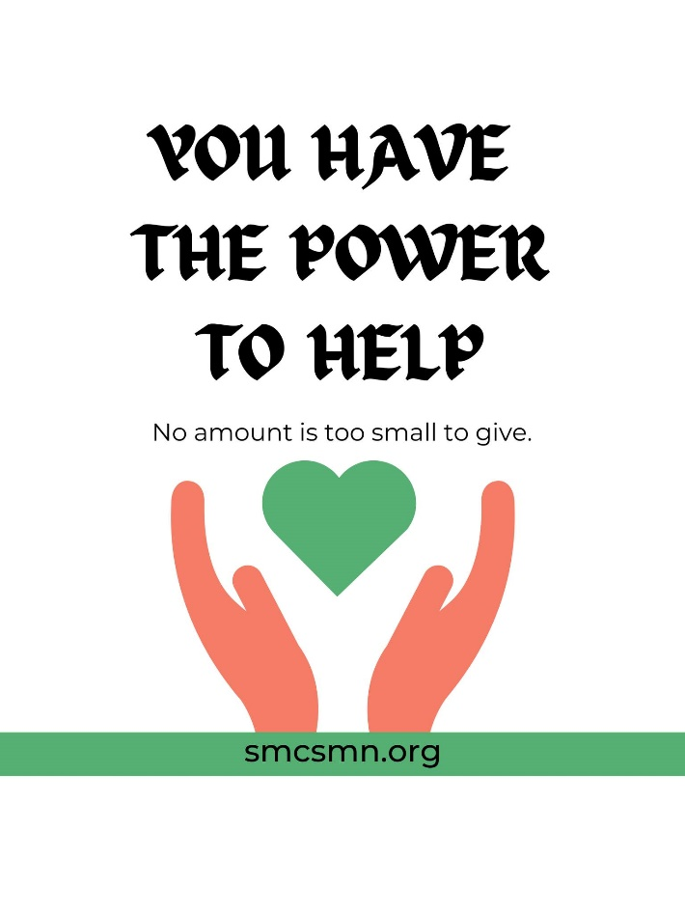
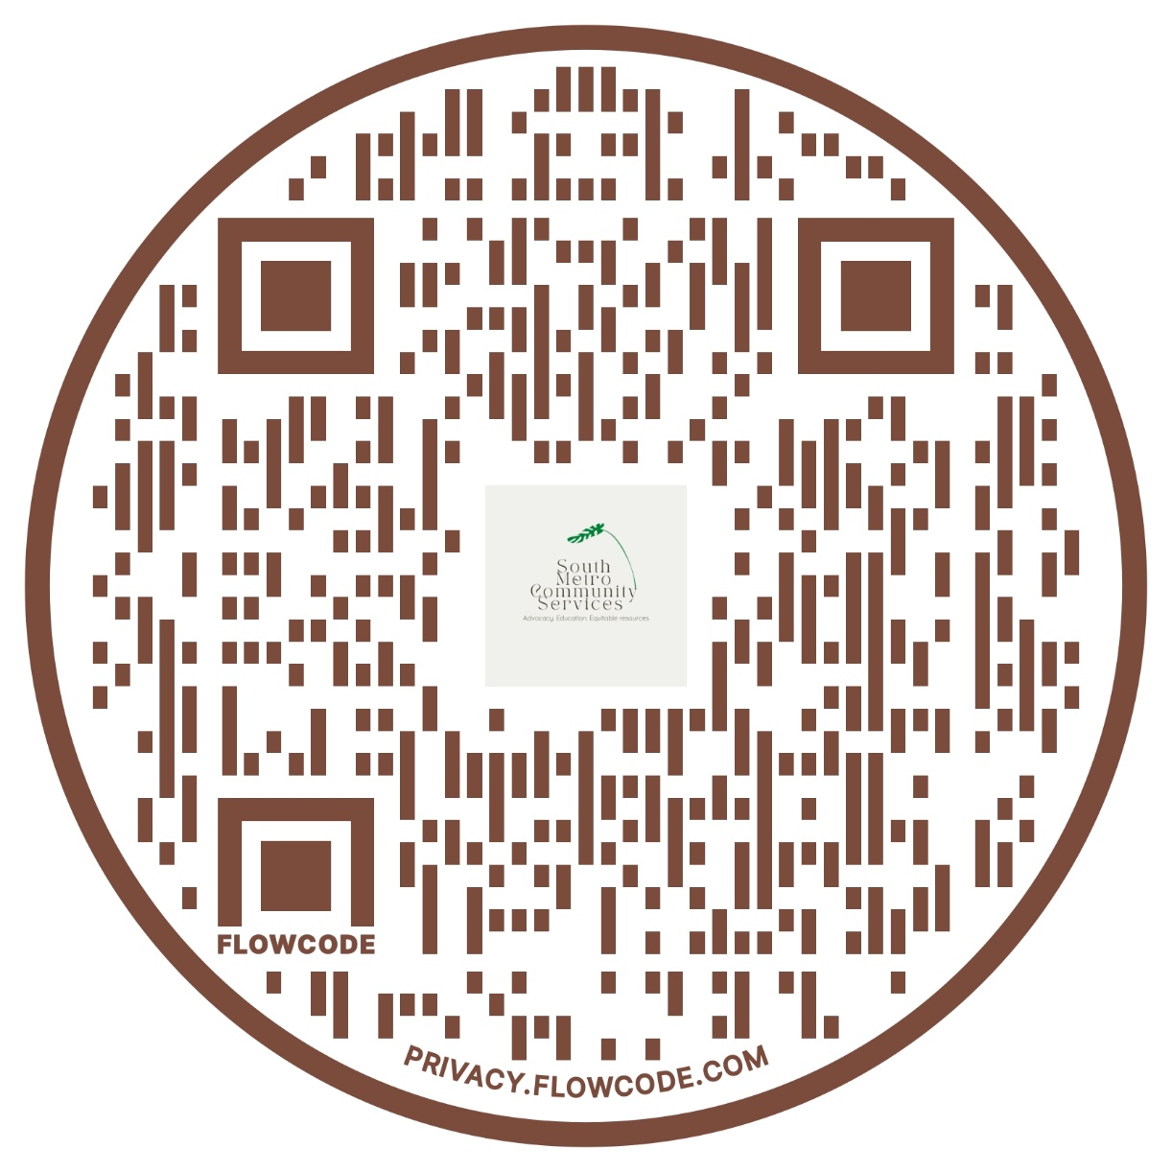
It takes a village

Slide 13
THANK YOU

