Slide 1
The Opioid Epidemic
Lisa Brodsky, Scott County Public Health

Slide 2
What are Opioids?
Medicines that relieve pain
Can be natural (from the poppy plant) or synthetic (man-made)
Common Prescription Opioids
Hydrocodone (Ex: Vicodin, Lortab); Oxycodone (Ex: OxyContin, Roxicodone, Percocet)
Commonly prescribed for a variety of painful conditions, including dental and injury-related pain
Morphine (Ex: DepoDur, Astramorph, Duramorph)
Often used before and after surgical procedures to alleviate severe pain
Fentanyl
50-100 times more potent than Morphine and Heroin; Used to treat severe pain, often in patch form
Codeine
Often prescribed for mild pain; Can also be used to relieve coughs and severe diarrhea

Slide 3
Signs of an Opioid Overdose
Immediately call 911, Use Naloxone
Opioids can interrupt the natural drive to breath
Small, constricted pinpoint pupils
Falling asleep or loss of consciousness
Slow, shallow breathing
Choking or gurgling sounds
Limp body
Pale, blue, or cold skin

Slide 4
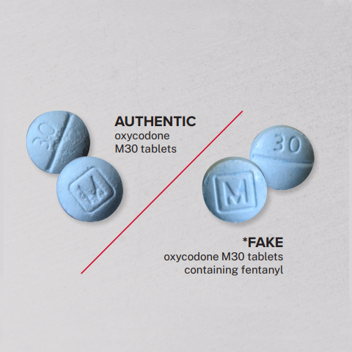
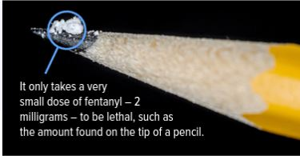
What is fentanyl?
2 forms-Pharmaceutical vs. illicit
Fentanyl is a potent synthetic opioid
Prescription opioids are powerful drugs with a high risk for dependency.
Fake pills are made to look like OxyContin®, Xanax®, Adderall®, and other pharmaceuticals.
Fentanyl is 80-100x stronger than morphine. 50x stronger than heroin.
A potentially lethal dose of fentanyl is the size of 2 grains of salt.
Notes:
The drug landscape is dramatically more dangerous today, or even from just a few years ago
The street supply of “prescription” pills has been flooded with fakes made with fentanyl.
Fentanyl is a powerful synthetic opioid that is up to 50 times stronger than heroin and 100 times stronger than morphine. It comes in two forms - prescription and illicitly-manufactured. Illicitly-manufactured fentanyl (IMF) is driving much of the increase in overdoses seen in Minnesota and nationally in recent years. The content on this page refers to illicitly-manufactured fentanyl.
Cheap ingredients, big profits
Easy to make in big batches
Powerful=small
Easy to hide & smuggle
No quality= inconsistent dose
What are fake pills? — The Sinaloa Cartel and Cartel de Jalisco Nueva Generacion are making fentanyl and pressing it into fake pills. Fake pills are made to look like OxyContin®, Xanax®, Adderall®, and other pharmaceuticals. These fake pills contain no legitimate medicine. — Fentanyl is also made in a rainbow of colors so it looks like candy.

Slide 5
National Trends
Data: CDC WONDER, 2012-2021.
Notes:
The number of Minnesotans that have experienced a nonfatal overdose or died from an opioid overdose has been increasing since 2000.

Slide 6
National Drug-Involved Overdose Deaths

Slide 7
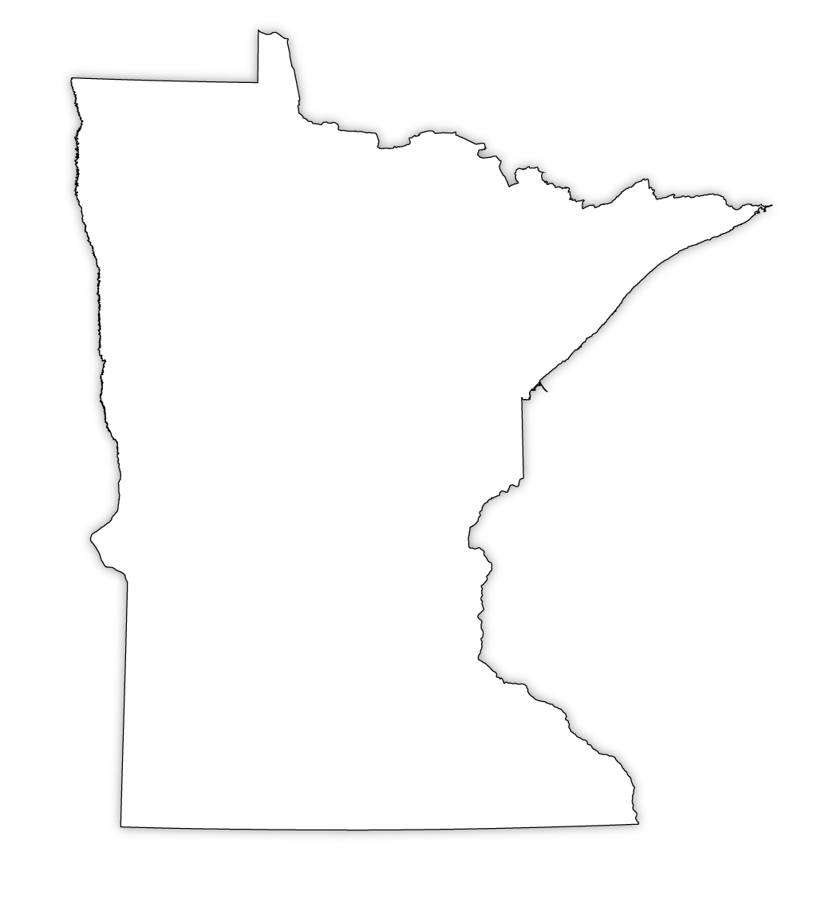
Opioid Overdose Deaths Statewide
6,546
Opioid involved overdose deaths since 2000
Notes:
6,546 since 2000

Slide 8
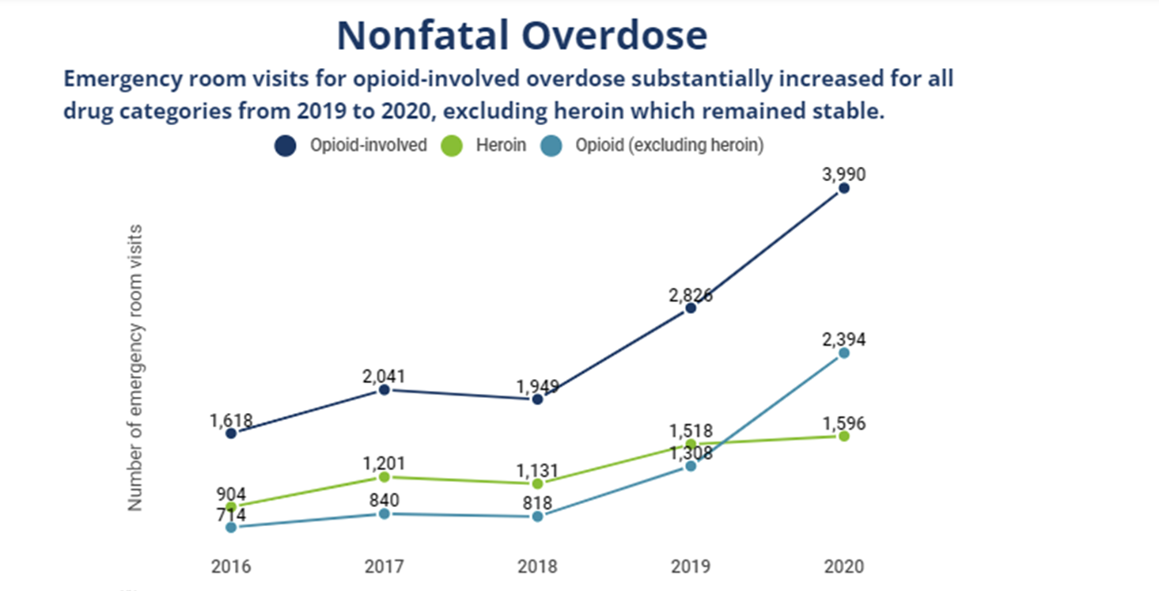
Nonfatal Overdoses Statewide
Notes:
2021

Slide 9
Scott County Opioid Overdose Deaths

Slide 10
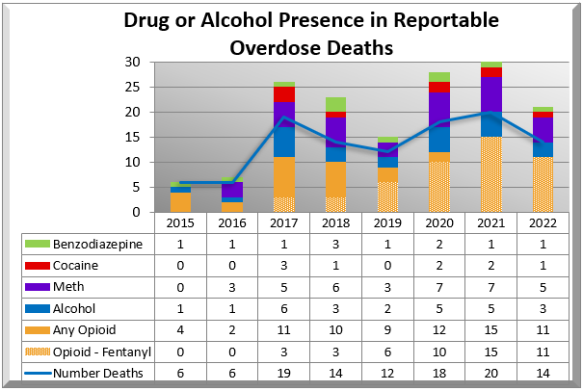
Scott County Overdose Deaths
Notes:
Source: Minnesota death certificates

Slide 11
The number of high school students reporting heroin use has doubled in the past 10 years.
Source: Youth Risk Behavior Surveillance System (YRBS) – Centers for Disease Control and Prevention (CDC)
Notes:
The landscape is changing

Slide 12
9 out of 10 people who meet the clinical criteria for substance use disorders involving nicotine, alcohol or other drugs began smoking, or drinking or using other drugs started using alcohol and marijuana before they turned 18.
Source: “Adolescent Substance Abuse: America’s #1 Public Health Problem”
National Center on Addiction and Substance Abuse at Columbia University, June 2011National Survey on Drug Use and Health , 2015 and 2016

Slide 13
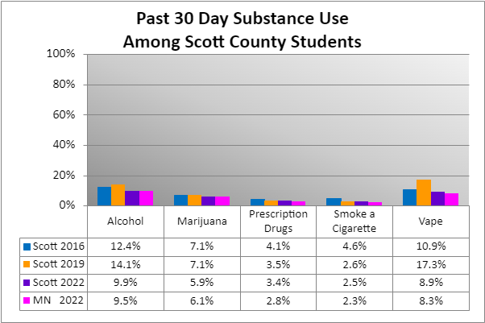
Past 30-Day Substance Use
Notes:
Minnesota Student Survey data

Slide 14
Nearly half of young people who use heroin report abusing prescription pain killers before starting heroin.
Source: National Institute of Health (NIH) Research Report Series: Heroin, November 2014.
Notes:
The landscape is changing – more and more young people are abusing opoiids

Slide 15
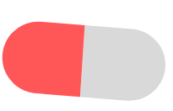
Prescription drugs misuse
Use prescription drugs with a doctor’s prescription at least once in the past 30 days
MN
3.0%
11th Grade
9th Grade
MN
2.9%
MN
2.8%
8th Grade
Notes:
MN 2022
5th graders (1% male ; 1% female)
8th graders (82% male ; 87% female)
9th graders (83% male ; 87% female)
11th graders (84% male ; 91% female)

Slide 16
Ease of Access
Parent Survey, 2020
Notes:
It is easy for youth to get substances in my community-Marijuana rose to the top at 67% followed closely by tobacco then alcohol

Slide 17
Parents talking to their child
Parent Survey, 2020
Notes:
Have talked to my child about the potential negative consequences of substances-Most talked about was using alcohol while least talked about was using prescription drugs not prescribed to them.

Slide 18
Access in the Home
Parent Survey, 2020
Notes:
It is likely that my child could access substances in my home without my knowledge-52% of parents said their kids could access alcohol without their knowledge

Slide 19
% of students who think substance use is risky
Perceived risk of vaping increased while risk of all other substances decreased

Slide 20
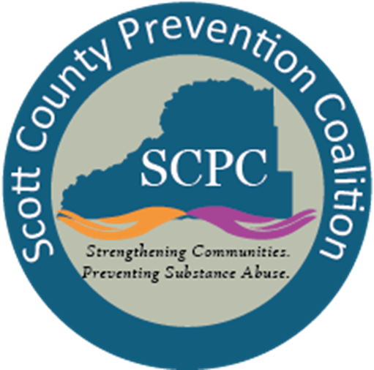
Scott County Prevention Coalition
5-year grant (2019-2024)​ that targets community change
Office of National Drug Control Policy
Drives community leaders to identify and respond to the top drug problems unique to their community and change local community environmental conditions tied to substance use.​
Goals:​
Increase community collaboration​
Decrease youth substance use and misuse
Notes:
Youth alcohol and drug use continued to pop up as the most concerning health issue in our county. As a result, Scott County Public Health applied for (and received) a five-year federal grant to help combat this issue, through the Drug Free Communities Support Program. The premise of the grant is that “local issues need local solutions”.
5-year grant (2019-2024)-Started in 2019 and goes until 2024, it comes out of the Office of National Drug Control Policy.
DFC grant recipients drive community leaders to identify and respond to the top drug problems unique to their community and change local community environmental conditions tied to substance use.
The Scott County Prevention Coalition works on these matters and meets bi-monthly to strengthen the framework among local partners to prevent and reduce substance use among middle and high school youth.
Goals:
Increase community collaboration
Decrease youth substance use and misuse
SCPC-
Youth
Parents
Businesses
Media
School
Youth-serving organizations
Law enforcement
Religious/fraternal organizations
Civic and volunteer organizations
Healthcare professionals
State, Local, and Tribal governments
Other organizations involved in reducing illicit substance use

Slide 21
7 Strategies of Community Change
Providing Information
Enhancing Skills
Providing Support
Reducing Access & Enhancing Barriers
Changing Consequences
Physical Design
Educate and Inform about modifying/changing laws or policies
Notes:
DFC grantees use these 7 strategies and its activities across the country to effectively prevent and reduce youth substance use.
Providing Information – Educational presentations, workshops or seminars or other presentations of data (e.g., public announcements, brochures, dissemination, billboards, community meetings, forums, web-based communication).
Enhancing Skills – Workshops, seminars or other activities designed to increase the skills of participants, members and staff needed to achieve population level outcomes (e.g., training, technical assistance, distance learning, strategic planning retreats, curricula development).
Providing Support – Creating opportunities to support people to participate in activities that reduce risk or enhance protection (e.g., providing alternative activities, mentoring, referrals, support groups or clubs).
Enhancing Access/Reducing Barriers- Improving systems and processes to increase the ease, ability and opportunity to utilize those systems and services (e.g., assuring healthcare, childcare, transportation, housing, justice, education, safety, special needs, cultural and language sensitivity).
Changing Consequences (Incentives/Disincentives) – Increasing or decreasing the probability of a specific behavior that reduces risk or enhances protection by altering the consequences for performing that behavior (e.g., increasing public recognition for deserved behavior, individual and business rewards, taxes, citations, fines, revocations/loss of privileges).
Physical Design – Changing the physical design or structure of the environment to reduce risk or enhance protection (e.g., parks, landscapes, signage, lighting, outlet density).
Modifying/Changing Policies – Formal change in written procedures, by-laws, proclamations, rules or laws with written documentation and/or voting procedures (e.g., workplace initiatives, law enforcement procedures and practices, public policy actions, systems change within government, communities and organizations).

Slide 22
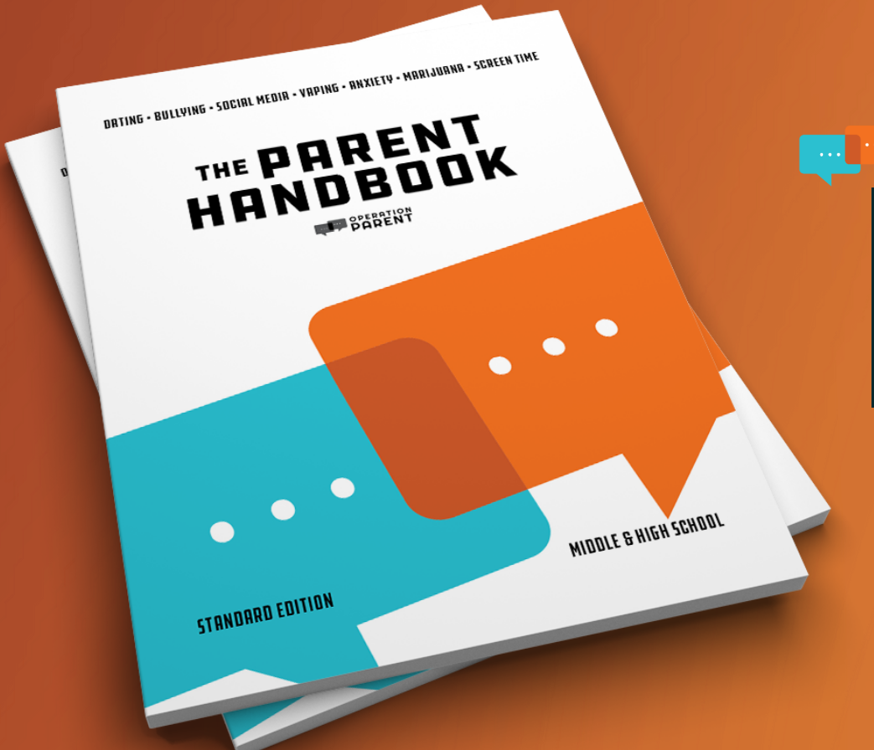
Current Coalition Activities
Talk Tin Distribution (Conversation starters for families)
Operation Parent Handbook distribution-English and Spanish
CAPS & SADD student partnerships
Community Naloxone Training and Substance Use Prevention Education at Shakopee High School
Creating a Student advisory committee
Resource bags: Naloxone and fentanyl test strips in the jail (UCARE)
Congratulate & Educate Checks
Sticker Shock Educational Campaign
Notes:
Talk Tin-The Power of Family Dinners and Just Talking with kids
Research shows that children and teens who have frequent family dinners:
• Are at half the risk for substance abuse compared to teens who dine with their families infrequently
• Are less likely to have friends or classmates who use illicit drugs or abuse prescription drugs
Ordered Operation Parent Handbooks-easy-to-read, visually appealing, guide for parents raising kids. Raise your awareness on today’s toughest parenting issues: INCREASING protective factors, alcohol, tobacco, marijuana, prescription drugs, opioids, dating, parties, sleepovers, gaming and more.
Continue hosting CAPS internships
Community naloxone training and Substance Use Prevention Education event at Shakopee High School in December with Know the Truth Prevention program-The Know the Truth™ program (KTT) is a substance use prevention program designed for teenagers and young adults. The program is operated by the Mn Prevention & Recovery Alliance and is delivered to middle and high school students throughout Minnesota as part of the schools’ health class curriculum.
Hoping to form a student advisory committee to really make it a youth led effort
Partnering with the jail on an initiative to give inmates released from the jail resource bags that include hygiene essentials with naloxone and fentanyl test strips. First doing a pilot in December.
Continue congratulate and educate checks-tobacco checks that are educational in our community.

Slide 23
Billboard Campaign
Notes:
Going south on 169 in Jordan
Billboard Campaign-Create awareness on the importance of parents talking to teens about substance use and reminding them to lock up any substances they have. The second billboard that went up in October is from the DEAs one pill can kill campaign.

Slide 24
DFC prevention resources
The Parent Handbook: Operation Parent (English and Spanish available) Middle & High School edition, Elementary School edition
Distributed at Scott County libraries, chemical health specialists/LADC’s in schools, school nurses, daycares
Let’s Talk Tins: Conversation Starters for Families (English & Spanish)
Get kids talking…and build skills at the same time! Our talk tin is filled with 120 open-ended questions that help teens and parents talk about their feelings, ideas, dreams and more!
Deterra Drug Deactivation Kits
Safe, permanent disposal of unused prescription and over the counter medications.

Slide 25
Harm reduction strategies
Naloxone-Reverses opioid overdose
Cannot self administer
Administer ASAP, may need multiple doses
Not harmful if given in error
Call 911, effects wear off
Good Samaritan Laws
Fentanyl Test Strips-Detect the presence of fentanyl in drug samples prior to use.
FTS are now legal to possess, carry, and distribute in Minnesota and are an important tool to prevent drug overdose.
FTS should be considered one ‘tool’ in the ‘toolbox’ of effective drug overdose prevention strategies.
Notes:
New drug trends-Xylazine
Xyzaline now is a new drug; in 2022, 23% of fentanyl powder pills contained this and Narcan cannot reverse

Slide 26
Thank you! Questions or comments?

