Slide 1
Community, Support, Solidarity and Friendship

Slide 2
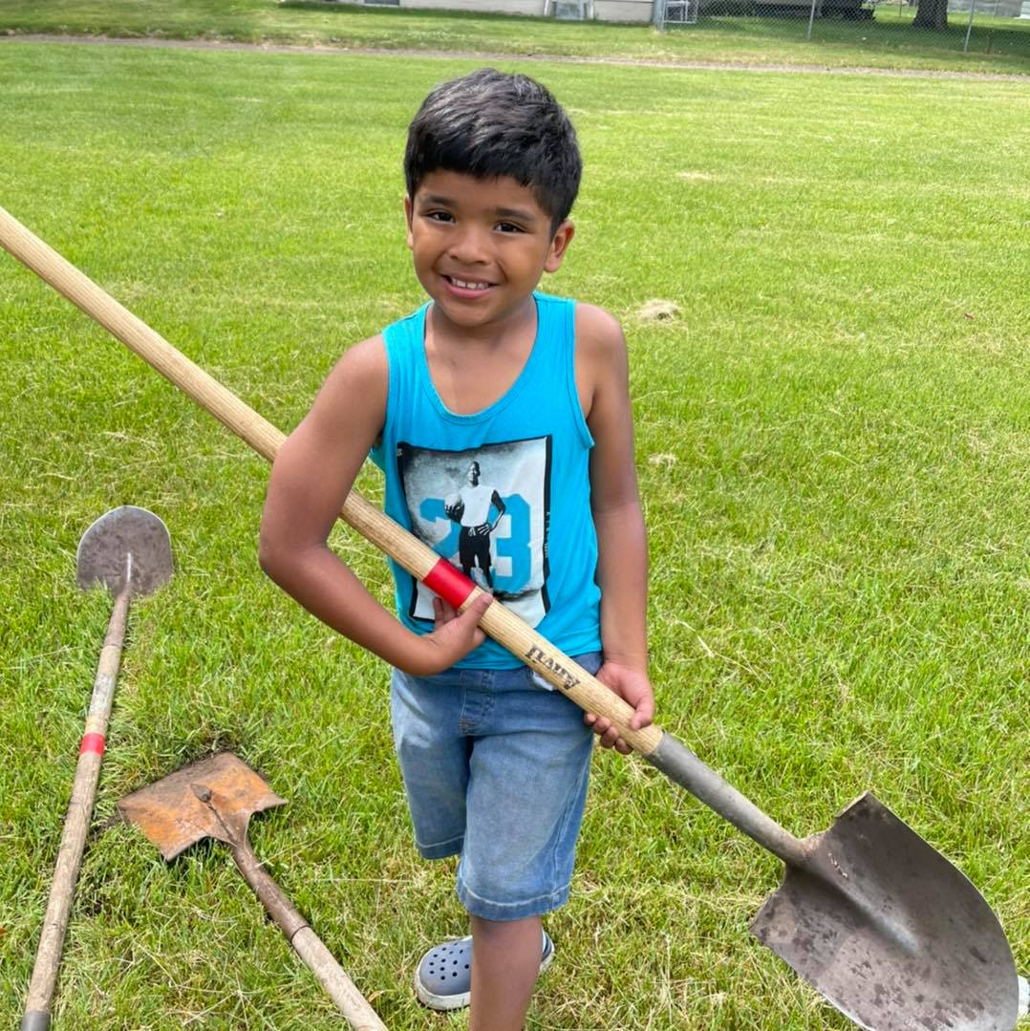
Agenda
We are….
A Latino organization promoting social advancement, economic fairness and welfare. While fostering and bolstering our culture and inherent capabilities.
Our goal is to uplift our community and create leadership for a systemic change.

Slide 3
Mi C.A.S.A Team
Debbie Aceves Project Coordinator
Lupita
Morales Assistant Director
Veva
Garcia Social media
Volunteer Coordinator
Astrid Martinez Project Coordinator
Yuni Montoya
Activities Director

Slide 4
What we do
Summer Camp
Cultural food distributions
Mental Health Awareness
Domestic Violence Awareness
Community Events
Sports /Activities
Workforce Ready Youth

Slide 5
Mi C.A.S.A
Due to the Coronavirus pandemic, food insecurity among Latinos rose, Latinos were 2.5 times more likely to experience food insecurity than white individuals. Latino children were more than twice as likely to live in food-insecure households as white children.
As of today, in partnership with Scott County SHIP, Second Harvest Heartland and the Sanneh Foundation, we have served 12,044 children and 12,293 18+ in Scott County through our food distributions.

Slide 6
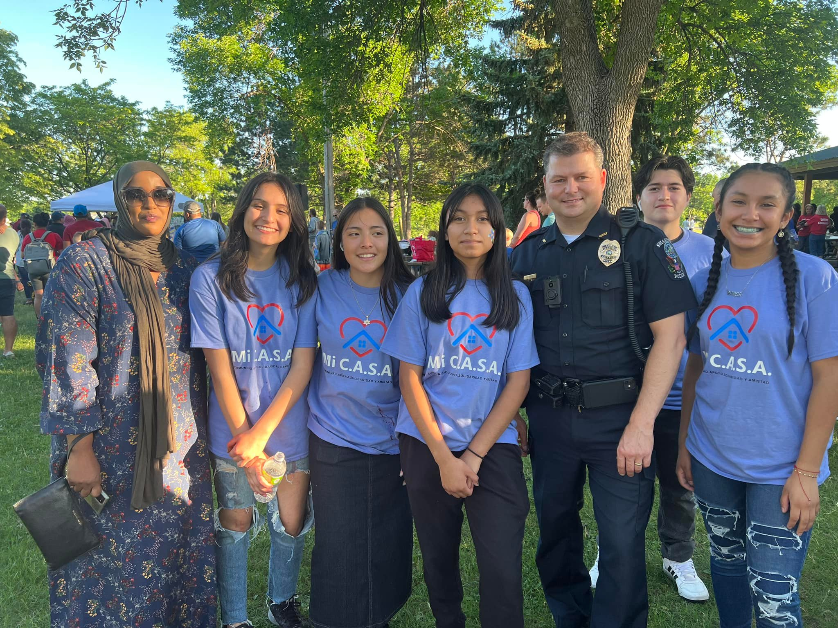
Belonging
We work with our Shakopee Schools students and provide volunteers opportunities while creating a sense of belonging and inclusion.
In partnership with Scott County SHIP, HEART, Parks & Rec, City of Shakopee and SMSC.
Events such as:
Picnic with the police
Tree lighting
Egg hunt
Holiday tree lighting
Spooky Family Fun
Shak-O-Lantern
Backpack and supplies distribution
Food distributions

Slide 7
Scott County Sheriff
The partnership with St. Francis Regional Medical Center, Community Education and Mi CASA can help close the educational gaps facing the Latino population in our community. Our collaboration helps develop strategies and programs intended to increase the education attainment levels in our Latino community.
100 students attended our camp this summer ☺

Slide 8
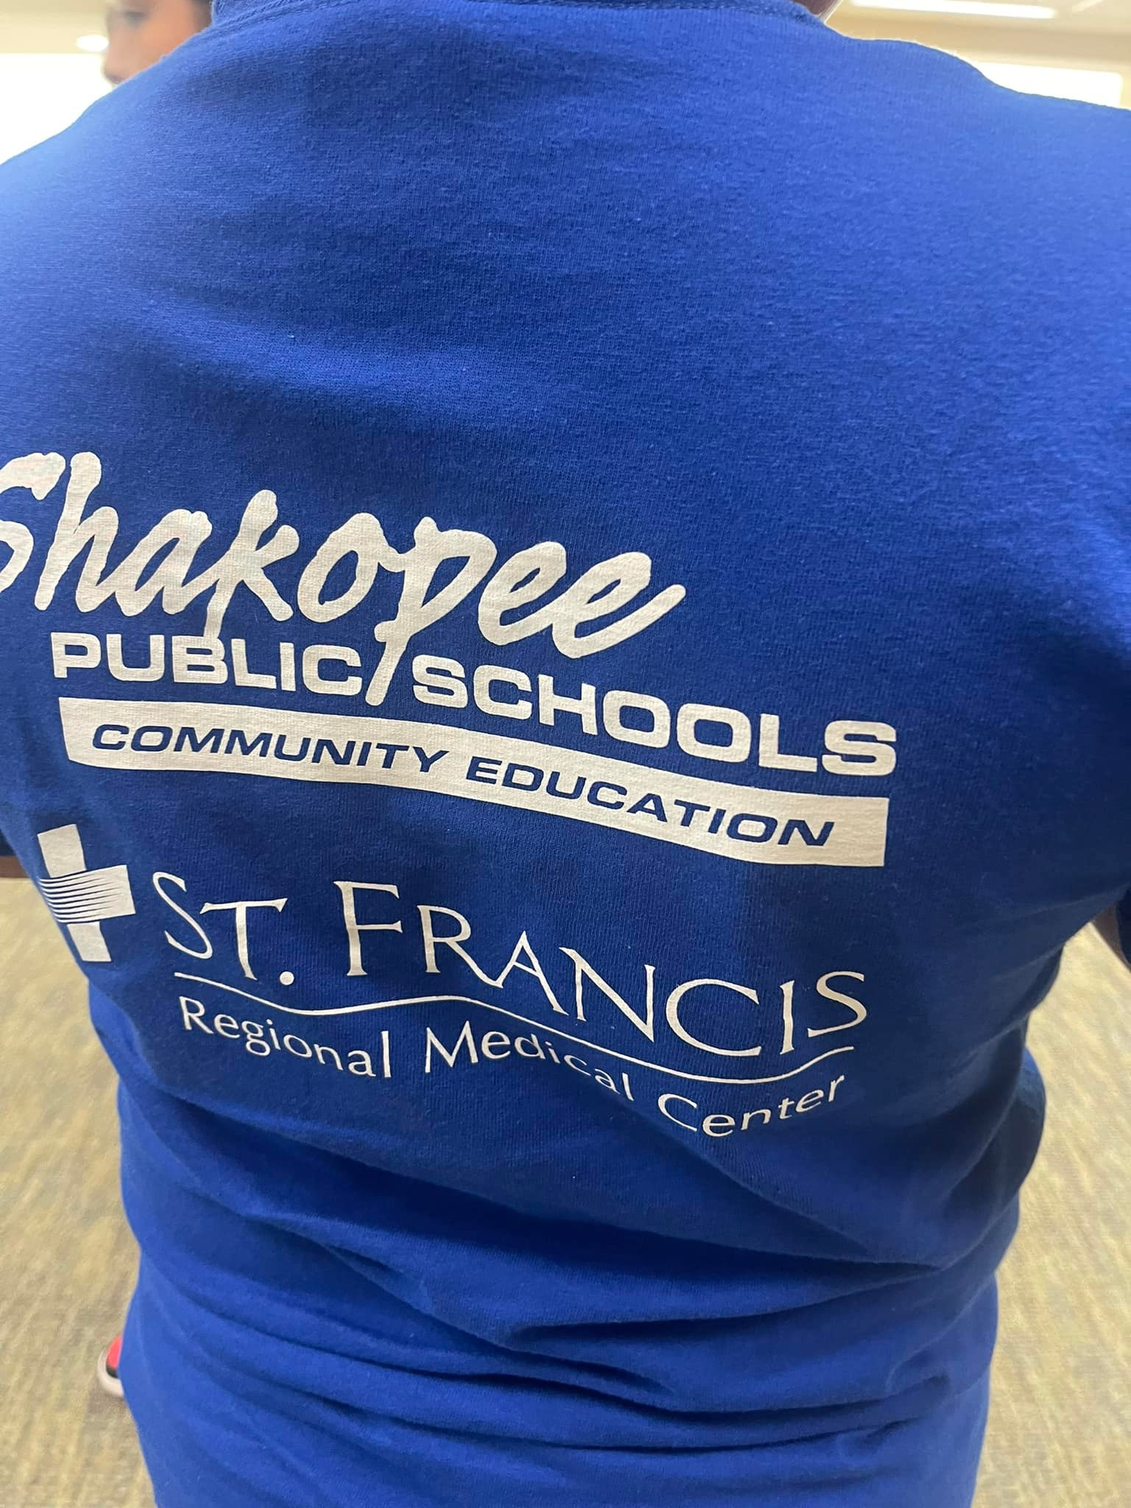
Working together will increase student interest in the academic and career planning goals, provide work experience, skills and generates an income for Youth.

Slide 9
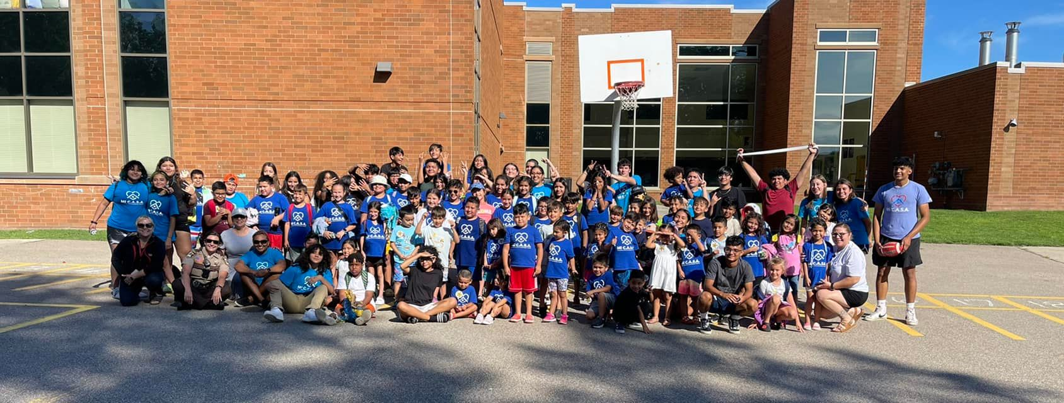
Summer camp 2022 St Francis Regional Medical Center, Shakopee Community Education

Slide 10
Summary
We are a group of mothers, from the community, working for the community to enrich our youth and the community where we reside.

Slide 11
Gracias, esto no seria posible sin ustedes.
Thank you to our partners
Scott County Public Health
Scott County Law Enforcement
Shakopee Public Schools
City Of Shakopee
St. Francis Regional Medical Center
HEART Response team

