Slide 1
City of Shakopee Equity and Diversity
September 8, 2022

Slide 2
Formalizing Priorities
Leadership Strategic Planning Process
Financial Stability
Enhancing Community Strengths
Effective Public Services
Communication
Establishment of Equity Committee
GARE Cohort
Staff Trainings

Slide 3
Goals in GARE Participation
Raised awareness
New organizational knowledge and learning
A tool to use to evaluate decisions in the context of racial equity
From participants - better means of engaging with all people in our community regardless of race
From participants – the cohort made us more conscientious overall, not just related to racial equity

Slide 4
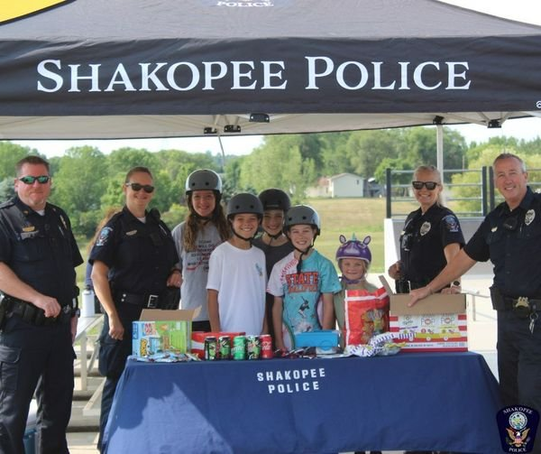
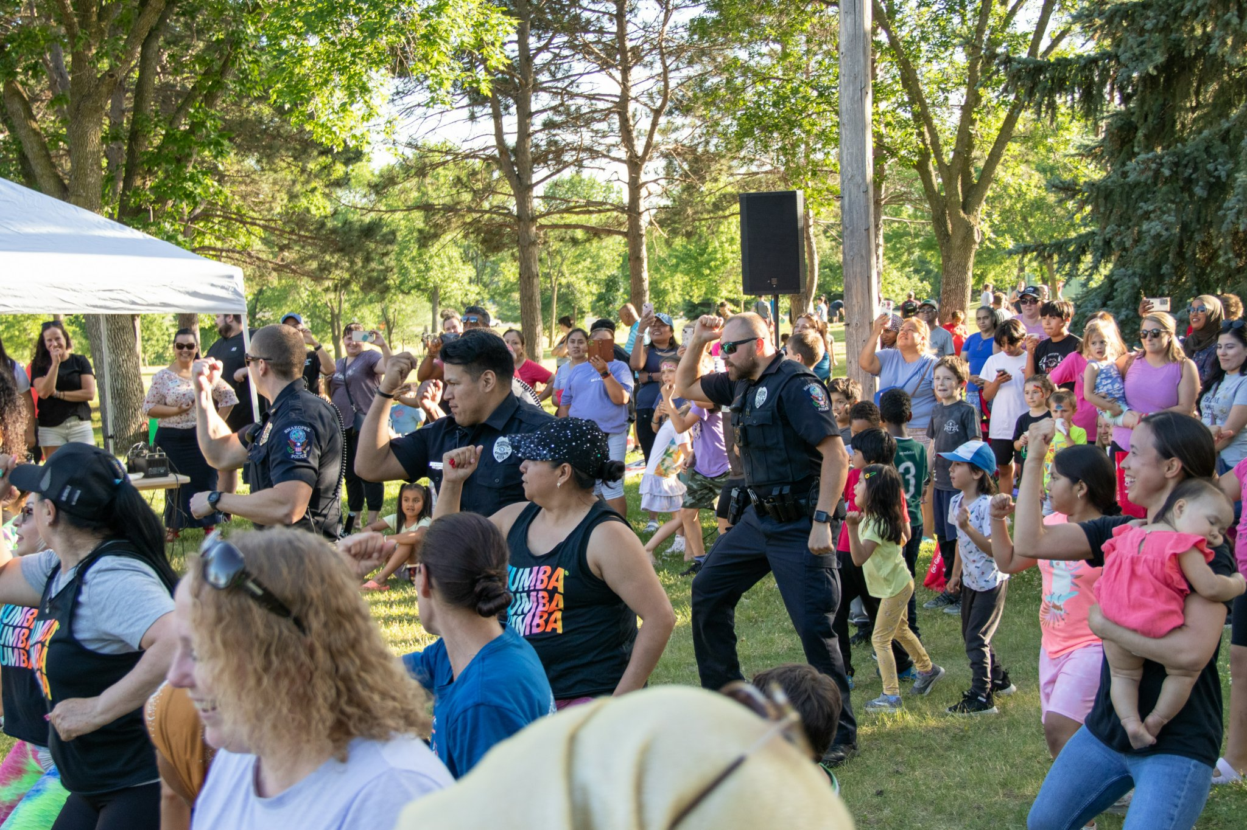
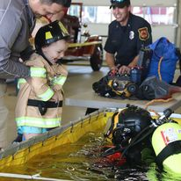
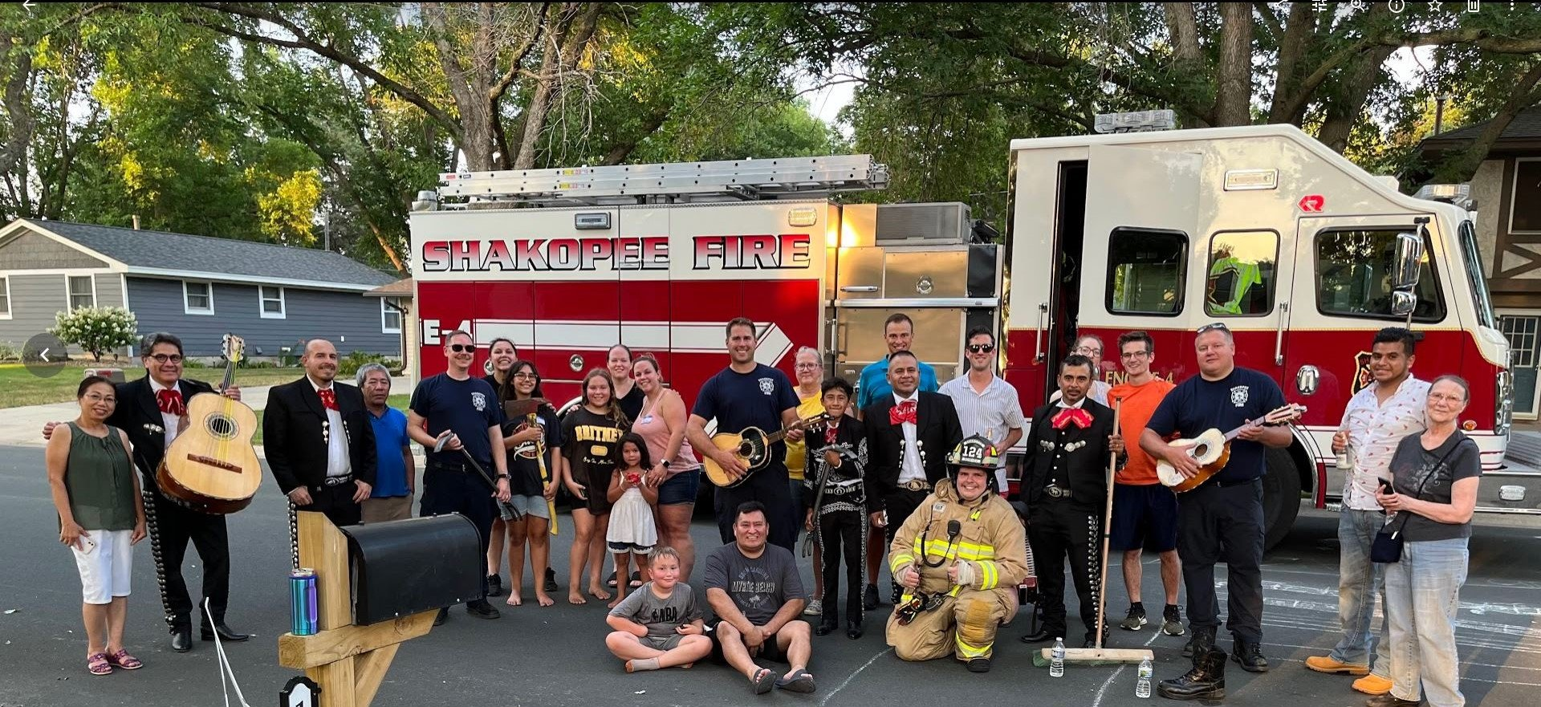
Community Engagement & Partnerships
Notes:
Night to Unite, Picnic with Police, Pop up Splash Pad, Pop up informational meetings (parks, developments), Beers with Bill, Coffee with the City, Pop up Splash Pad, Pop with Police, Shop with a Cop

Slide 5
Thank You!

