Slide 1
Advocates For Thriving Communities
Sahra M. Odowa, MPH, eXEcutive director

Slide 2
Mission and Values
To achieve positive health and wellness outcomes for the communities we serve.
We are building an interdependent system to address local issues; provide opportunities to residents in employment, health and wellness; and to promote sustainable livelihoods for generations to come.
We collaborate locally to share resources and to jointly plan, implement, and evaluate programs to achieve a common vision and collection of data to aid a thriving future.

Slide 3
About Us
November 6th 2021, AFTC Open House
We are an organization that consists of health professionals, educators and community members working together to empower community residents and to provide essential tools for healthy lifestyles. We provide the latest public health information and resources to promote individual and community wellness. We believe every community resident deserves to thrive, and we work to ensure that opportunities to do so are available and accessible.

Slide 4
Barriers
Language and cultural barriers
Navigating the healthcare system
Fear of accessing programs and services
Increased mental health needs
Less coverage and benefits from employers
Housing challenges

Slide 5
Our Work

Slide 6
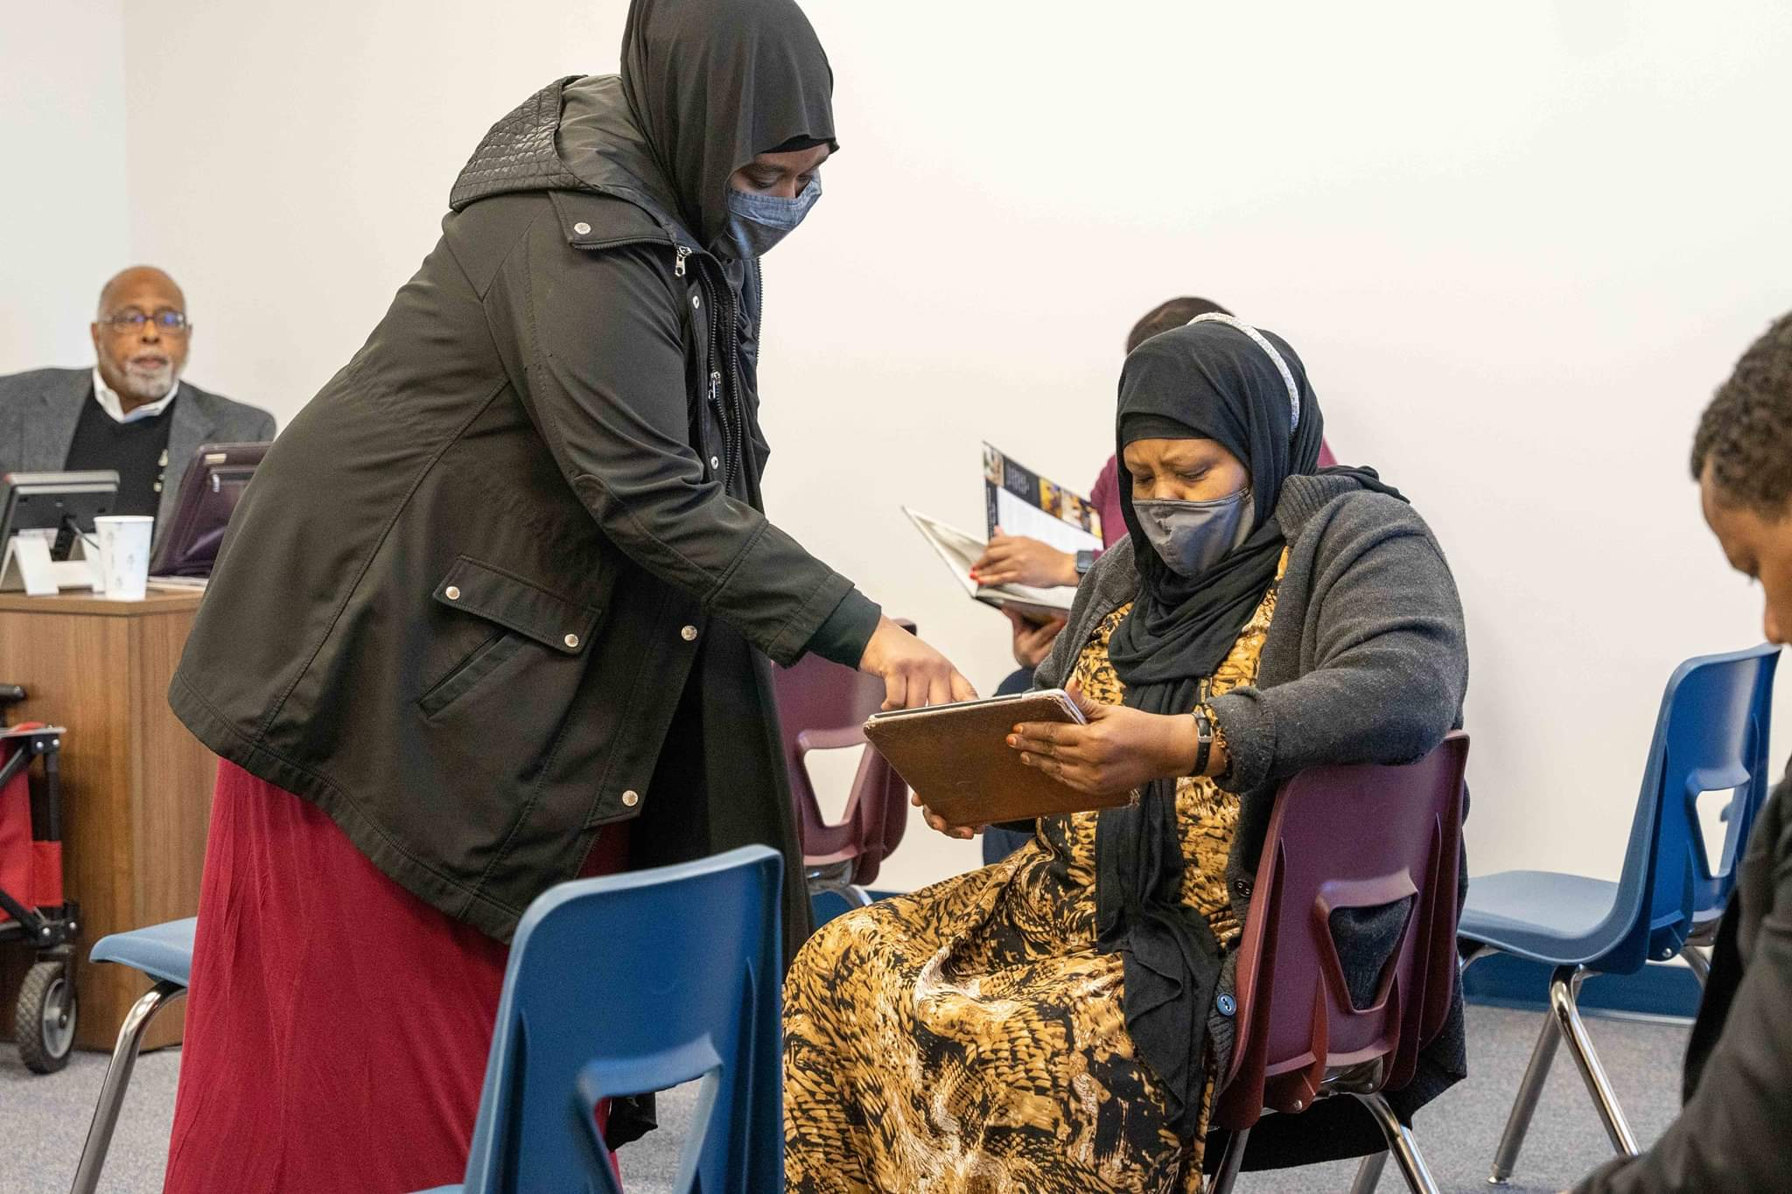
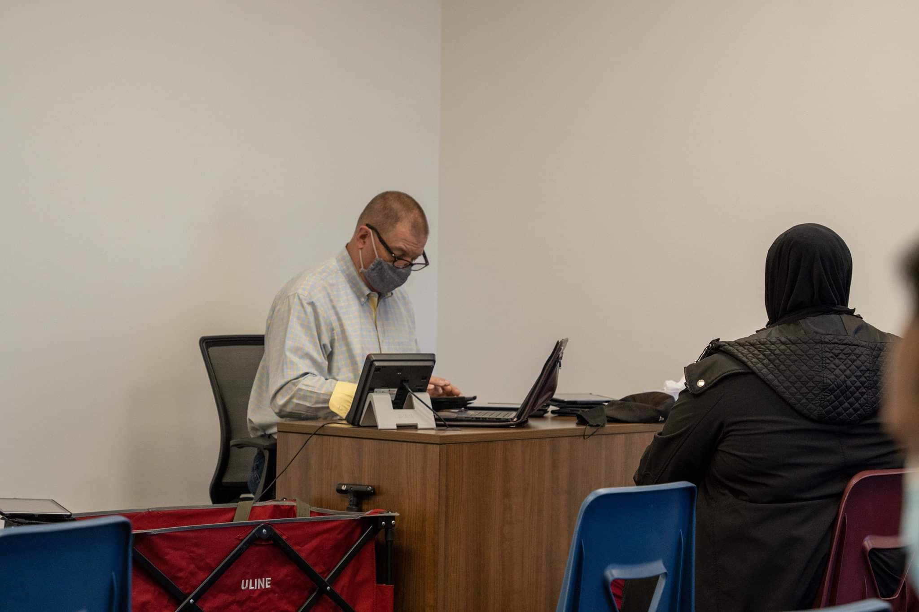
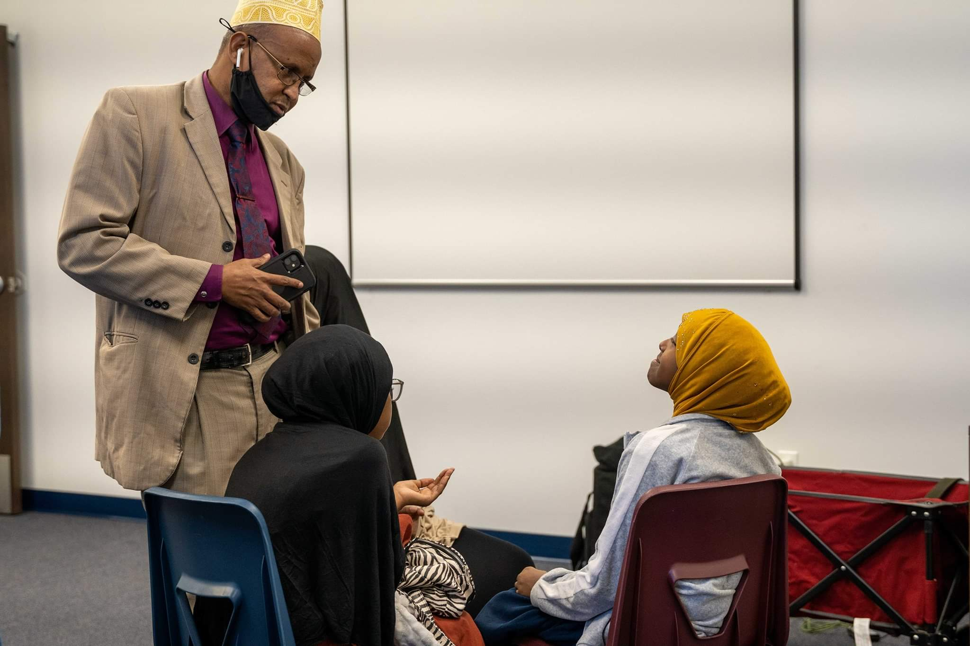
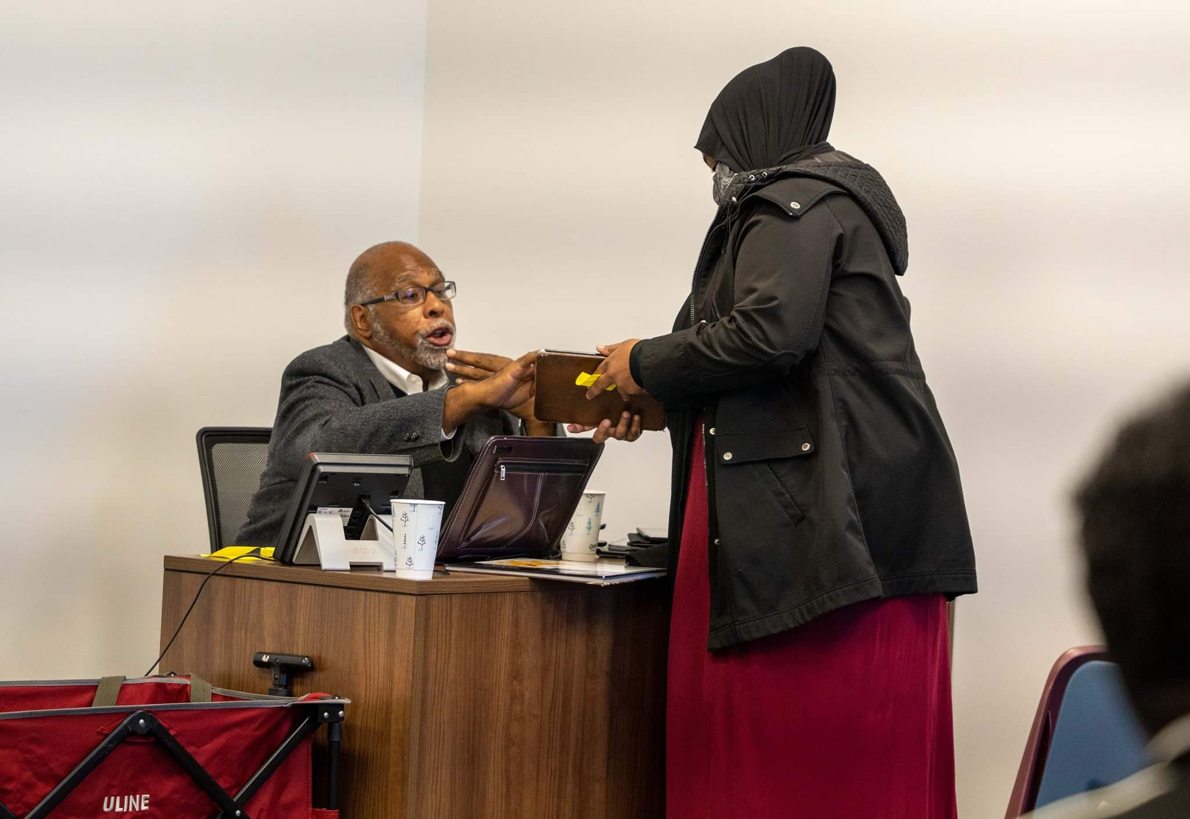
My Strength, My Health Survey
Strengths-based approach
Data to go back to the community to help facilitate real change at the community level

Slide 7
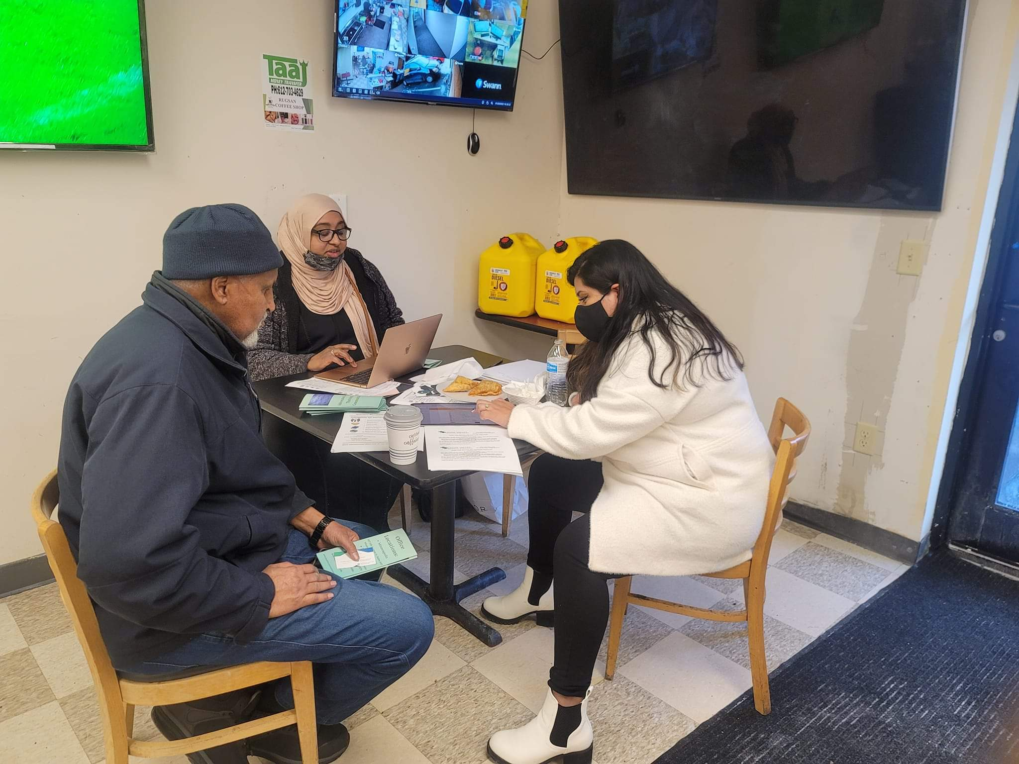
My Strength, My Health Survey (Part 2)

Slide 8
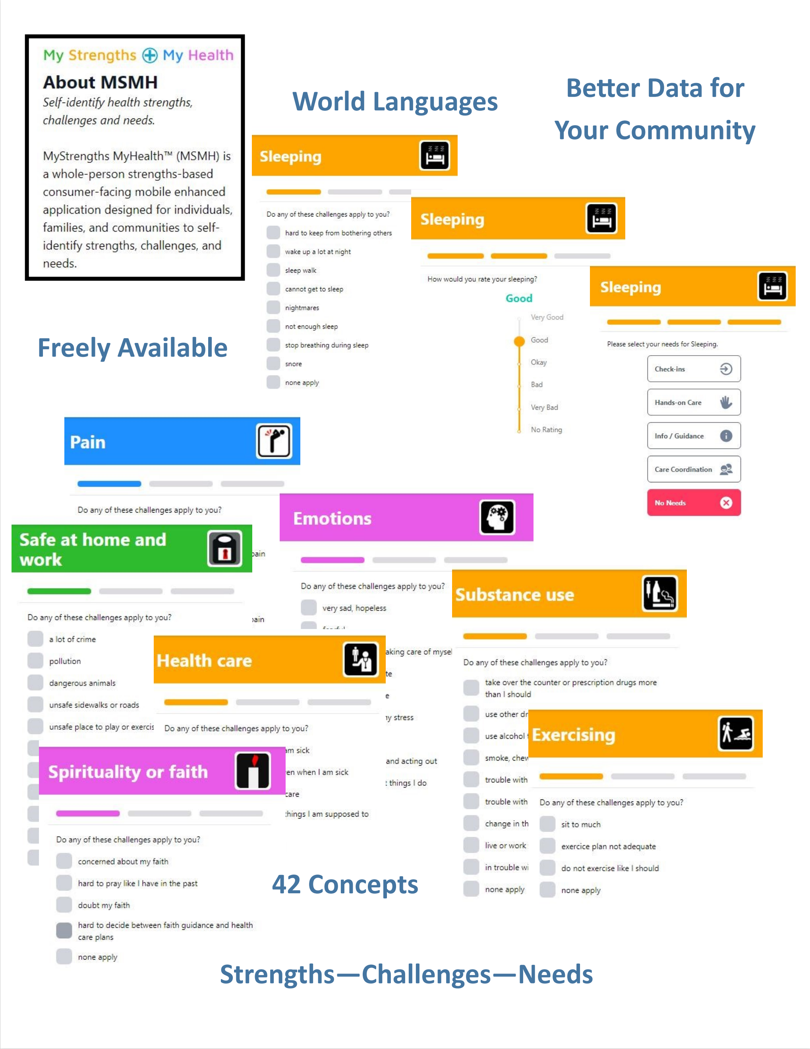
MyStrengths+MyHealth research survey from the University of Minnesota School of Nursing.
Online Survey
Information collected is intended to be “foundational”.
Data used to identify the strengths of the community and demonstrated needs/challenges.
MyStrengths+MyHealth App

Slide 9
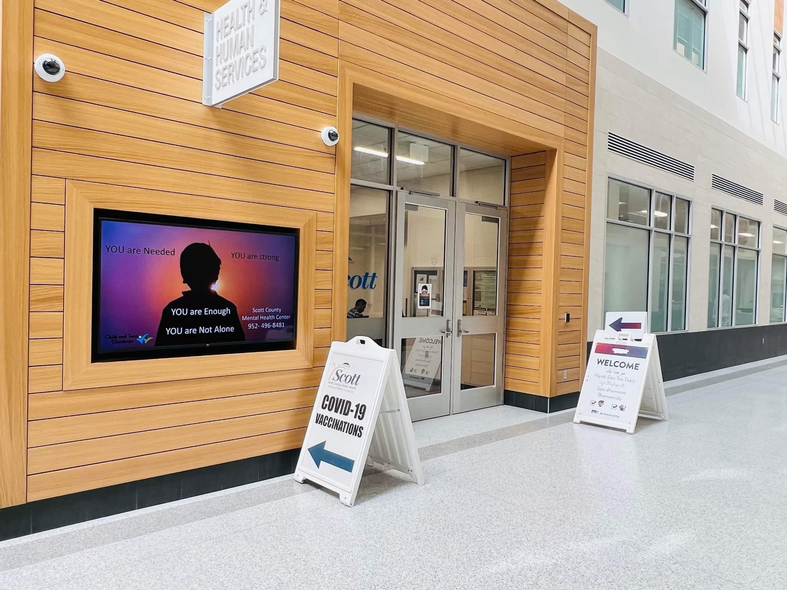
MDH COVID-19 Community Vaccination Grant
Partnership with Scott County Public Health
and the Minnesota Department of Health
Vaccination events 2x/month

Slide 10
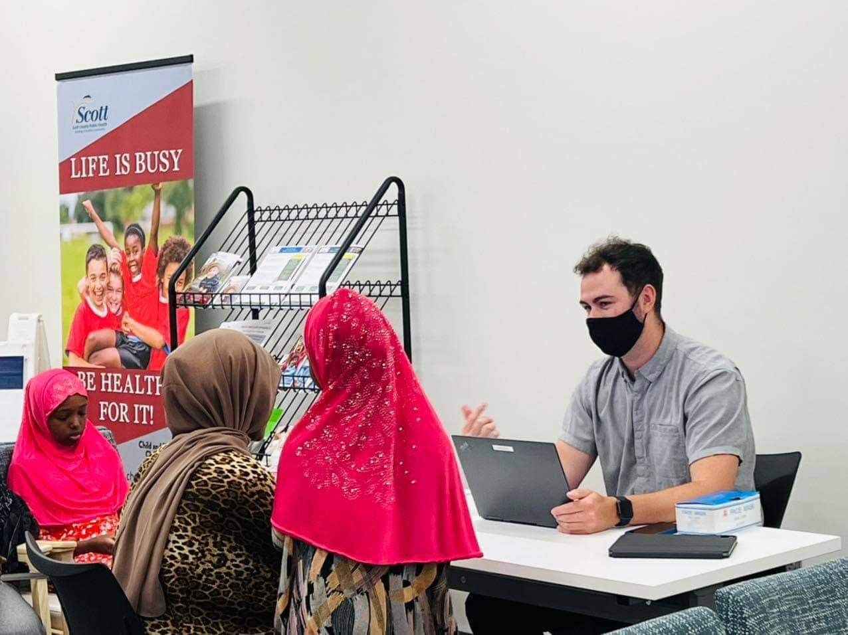
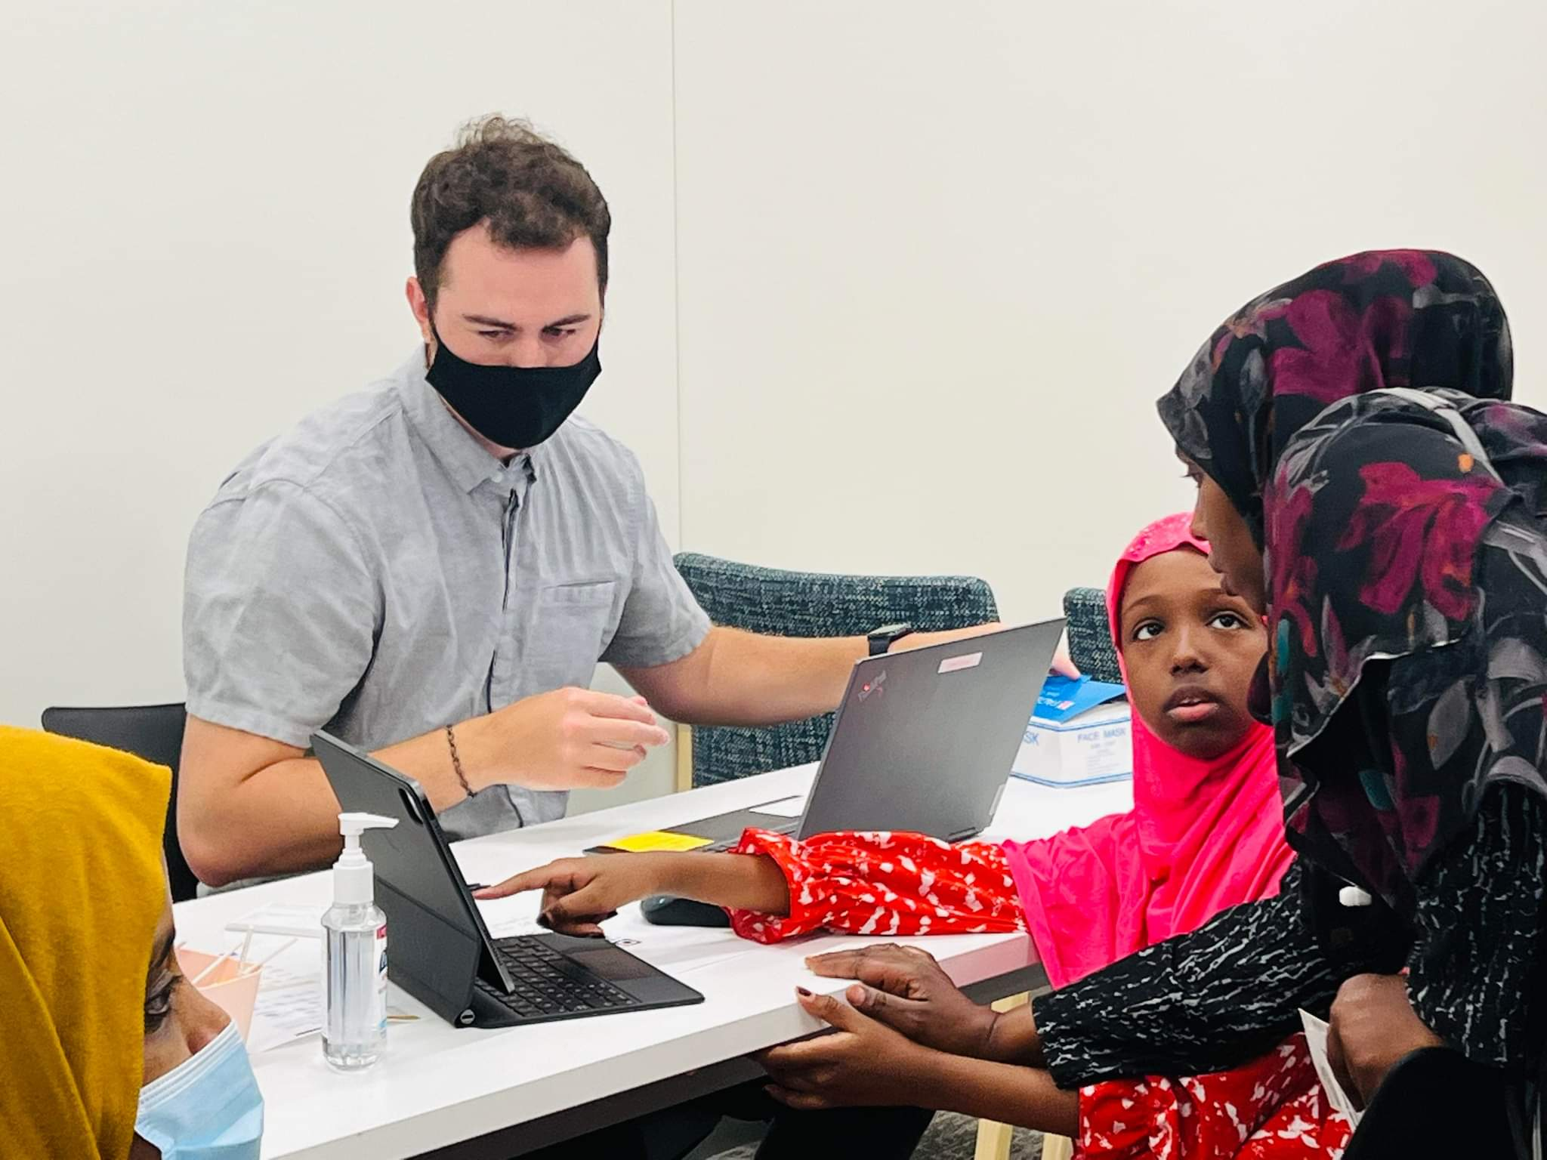
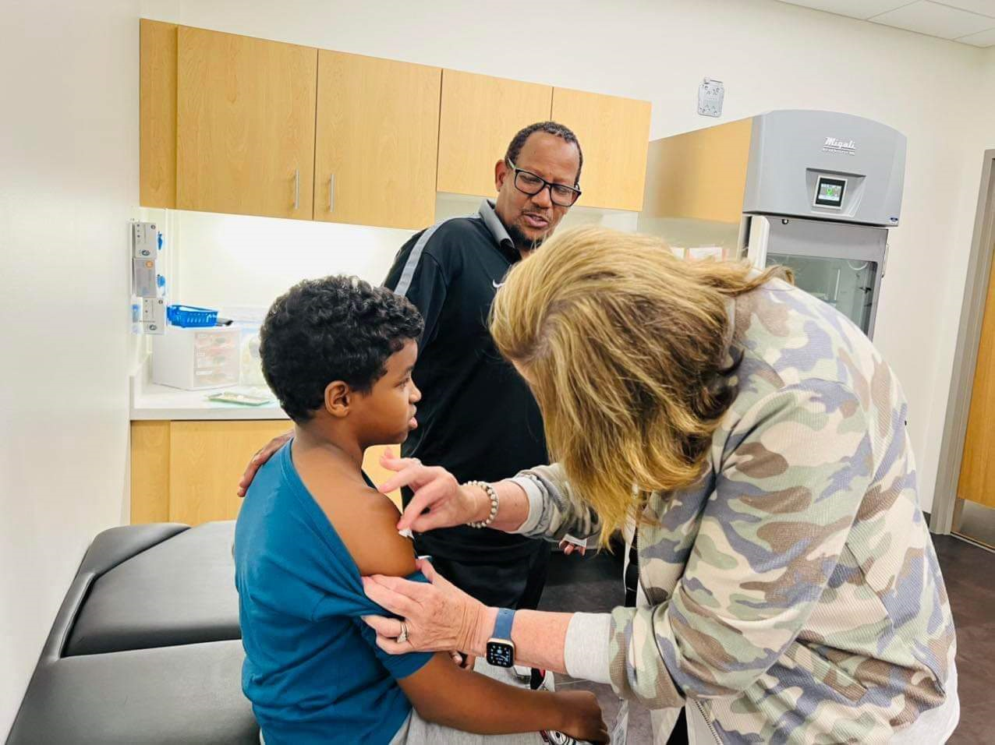
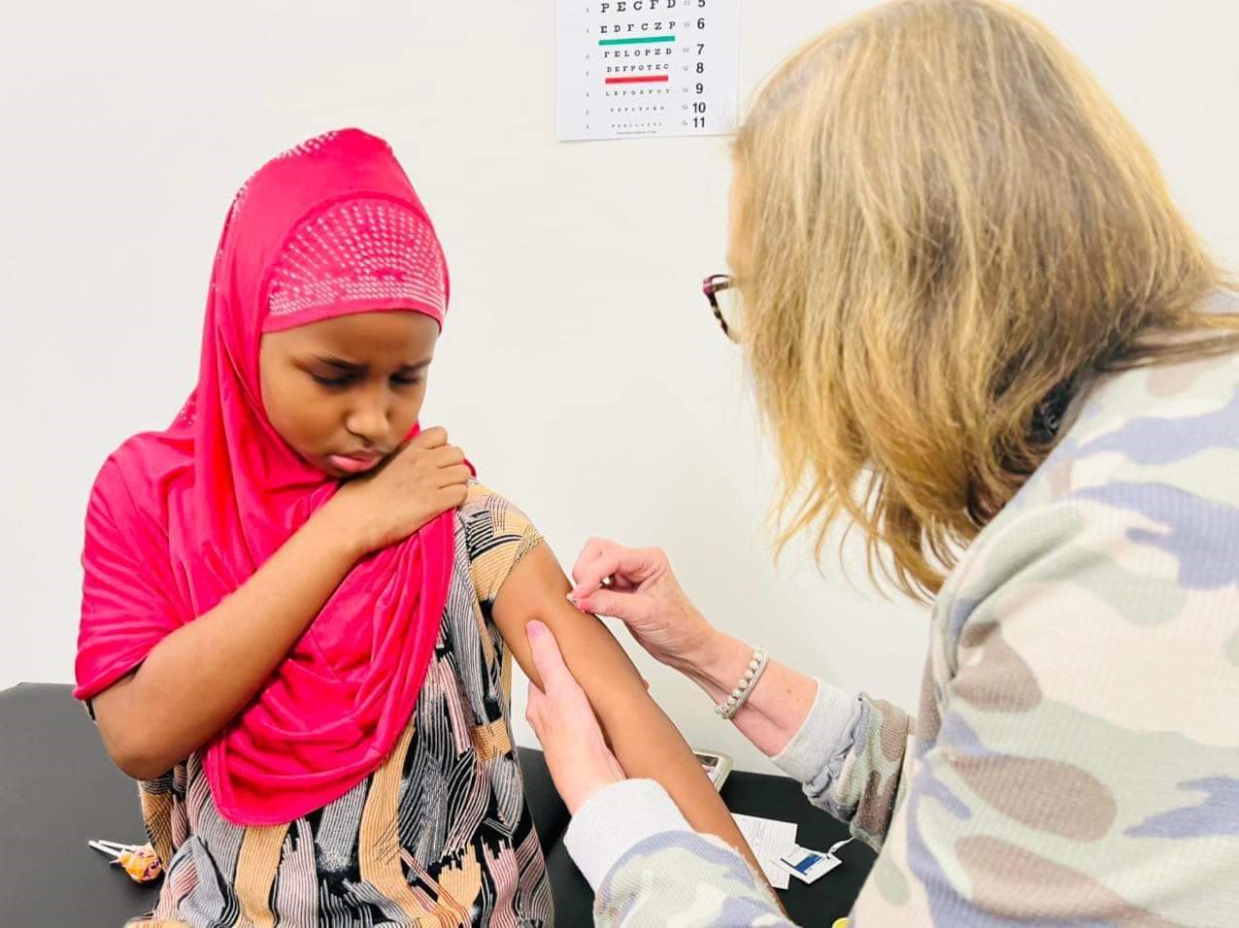
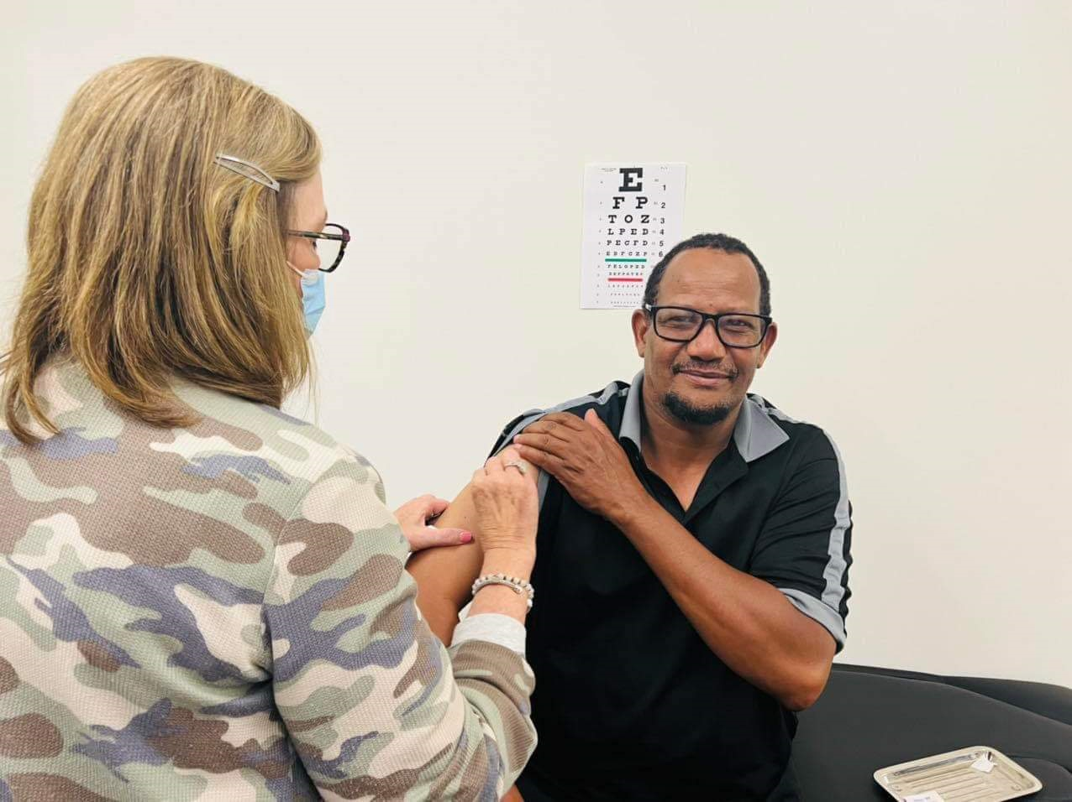
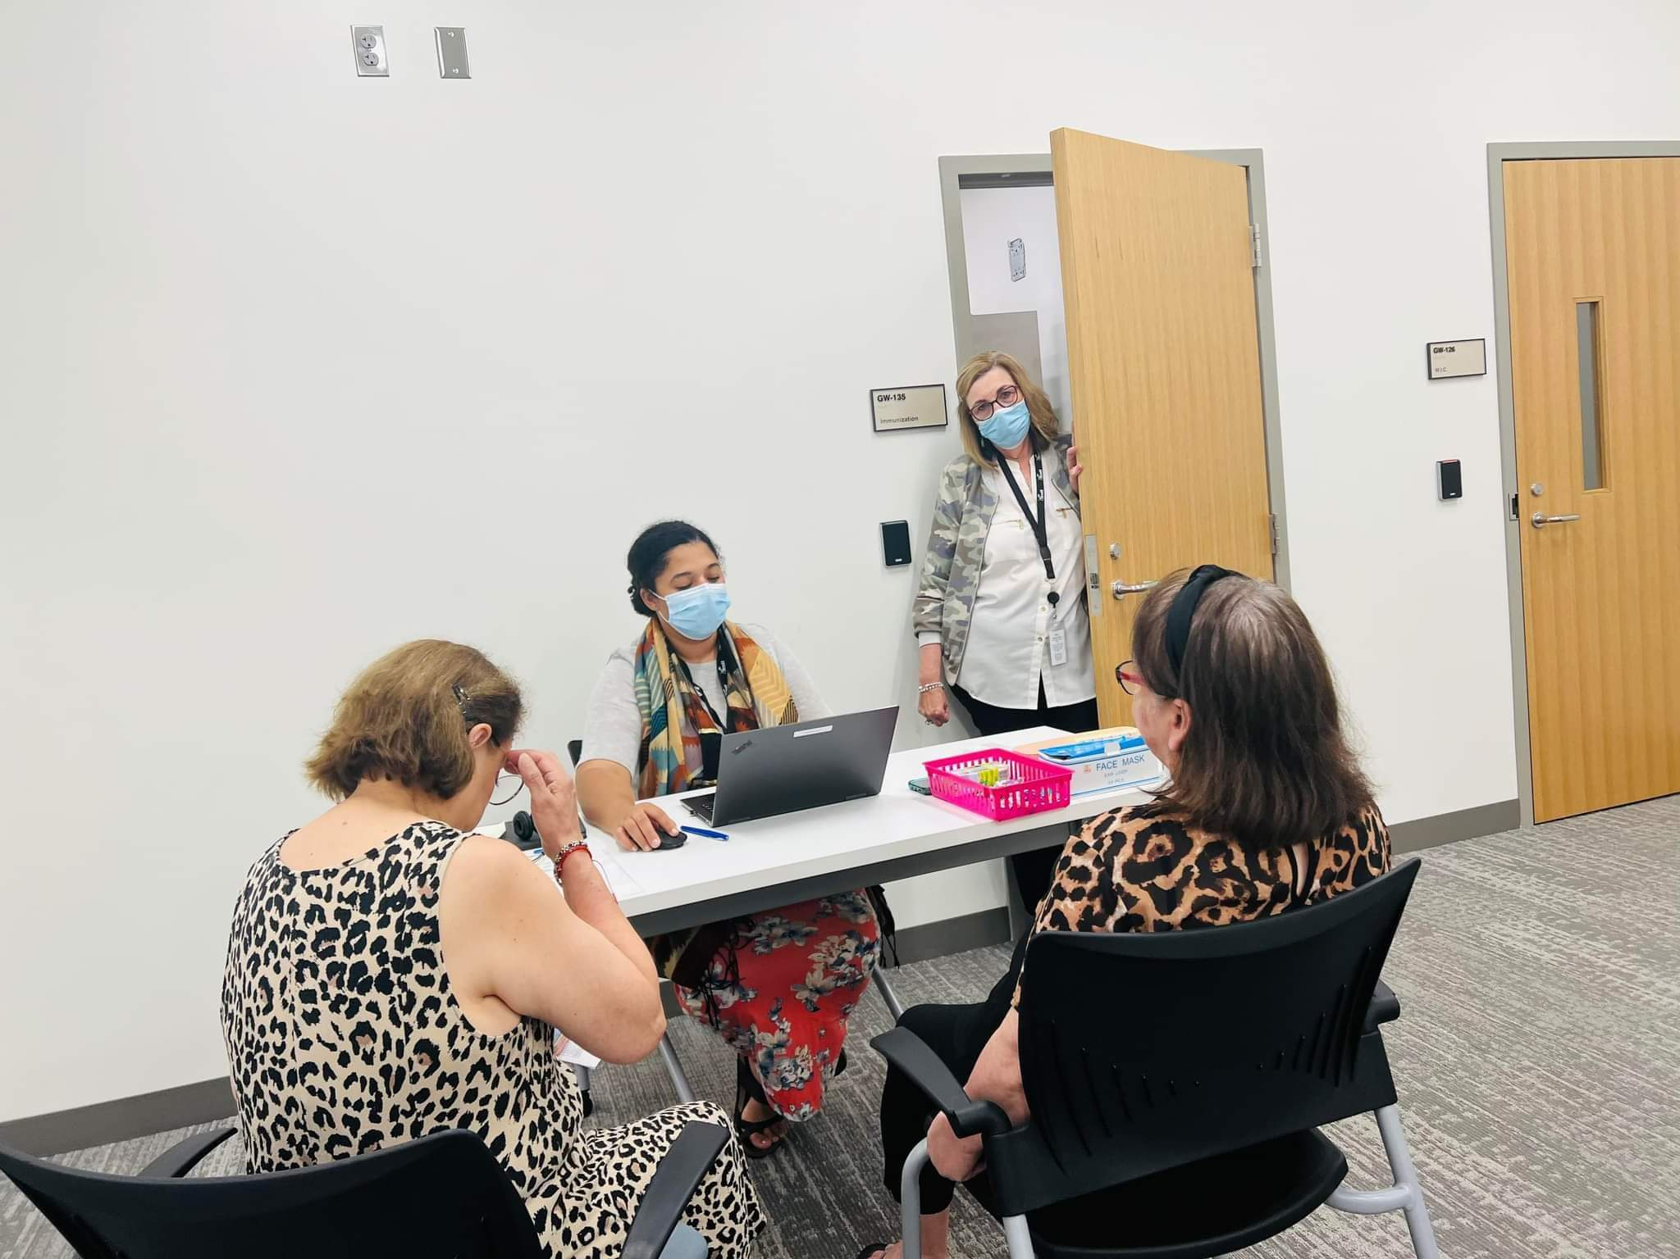
Photos from our August 10th Vaccination Event at the Scott County Government Center

Slide 11
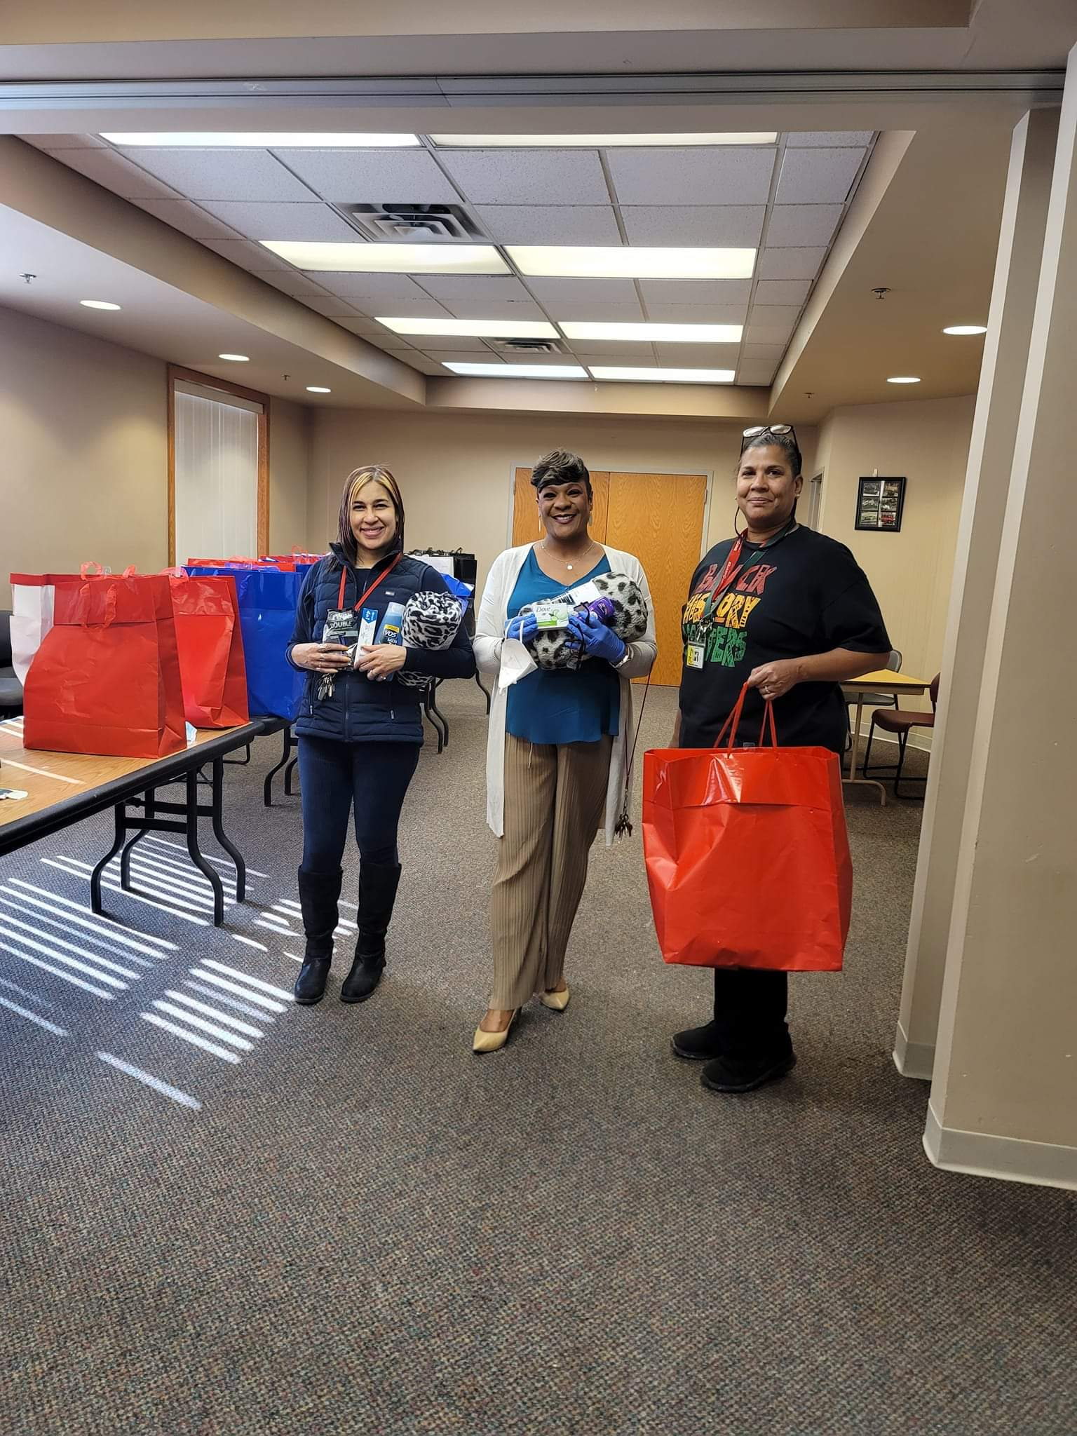
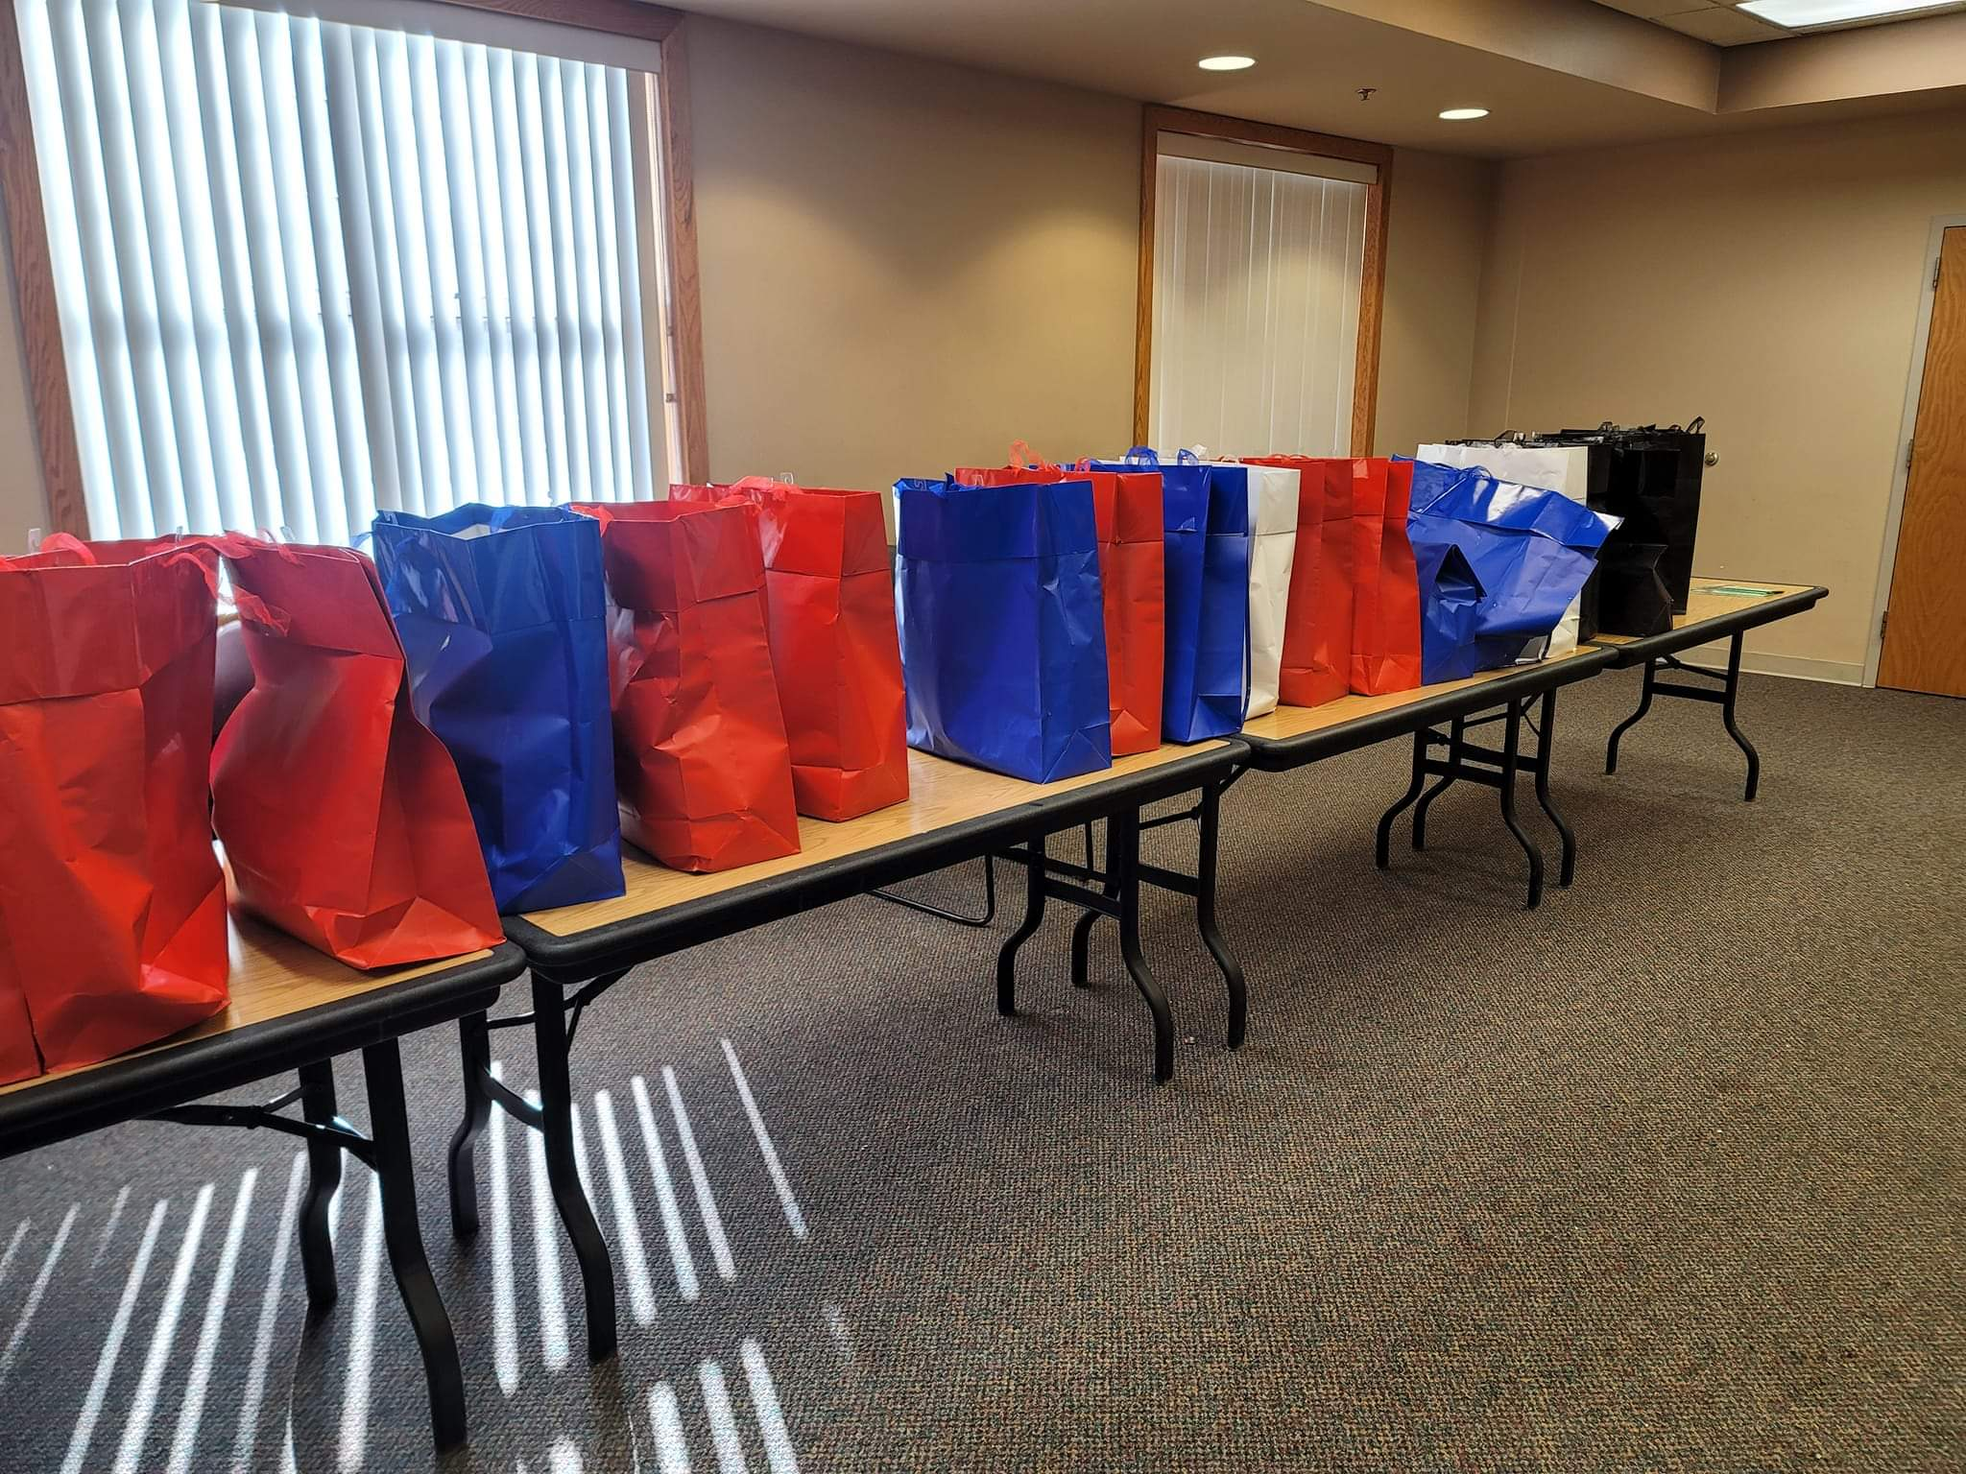
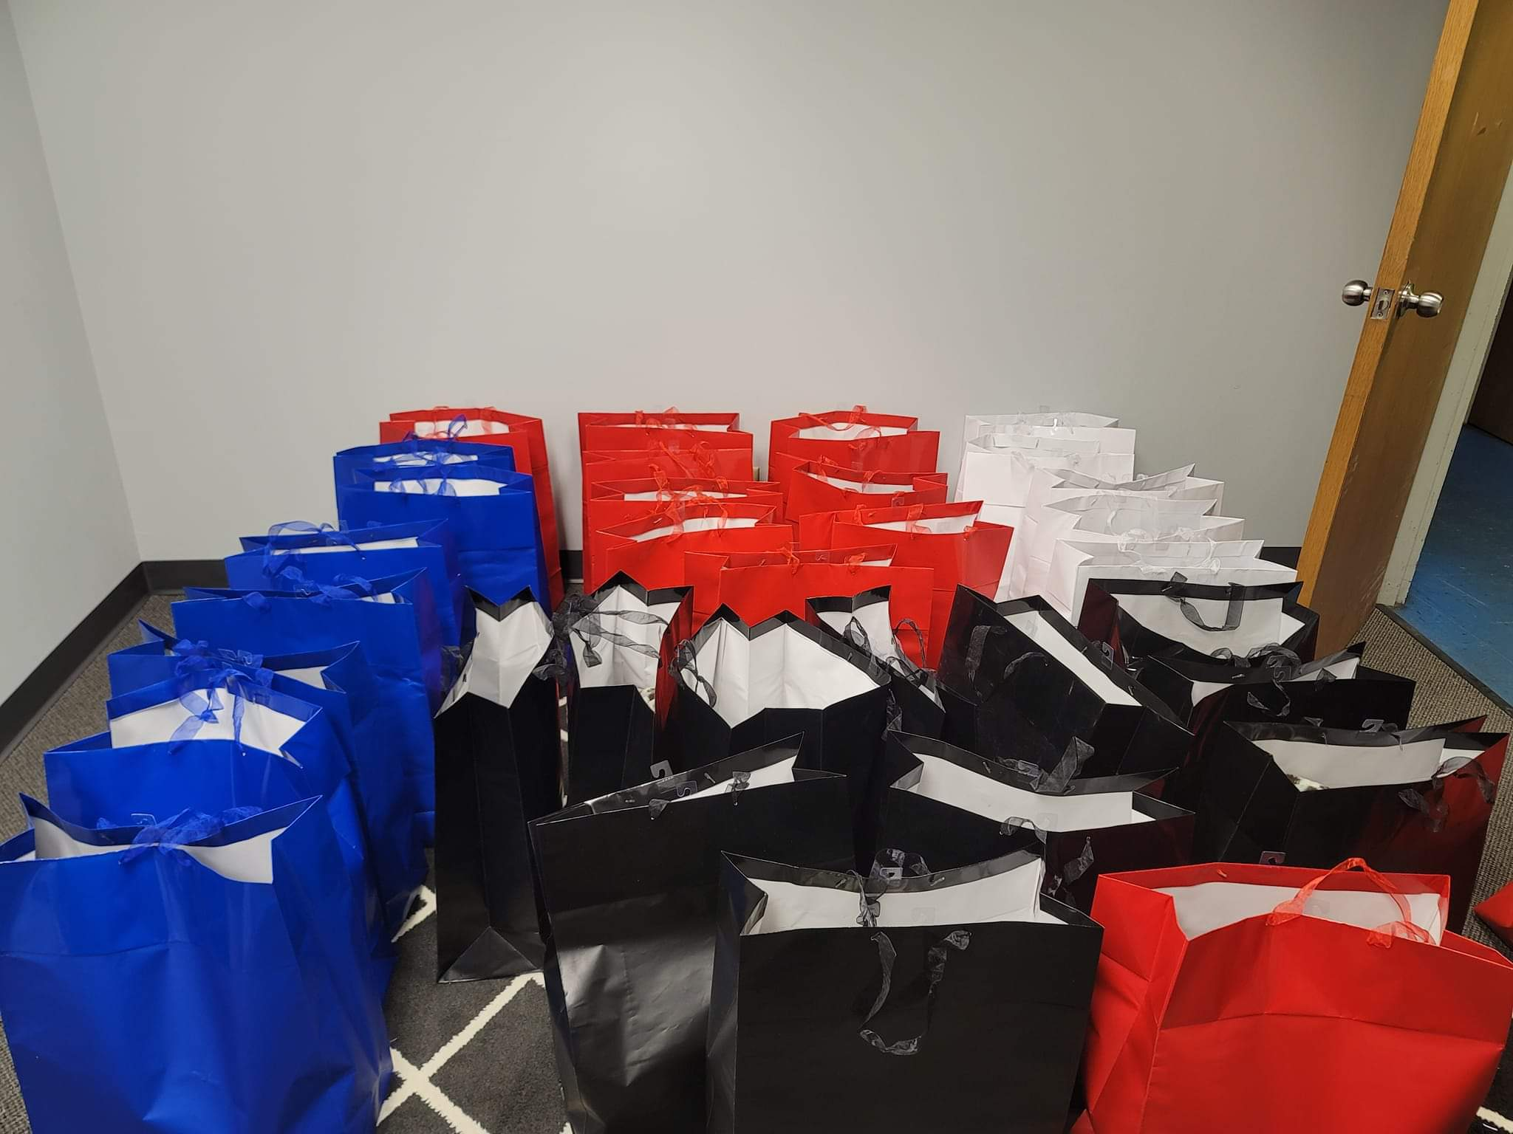
Personal Care Package Drive
OYH Funding to provide personal care packages to residents living in HOPE Harbor
Supportive Housing
Distributed 25-50 personal care bags containing hygienic products (both male/female),
blankets, and vouchers.

Slide 12
Cooking Matters Curriculum

Slide 13
Cooking Matters For Mothers
Participants enrolled in a 6-week CM class offered through the U of MN Extension.
Hands-on food preparation
All of our participants received recipes and other educational materials (i.e., Cooking Matters cookbook).
At the end of each class, participants too home a bag of groceries each week to practice what they’ve learned in class at home.
Participants received a certificate of completion

Slide 14
Shaah Iyo Sheeko/East African Women’s Circle
Partners: Together WE CAN, Family
Resource Centers, Advocates For Thriving Communities
Monthly circles of support, empowerment, and socialization
Community resources are provided

Slide 15
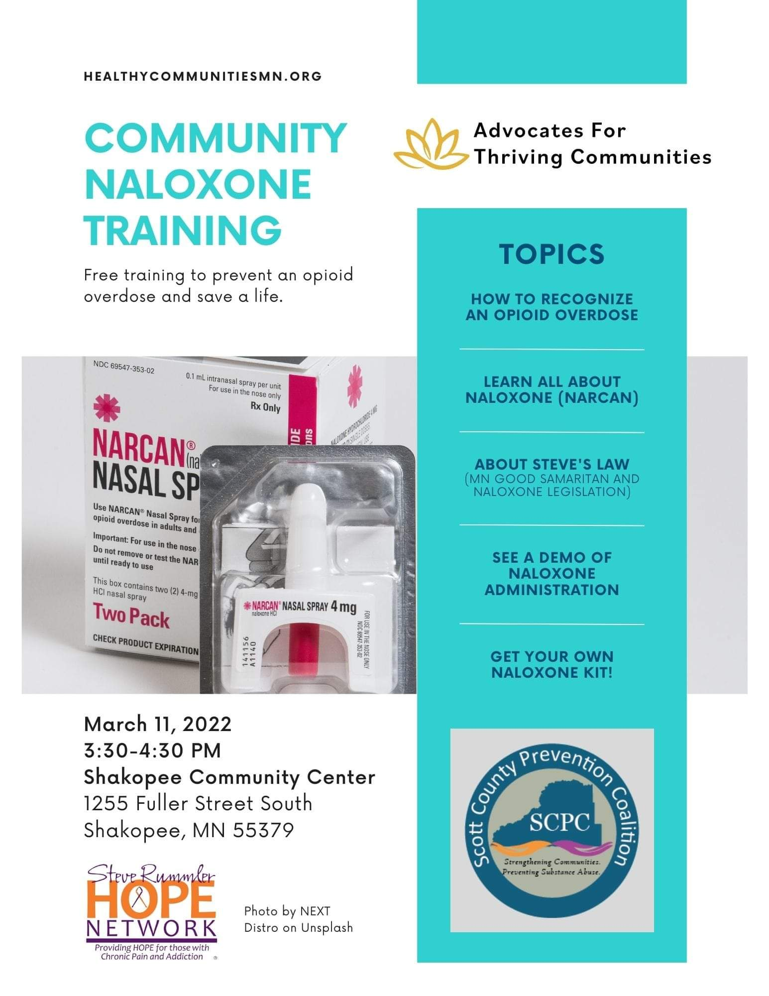
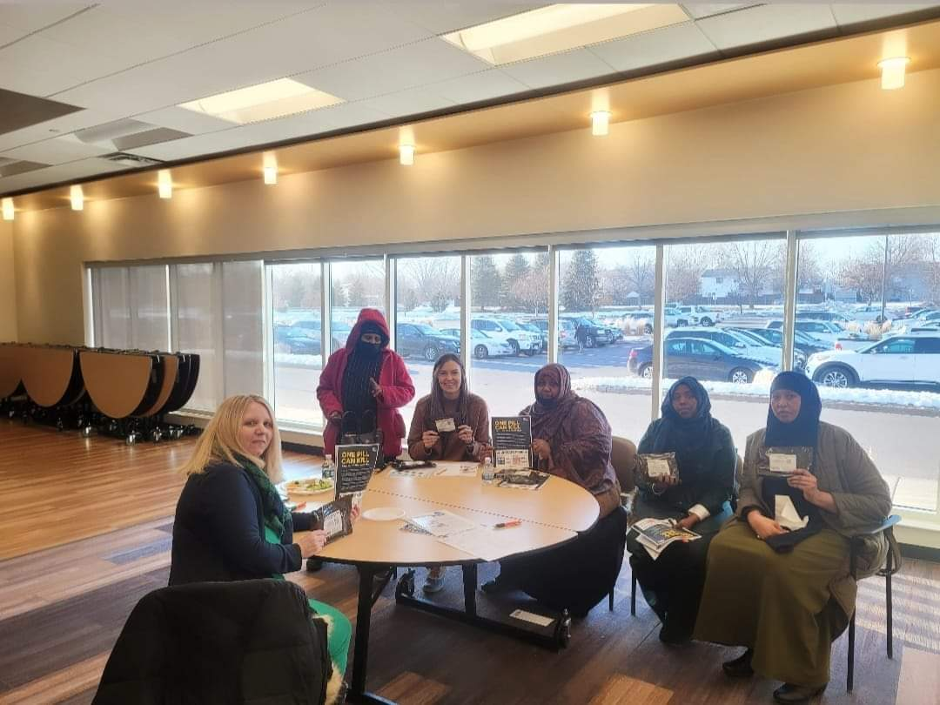
Trainings and Learning Opportunities
Naloxone Training
Cultural competency trainings
Mental Health
Health Equity/Health literacy/

Slide 16
Q & A

